Slide 1
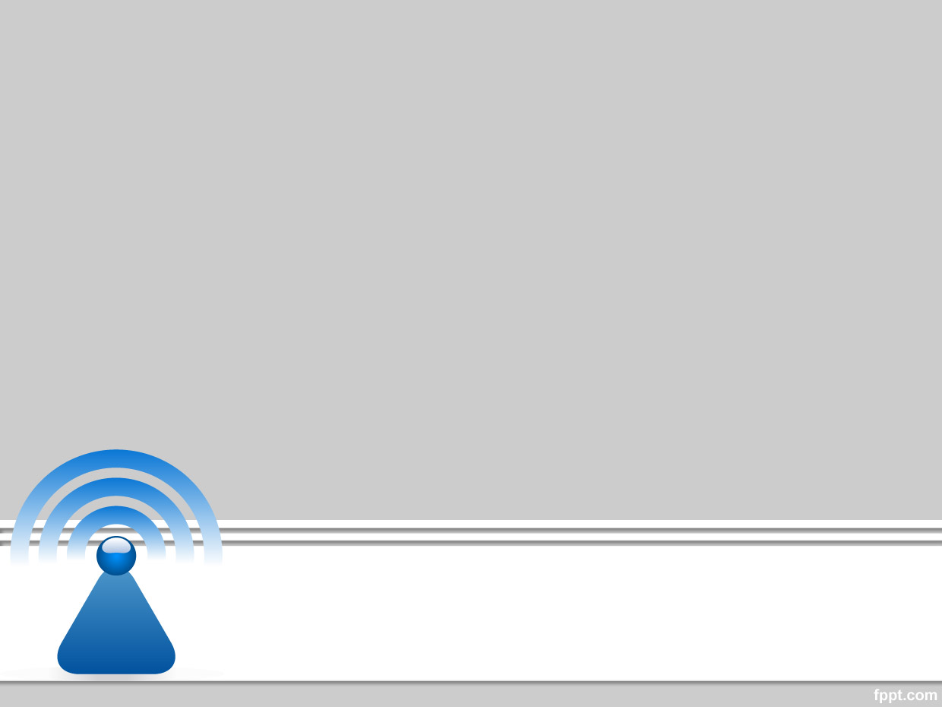
Wireless and Mobile Communication
Dr. Nyein Aye Maung Maung
Dr.Eng (Ritsumeikan University)
Computer Engineering and Information Technology Dept
Yangon Technological University

Slide 2
Course Information
Course Title
  Wireless and Mobile Communication
Description
  This course deals with the concepts of wireless and mobile communication systems, radio propagation characteristics and state-of-the-art technologies that are making wireless and mobile communication enable.

Slide 3
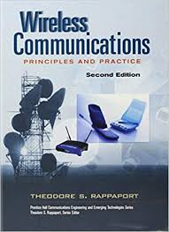
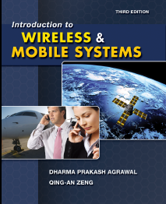
Textbook and References
Rappaport, Theodore S. Wireless communications: principles and practice. Vol. 2. New Jersey: prentice hall PTR, 1996.
Agrawal, Dharma P., and Qing-An Zeng. Introduction to wireless and mobile systems. Cengage learning, 2015.

Slide 4
Course Objectives
To help students understand system design fundamentals and factors for improving coverage and capacity of cellular systems
To promote students’ ability to analyze propagation characteristics of wireless channels and have technical know-hows to design and evaluate performance of different indoor and outdoor radio propagation models
To have a good knowledge of technical concepts such as modulation types, channel coding, equalization, antenna diversity and multiple access techniques
To understand differences between different network standards including cellular networks (GSM, 3G, 4G), WiFi, PANs, etc
To have strong technical skill on system design considerations for a given channel environment and different cellular network standards

Slide 5
Schedule of the Course
Week |  | Topic
Part I | 1 | Introduction to Wireless Communication Systems and Modern Wireless Communication Systems
 | 2 | The Cellular Concept – System Design Fundamentals
 | 3 | The Cellular Concept— Trunking and Grade of Service, Improving Coverage and Capacity
 | 4 | Mobile Radio Propagation: Large-Scale Path Loss
 | 5 | Mobile Radio Propagation: Practical Link Budget Design using Path Loss Models
 | 6 | Mobile Radio Propagation – Small-scale Fading and Multipath
Part II | 7 | Modulation Techniques: Analog Modulation Techniques
 | 8 | Modulation Techniques: Digital Modulation Techniques
 | 9 | Multiple Access Techniques
 | 10 | Channel Equalization and Antenna Diversity
 | 11 | Channel Coding
 | 12 | Wireless Networking, Systems and Standards

Slide 6
Exam and Grading System
Task | Mark
Final Exam | 80%
Practical Assignments | 10%
Tutorial | 10%
Mark | Grade
85~100 | A+
80~85 | A
70~80 | B
50~70 | C
<50 | F

Slide 7
Lecture 1
Introduction to Wireless Communication Systems and Modern Wireless Communication Systems

Slide 8
Outline of Class (Lecture 1)
Introduction to Wireless Communication Systems
  History and Evolution of Mobile Radio Communications
  Wireless Communication System Definitions
  Examples of Wireless Communication Systems
Modern Wireless Communication Systems

Slide 9
Lecture Objectives
To demonstrate the historic evolution of the wireless communications industry
To state rapid growth of cellular radio throughout the world
To have knowledge on major modern wireless communication systems of the 21st Century, such as Third Generation (3G), Wireless Local Area Networks (WLANs), Local Multipoint Distribution Services (LMDS) and Bluetooth
To demonstrate how wireless networks are beginning to penetrate our daily lives for data and multimedia applications, as well as voice services

Slide 10
  History and Evolution of Mobile Radio Communications

Slide 11
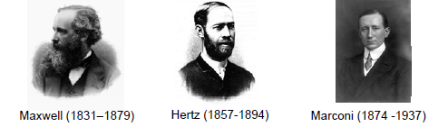
History of Mobile Radio Communications
Invention of Radio
  Maxwell: predicted the existence of electromagnetic waves (1864)
  Hertz: confirmed Maxwell's work in lab experiment (1887)
  Marconi: commercializing wireless telephony
    Found Wireless Telegraph Company (1897)
    Wireless transmission across the Atlantic (1901)

Slide 12
History of Mobile Radio Communications
AT&T introduces first mobile telephony system in St. Louis (1946)
Bell Labs invented the concept of cellular systems (1947)
1970’s - Wireless communication era was born
  Development of highly reliable, miniature solid state radio frequency hardware
  1971 AT&T, RCA and Motorola file proposals to use 800 MHz band for cellular systems
  1983 FCC grants first commercial cellular licenses
  1983 Ameritech launched first commercial cellular system in Chicago

Slide 13
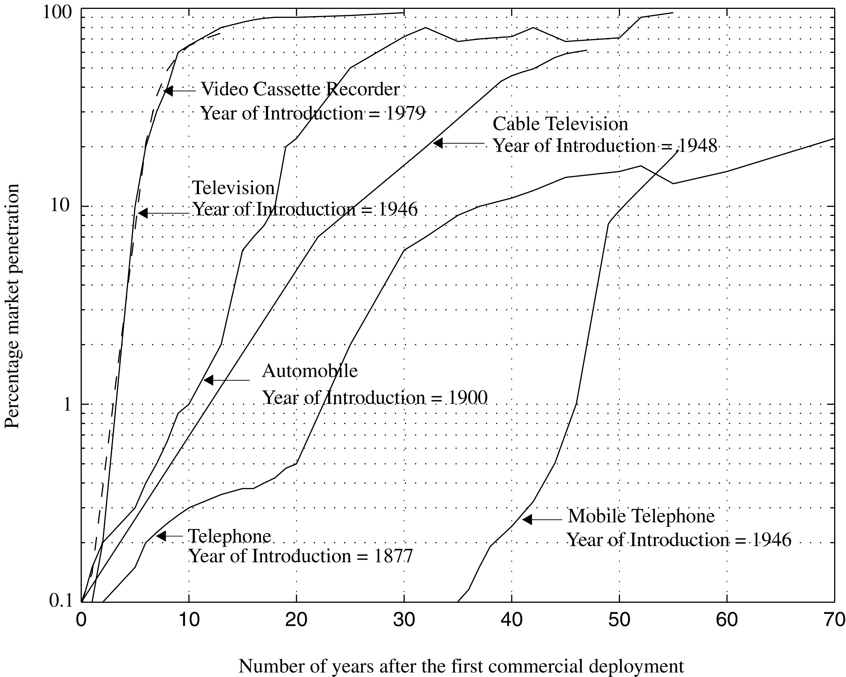
Growth of Mobile Telephony
The growth of mobile telephony as compared with other popular inventions of the 20th century.

Slide 14
  Wireless Communication System Definitions

Slide 15
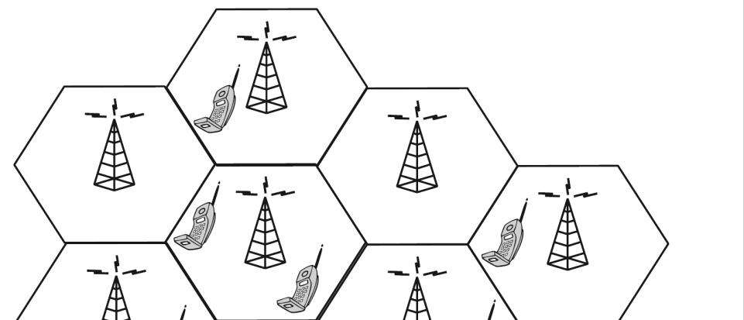
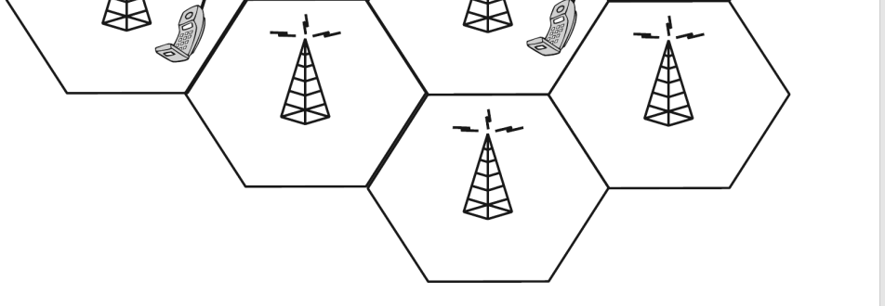
(1) Base station
Base Station
Radio transmission and reception equipment
Located at the center or edge of cell
Consists TX and RX antennas mounted on a tower
Mobile station/Subscriber unit

Slide 16
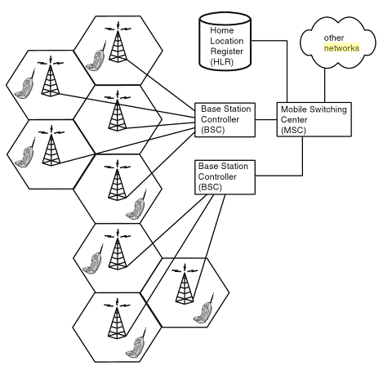
(2) Mobile Switching Center (MSC)
  Coordinates routing of calls
  Manages the setup and teardown of calls
  Connects cellular base stations and the mobiles to the PSTN
  Also called Mobile Terminal Switching Office (MTSO)

Slide 17
(3) Channels
Control Channel
  Radio channel used for transmission of call setup, call request, call initiation, and other beacon or control purposes
Forward Channel
  Radio channel used for transmission of information from the base station to the mobile
Reverse Channel
  Radio channel used for transmission of information from he mobile to base station

Slide 18
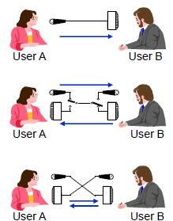
(4) Duplexing
A method to separate the uplink and downlink transmissions:
  Simplex Communication
    Information is transmitted in one and only one pre-assigned direction, Only one user speaks
    eg. AM, FM broadcasting
  Half Duplex Communication
    Information is transmitted only one direction at a time. Users take turns speaking. Not simultaneous
    Eg. ‘Push-to-talk’ Walkie-talkie’
  Full Duplex Communication
    Information is transmitted and received in both directions simultaneously
    Require two frequency radio communication

Slide 19
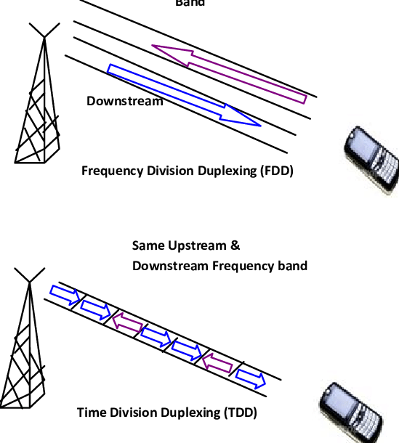
(4) Duplexing (cont.)
FDD (Frequency Division Duplex)
  Transmitters and receivers operate at different carrier frequencies: one for uplink signals and another for downlink signals
TDD (Time Division Duplex)
  Use a single frequency band for both uplink and downlink signals
  Share the band by assigning alternating time slots to uplink (forward time slot) and downlink (reverse time slot) signals
Different frequency bands
Same upstream and
downstream frequency band

Slide 20
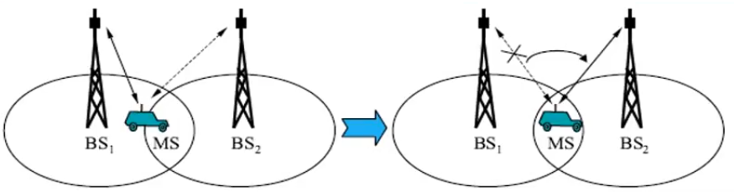
(5) Handoff
Ability of a subscriber to maintain a call while moving within the network (without the subscriber noticing any changes)
Handoff can take place between
  two sectors of the same BS, two BSs, two MSC of same operator
  two networks (different operators) called inter-network handoff which is not supported in some systems for billing reasons

Slide 21
  Examples of Wireless Communication Systems

Slide 22
Examples of Wireless Communication Systems
Paging Systems
Cordless Telephone Systems
Cellular Telephone Systems

Slide 23
(1) Paging Systems
  Send brief messages (text or voice)
    A numeric message, an alphanumeric message, or a voice message
    Modern Paging Systems → news headlines, stock quotations, fax
  Use to notify a subscriber of the need to call a particular telephone number to a known location to receive further instructions
  Simple paging systems → up to 5 km
  Wide area paging systems → Worldwide coverage, require sophisticated transmission systems
    A network of telephone lines, BSs, radio towers

Slide 24
(1) Paging Systems
How do pagers work in a paging system?
External Events
Paging Controller
Paging Transmitter
Pager 1
Pager 2
Manually entered messages, schedules
Pager n

Slide 25
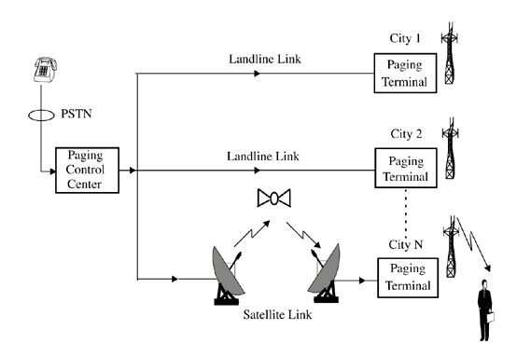
(1) Paging Systems
A wide area paging system. The paging control center dispatches pages received from the
PSTN throughout several cities at the same time.

Slide 26
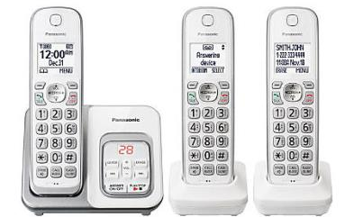
2. Cordless Telephone Systems
  A telephone system in which the handset is portable and communicates with the body of the phone by radio, instead of being attached by a cord
  Provide limited range and mobility
Panasonic DETC Cordless Phones

Slide 27
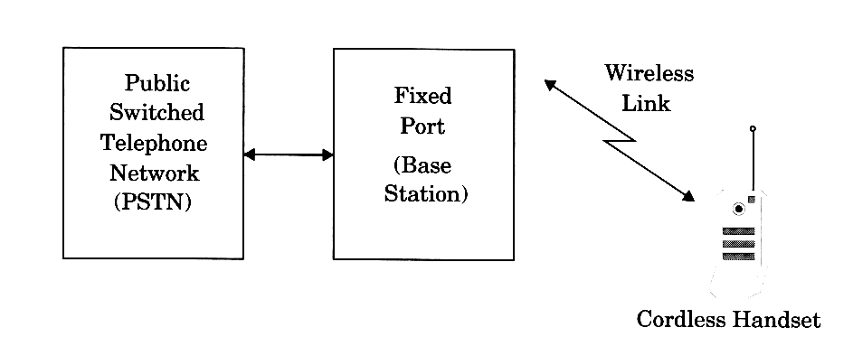
2. Cordless Telephone Systems
A cordless telephone system

Slide 28
3. Cellular Telephone Systems
  Provide a wireless connection to the PSTN for any user location within the radio range of the system
  Consists of a large number of wireless subscribers who have cellular telephones
  Also consists of a large number of fixed Base-stations (BS), arranged to provide coverage of the subscribers
  The area covered by a based station is called a cell
  Network is divided into cells

Slide 29
3. Cellular Telephone Systems
Basic Network Architecture of Cellular System

Slide 30
3. Cellular Telephone Systems
Major Components
  Base Station Controller (BSC)
    Contain logics to control each BS
    Manage handoff of calls from one BS to another as subscribers move from cell to cell
  Mobile Switching Center (MSC)
    The switch that manages the setup and teardown of calls
    In some cases, BSC functionalities may be in MSC
  Home Location Register (HLR)
    Contain subscription information related to a number of subscribers
    Subscriber Database, Play major role in mobility management

Slide 31
3. Cellular Telephone Systems
  Common Air Interface (CAI)
    Define four different channels for communication between Base Station and the mobile
      Forward Voice Channels : for voice transmission from BS to mobile
      Reverse Voice Channels: for voice transmission from mobile to BS
      Forward Control Channels: for initiating mobile calls and service requests
      Reverse Control Channels: for initiating mobile calls and service requests
check
route to new MSC
PSTN
HLR
inform
incoming
call
MSC
MSC
route

Slide 32
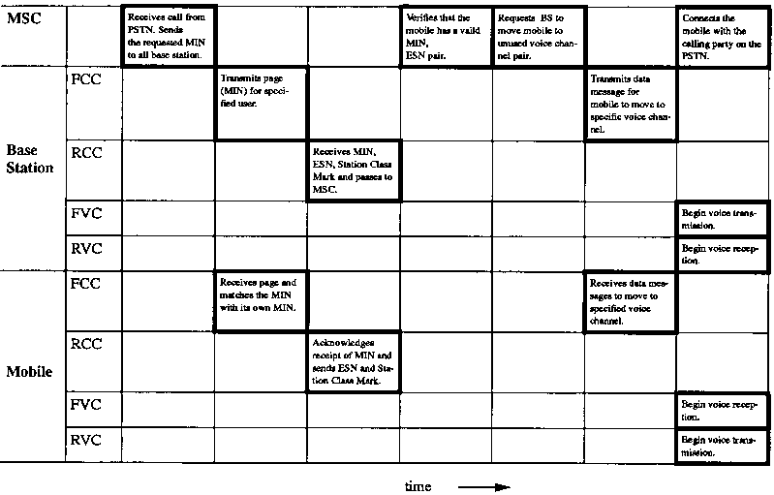
How a Cellular Telephone Call is Made
Receiving a call

Slide 33
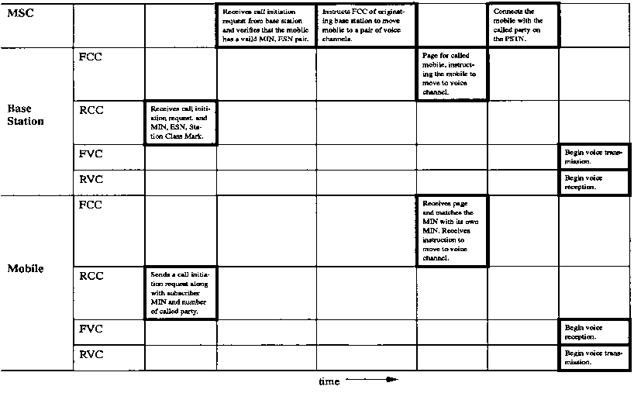
How a Cellular Telephone Call is Made
Initiating a call

Slide 34
How a Cellular Telephone Call is Made
Roaming a call
  All cellular systems provide a service called roaming. This allows subscribers to operate in service areas other than the one from which the service is subscribed.
  MSC issues a global command every several minutes, asking all unregistered mobiles to report their subscription information.
  Mobile report back upon receiving the request.
  If the mobile has roaming authorization for billing purpose, the MSC registers the subscriber as a roamer.

Slide 35
  Modern Wireless Communication Systems

Slide 36
Modern Wireless Communication Systems
Second Generation (2G) cellular networks
Third Generation (3G) cellular networks
Wireless Local Loop (WLL) and LMDS
Wireless Local Area Networks (WLAN)
Bluetooth and Personal Area Networks

Slide 37
(1) Second Generation (2G) cellular networks
Many of today’s cellular systems use 2G technologies
First Generation (1G) cellular network
  FDMA/FDD and analog FM
Second Generation (2G)
  Use digital modulation formats
  Use TDMA/FDD and CDMA/FDD
Most popular 2G Standards
  Global System Mobile (GSM)
  Interim Standard (IS-136)
  Pacific Digital Cellular (PDC)
  Interim Standard 95 Code Division Multiple Access (IS-95)

Slide 38
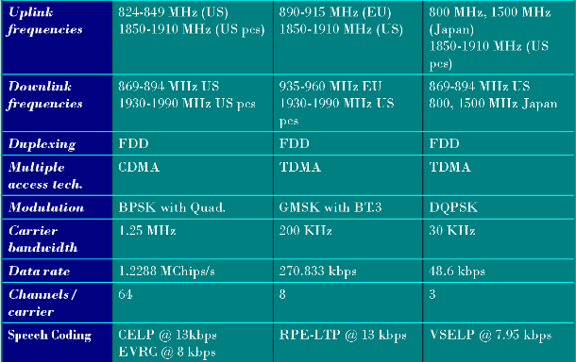
Key Specifications of Leading 2G Technologies
 | IS-95 | GSM | IS-136, PDC

Slide 39
Evolution to 2.5G Mobile Radio Networks
2G → 2.5G for increased data rates for modern Internet applications
  2G standards support only 9.6kbps data rate
2.5G standard can be overlaid on existing 2G technologies
2.5G supports new web browsing format language called WAP (Wireless applications Protocol)
WAP enables standard web pages to be viewed in a compressed format
  suitable for small portable hand-held wireless devices.
First developed in Japan by NTT-DoCoMo in 1998

Slide 40
2.5G TDMA Standards
HSCSD (High Speed Circuit Switched Data) for 2.5G GSM
  Allows a single mobile user to use more than one specific time slot as in GSM TDMA
  Increases application rate from 9.6kbps (2G GSM) to 14.4kbps (2.5G GSM)
  Ideal for streaming internet access or real-time interactive web sessions.
  Can be implemented by a software change at existing GSM base stations.

Slide 41
2.5G TDMA Standards
GPRS (General Packet Radio Service) for 2.5G GSM and IS-136
  Packet based data network suited for non-real time internet usage
  E-mail retrieving, faxes and asymmetric web browsing where more data on download than upload
  Provide a packet network on dedicated GSM or IS-136 radio channels but use a completely redefined air interface to better handle packet data access
  GPRS can support more users than HSCSD, but in a bursty manner.
  Support data rate up to 171.2 kbps

Slide 42
2.5G TDMA Standards
EDGE (Enhanced Data Rate for GSM Evolution)
  A common technology path of GSM and IS-136 for eventual 3G high speed data access
  Regains additional hardware/software at existing base stations
  Introduces a new digital modulation format (8-PSK/octal PSK)
  Raw data rate of 547.2 kbps is possible with 8 GSM slots of a GSM channel

Slide 43
2.5G CDMA Standard
IS-95B for 2.5G CDMA (or cdmaOne)
  Provide medium data rate service with throughput of 115.2 kbps per user
  Specify hard handoff procedures that allow subscriber units to search different radio channels in the network without instruction from the Switch

Slide 44
(2) Third Generation 3G Wireless Networks
3G systems promise
  Multi-megabit Internet access
  Voice over Internet Protocol (VoIP)
  Unparalleled network capacity
  Ubiquitous always-on access
A global frequency band in 2000 MHz range proposed by ITU (International Telecommunications Union)
  Single wireless communications standard for all countries in the world
  World community remains split between GSM/IS-136/PDC and CDMA

Slide 45
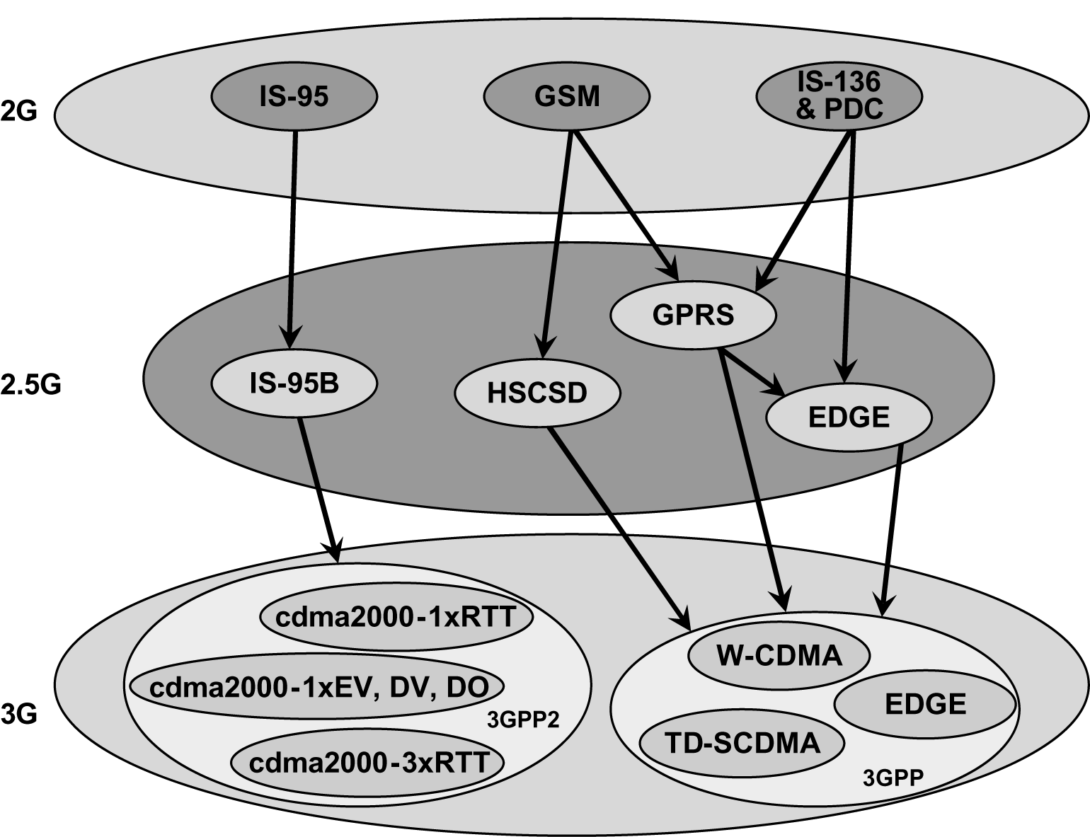
Various Upgrade Paths from 2G to 3G

Slide 46
3G W-CDMA (UMTS)
UMTS - Universal Mobile Telecommunications System)
  Backward compactible with GSM, IS-136 and PDC TDMA
  3G W-CDMA air interface standard designed for ‘always-on’ packet based wireless service (anytime, anywhere Internet Access)
  Support packet data rates up to 2.048 Mbps per stationary user
  Broadcasting, VHE (Virtual Home Entertainment), m-commerce (mobile commerce), games, interactive video, virtual private technology - all possible from small portable wireless device

Slide 47
3G cdma2000
Evolutionary high data rate upgrade path for current 2G and 2.5G CDMA users
Based on IS-95 and 2.5G IS-95B air interface
  1.25MHz channel bandwidth
cdma2000 1X → data rate of 307 kbps
cdma2000 1xEV-DO (data only) → data rate of up to 2.4 Mbps
cdma2000 1xEV-DV (data and voice) → data rate of up to 144 kbps, twice as many voice channels as IS-95B

Slide 48
3G TD-SCDMA
3G TD-SCDMA (Time Division Synchronous Code Division Multiple Access)
  Developed by CATT (Chinese Academy of Telecommunications Technology) and Siemens
  Most popular in China
  Backward compactible with GSM infrastructure
    Addition of high data rate equipment at each GSM BS
  Combines TDMA and TDD techniques
  Provides data rate of up to 384 kbps
  Utilize 1.6 MHz channel bandwidth and rely on smart antennas, spatial filtering and joint detection technologies

Slide 49
(3) Wireless Local Loop (WLL) and LMDS
A broadband wireless service which becomes in demand for computer access from businesses and home
  especially useful in developing nations with inadequate telecommunication infrastructure
Wireless Local Loop is an ideal application to provide telephone and Internet service to a remote rural area
Advantages of WLL:
  Eliminates the last mile construction of the network connection.
  Low cost due to no use of conventional copper wires.
  Secure communication using digital encryption techniques
  Not require installation of more wires for scaling it.

Slide 50
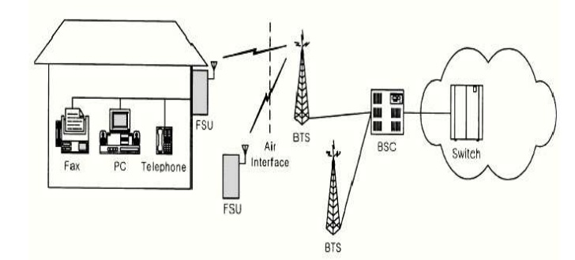
Typical Architecture of WLL

Slide 51
(4) Wireless Local Area Networks
Unlicensed Spectrum supporting low-power license-free spread spectrum data communication
IEEE 802.11 (1997) standard and (IEEE 802.11b) approved to provide guidelines for WLAN manufacturers
Use Frequency Hopping Spread Spectrum (FHSS) and Direct Sequence Spread Spectrum (DSSS)

Slide 52
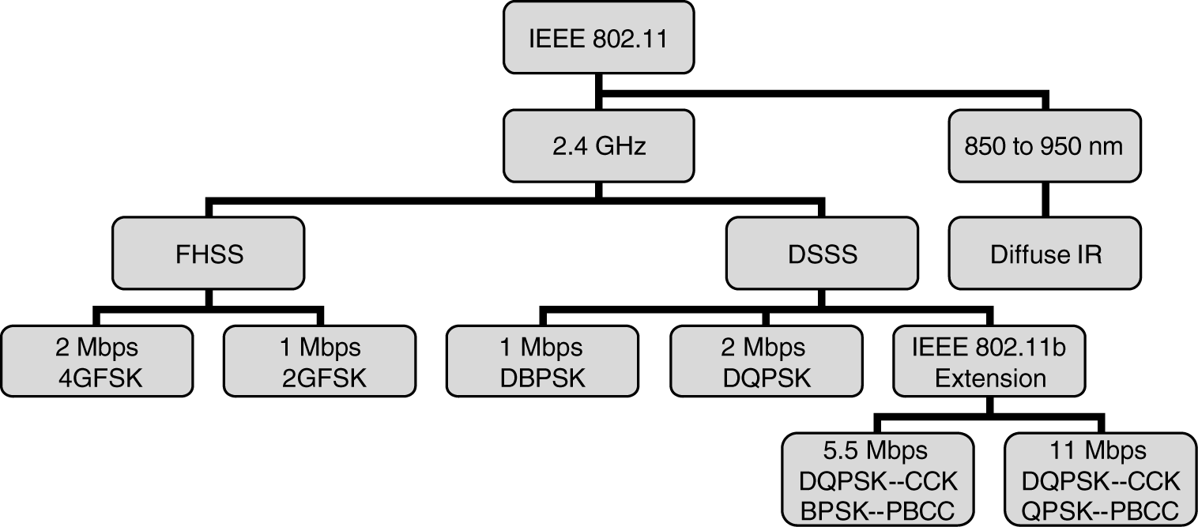
Overview of IEEE 802.11 Standard

Slide 53
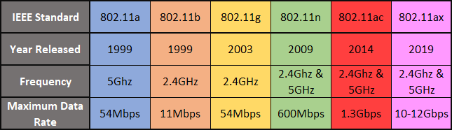
IEEE 802.11 Standard Updates
Wireless Standards [Ref-1]
Ref-1: The Most Common Wi-Fi Standards and Types Explained by Gavin Phillips

Slide 54
(5) Bluetooth and Personal Area Networks
Bluetooth operates in 2.4GHz ISM band (2900 2483.5MHz) with 1 MHz channel bandwidth
Uses FH-SS TDD scheme with 1600 hps
1Mbps symbol rate using GSFSK modulation
Provide an ad-hoc approach for enabling various devices to communicate with each other within a nominal 10 meter range

Slide 55
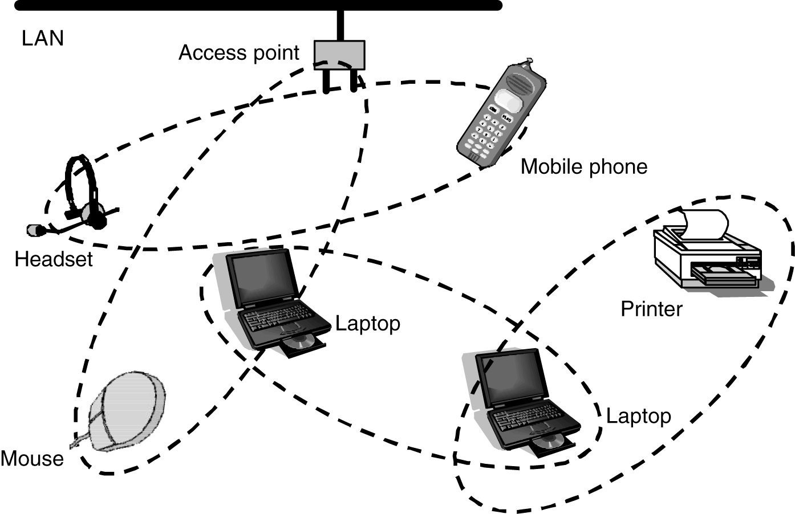
Personal Area Network provided by Bluetooth Standard

Slide 56
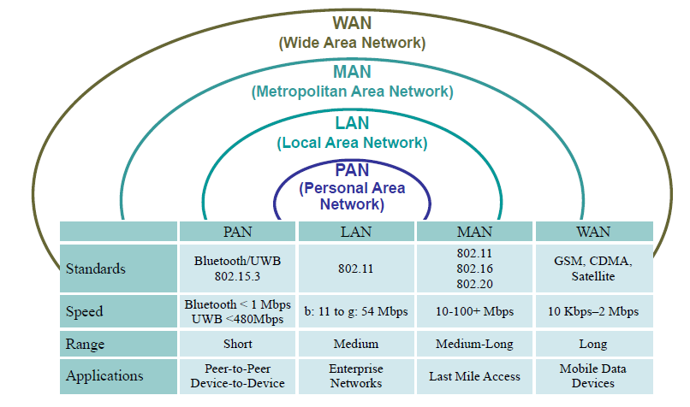
Comparison of Wireless Technologies

Slide 57
Next Lecture
Cellular Concept – System Design Fundamentals

Slide 58
  Thank You …

