Slide 1
PROTEIN ENGINEERING

Slide 2
Protein engineering-Why?
Enhance stability/function under new conditions
  temperature, pH, organic/aqueous solvent, [salt]
Alter enzyme substrate specificity
Enhance enzymatic rate
Alter epitope binding properties

Slide 3
Protein Engineering
Obtain a protein with improved or new properties
Rational Protein Design
Nature
Proteins with Novel Properties
Random Mutagenesis

Slide 4
Evolutionary Methods
Non-recombinative methods:
-> Oligonucleotide Directed Mutagenesis (saturation mutagenesis)
-> Chemical Mutagenesis, Bacterial Mutator Strains
-> Error-prone PCR
Recombinative methods -> Mimic nature’s recombination strategy
Used for: Elimination of neutral and deleterious mutations
-> DNA shuffling
-> Invivo Recombination (Yeast)
-> Random priming recombination, Staggered extention precess (StEP)
-> ITCHY

Slide 5
RATIONAL DESIGN
-Site directed mutagenesis of one or more residues
-Fusion of functional domains from different proteins to create chimaeric
(Domain swapping)
Functional evaluation

Slide 6
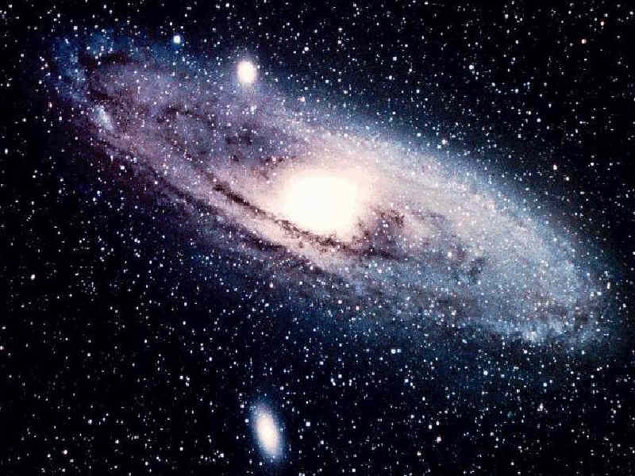
A protein library having the mass of our galaxy could only cover the combinatorial possibilities for a peptide with 50 residues

Slide 7
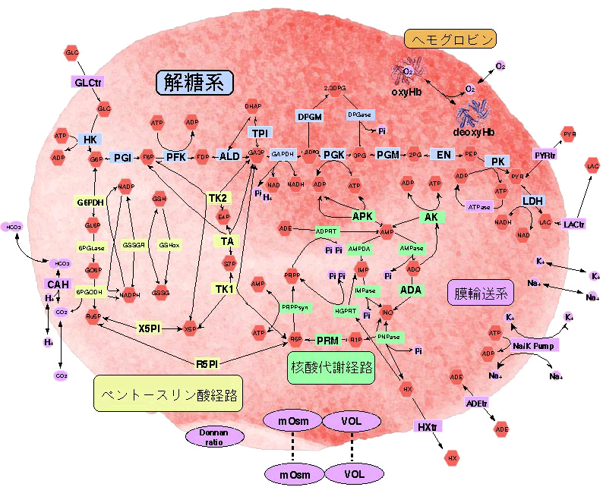
Therefore even genetic selection approaches for designing novel functional proteins will not generally build on fully random sequences, but will be based on existing protein scaffold that serve as template.

Slide 8
In order to consider the rational design of a target enzyme, one needs to have several pieces of information:
1. A cloned gene coding for the enzyme.
2. The sequence of the gene.
3. Information on the chemistry of the active site, ideally one would know which amino acids in the sequence are involved in activity.
4. Either a crystal/NMR structure for of the enzyme, or the structure of another protein displaying a high degree of structural homology.
The above information is needed in order to have a clear idea of which amino acids one should mutate to which likely effect.

Slide 9
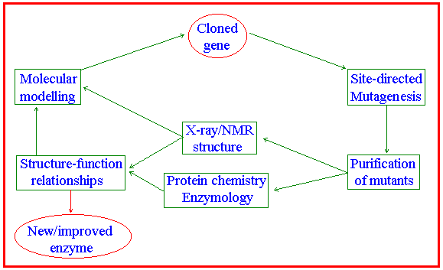
Typically, protein engineering is a cyclic activity involving many scientists with different skills:

Slide 10
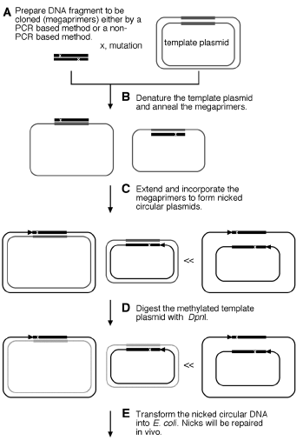

Slide 11
7–9 point and 0.4–1.3 frame-shifted mutations per kilobase of DNA

Slide 12
PCR-mediated deletion mutagenesis
Target DNA
PCR products
Oligonucleotide design allows precision in deletion positions

Slide 13
Domain swapping using “megaprimers” (overlapping PCR)
N-
-C
Template 1
PCR 1
Mega-primer
Template 2
PCR 2
Domains have been swapped

Slide 14
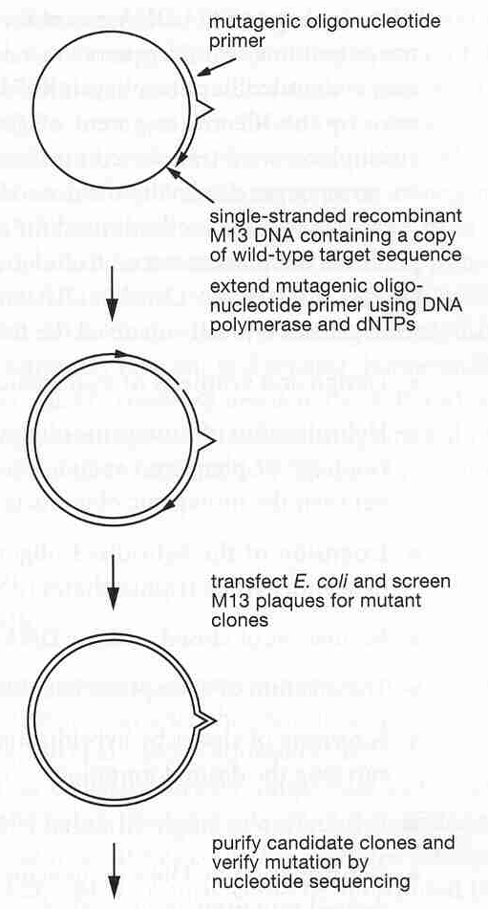
Site-directed mutagenesis: primer extension method
Drawbacks:
-- both mutant and wild type versions of the gene are made following transfection--lots of screening required, or tricks required to prevent replication of wild type strand
-- requires single-stranded, circular template DNA

Slide 15
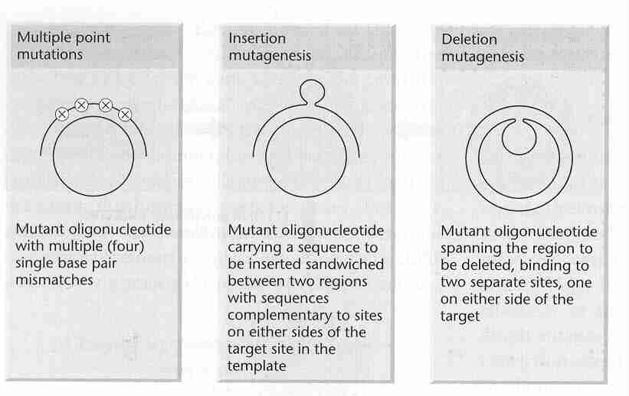
Alternative primer extension mutagenesis techniques

Slide 16
(1)
Rational design of coagulation factor VIIa variants with substantially increased intrinsic activity.

Slide 17
Kallikrein
HMWK
EXTRINSIC
Vascular
PATHWAY
damage
FXII
FXIIa
thrombin
FVIIa, FIXa, FXa
TF
TF
FXI
FXIa
FVIIa
FVII
INTRINSIC
PATHWAY
FVIIa,
FIX
FIXa
FIX
FIXa,
TF
FXa
FVIII
FVIIIa
FVIIa
FXa, thrombin
FX
FXa
FX
FV
FVa
FXa, thrombin
FXIII
thrombin
P
T
thrombin
COMMON
PATHWAY
cross
FXIIIa
-
linked
fibrin
fibrinogen
fibrin

Slide 18
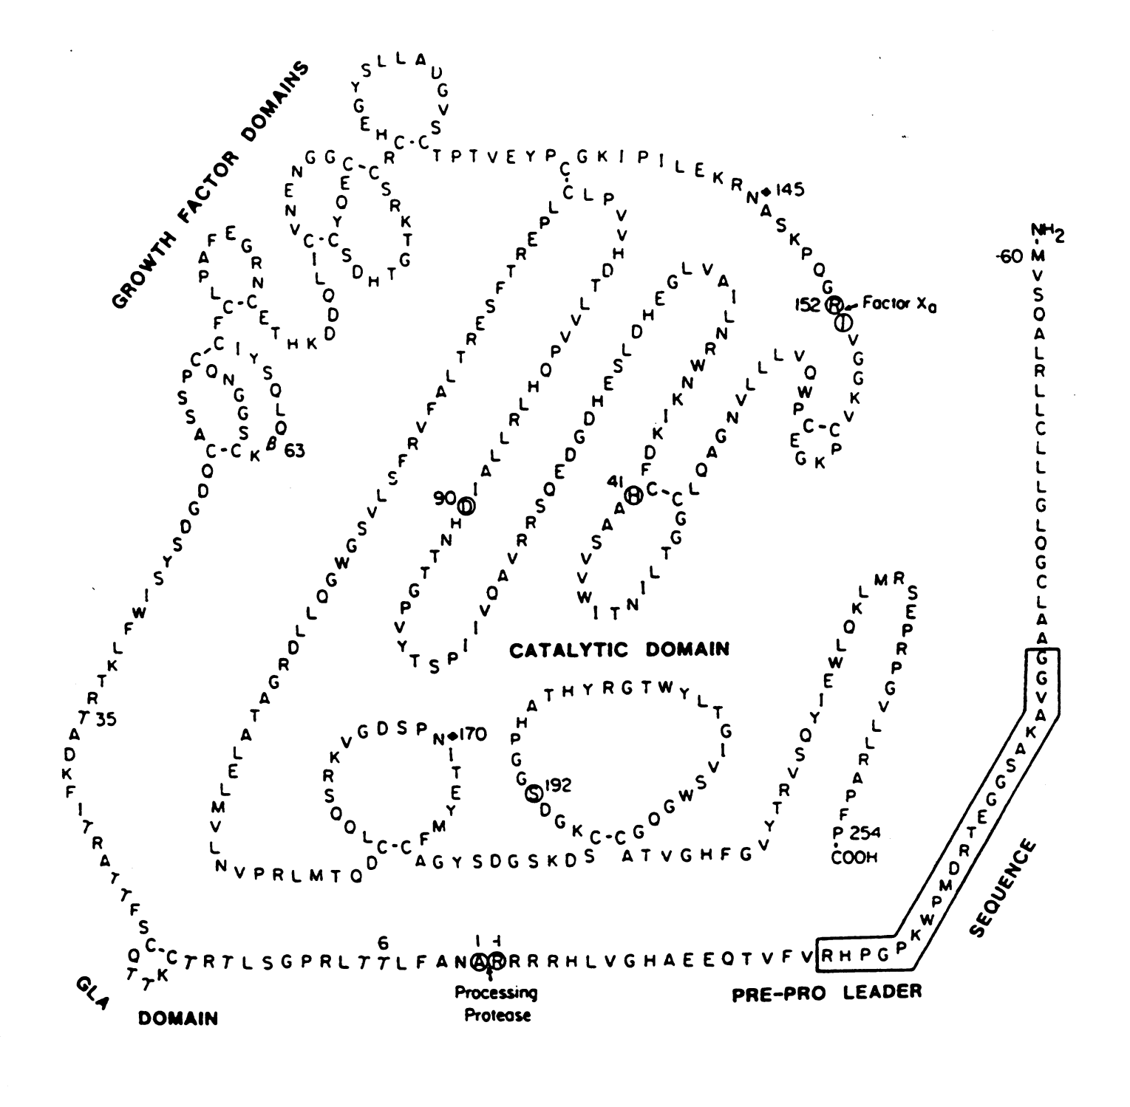
FVII

Slide 19
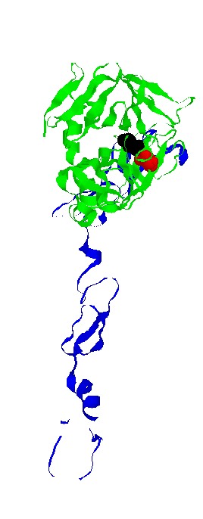
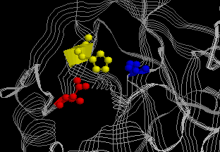
Asp¹⁹⁴
HC
TRIPSINA
Ile¹⁶
His57
Ser195
Asp102
LH
TRIPSINA
Asp102
10.27Å
Ser195
6.40Å
8.16Å
His57
FVIIa

Slide 20
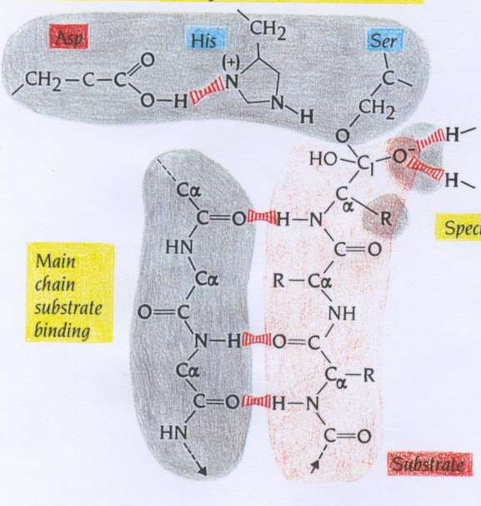
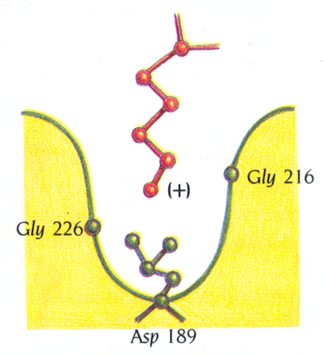
CARATTERISTICHE DEL DOMINIO SERIN PROTEASICO
1. TRIADE CATALITICA
2. INCAVO
OSSIANIONICO
4. TASCA DI
SPECIFICITA’
3. SITO DI LEGAME
ASPECIFICO

Slide 21
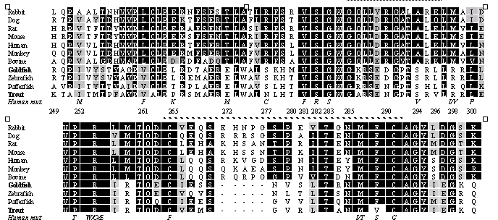
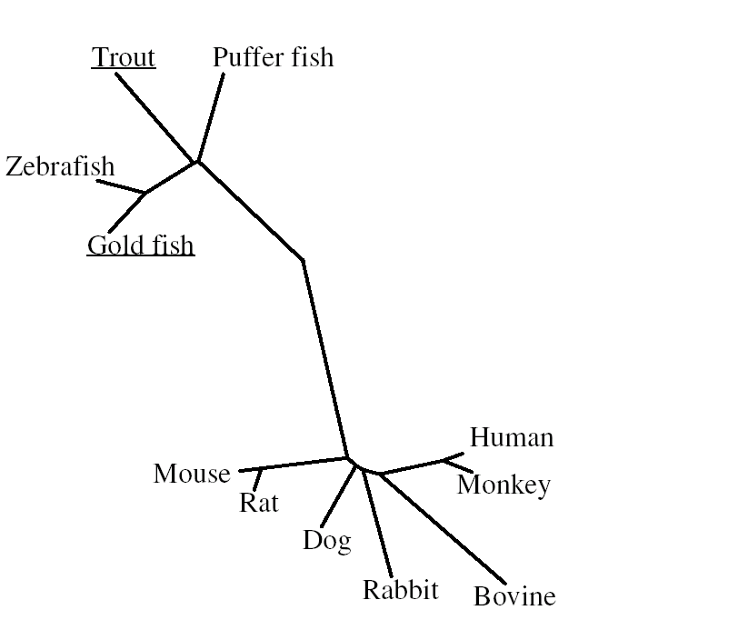
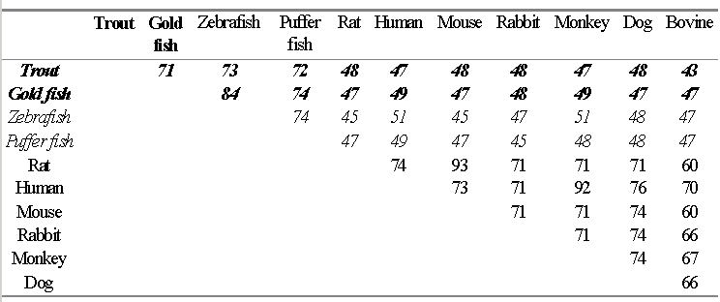

Slide 22
FVIIa
FVIIa
k₁
TF
TF
k₄
k₂
FVIIa
FVIIa
TF
k₃
TF
Il complesso Xasico

Slide 23
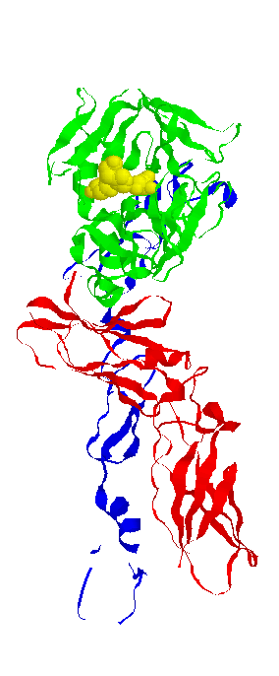
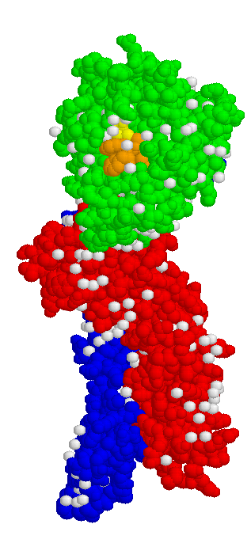
Triade
catalitica
Asp¹⁹⁴
HC
Inibitore
Ile¹⁶
LH
sTF
FVIIa
Soluble TF/FVIIa

Slide 24
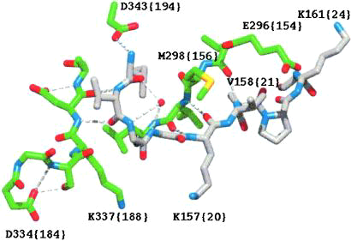
Activation pocket region of FVIIa. The structure is from the complex between FVIIa and TF. The carbon atoms of N-terminal Ile-153 {16} to Lys-161 are shown in gray and those of the amino acids constituting part of the activation pocket are in green. The water molecule (shown as a red sphere)
interacting with main chain atoms of Gly-155 {18} and Gly-156 {19} lacks hydrogen bonds to the side chain of Met-298 {156}.

Slide 25
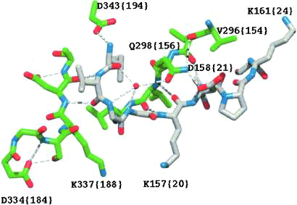
Activation pocket region of FVIIa after mutating the residues in positions 158 {21}, 296 {154}, and 298 {156} to those occupying the corresponding positions in thrombin (Asp, Val and Gln, respectively). The backbone structure (3) and coloring scheme are the same as in Fig. 1. The introduced side
chains are oriented as in the thrombin structure. Note that a hydrogen bond network between the water molecule, Gln-298 {156} and Asp-158 {21} is established.

Slide 26
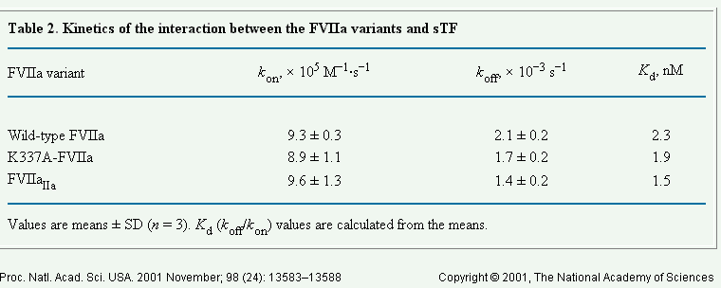
In the presence of Tissue factor the activity of variants
was comparable or slightly increased
as compared to wtFVIIa

Slide 27
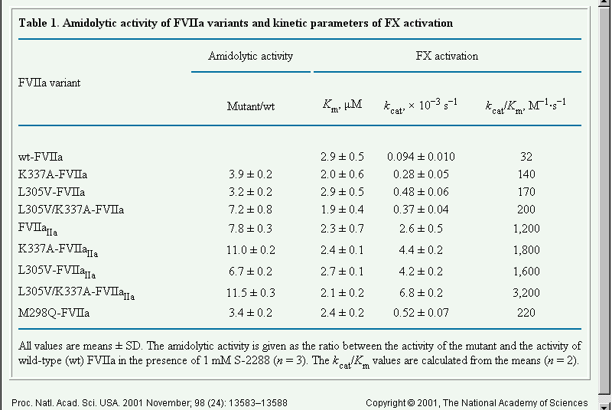

Slide 28
Directed mutagenesis
Make changes in amino acid sequence based on rational decisions
Structure known? Mutate amino acids in any part of protein thought to influence activity/stability/solubility etc.
Protein with multiple family members? Mutate desired protein in positions that bring it closer to another family member with desired properties

Slide 29
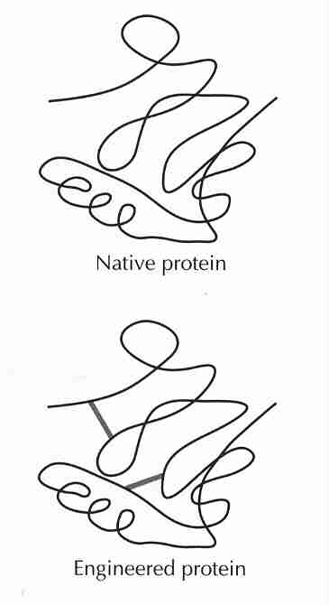
An example of directed mutagenesis
T4 lysozyme: structure known
Can it be made more stable by the addition of pairs of cysteine residues (allowing disulfide bridges to form?) without altering activity of the protein?

Slide 30
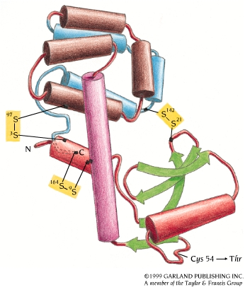
T4 lysozyme: a model for stability studies
Cysteines were added to areas of the protein in close proximity--disulfide bridges could form

Slide 31
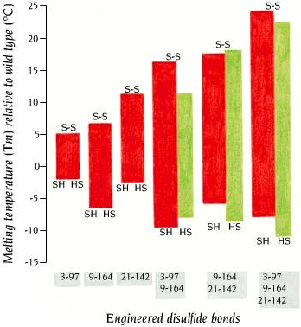
More disulfides, greater stabilization at high T
Bottom of bar: melting temperature under reducing condtions
Top of bar:
Melting temperature under oxidizing conditions
Green bars: if the effects of individual S-S bonds were added together

Slide 32
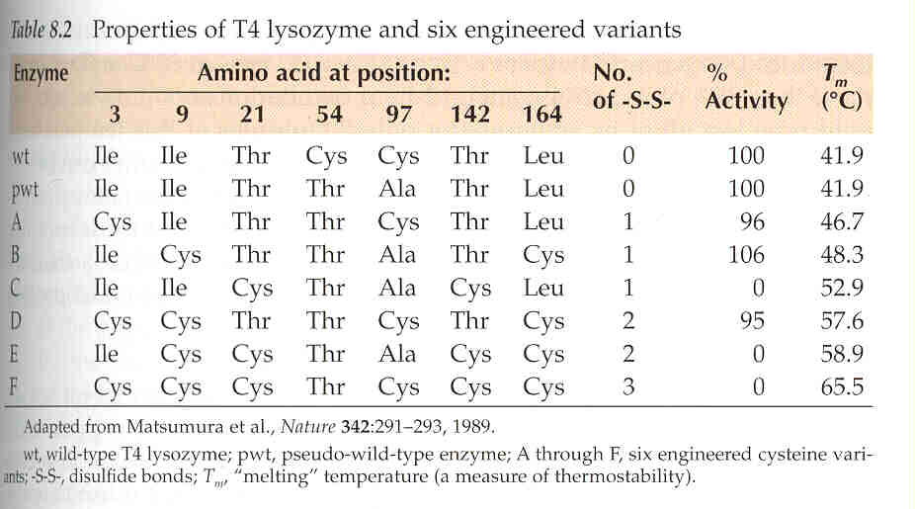
Stability can be increased - but there can be a cost in activity

Slide 33
IRRATIONAL DESIGN
To attempt to mimic the natural processes by which protein variants arise and are tested for fitness within living systems

Slide 34
Directed Evolution – Random mutagenesis
-> based on the process of natural evolution
- NO structural information required
- NO understanding of the mechanism required
General Procedure:
Generation of genetic diversity
⇒ Random mutagenesis
Identification of successful variants
⇒ Screening and seletion

Slide 35
Directed Evolution Library
Even a large library -> (10⁸ independent clones)
will not exhaustively encode all possible single point mutations.
Requirements would be:
20^{N} independend clones -> to have all possible variations in a library
(+ silent mutations)
N….. number of amino acids in the protein
For a small protein: -> Hen egg-white Lysozyme (129 aa; 14.6 kDa)
-> library with 20¹²⁹ (7x 10¹⁶⁸) independent clones
Consequence -> not all modifications possible
-> modifications just along an evolutionary path !!!!

Slide 36
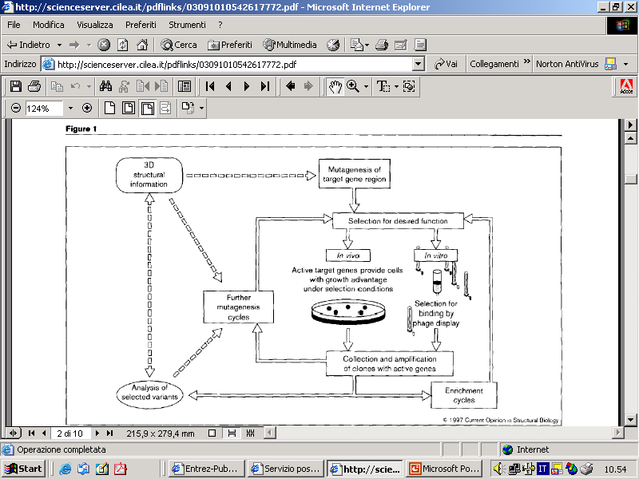
The outcome of directed evolution experiments is critically dependent on how a library is screened

Slide 37
Selection:
only those clones that are actually desided appear
Screening:
When all members of the library are present when one chooses the best for further analysis

Slide 38
Limitation of Directed Evolution
Evolutionary path must exist - > to be successful
Screening method must be available
-> You get (exactly) what you ask for!!!
-> need to be done in -> High throughput !!!

Slide 39
Evolutionary Methods
Non-recombinative methods:
-> Oligonucleotide Directed Mutagenesis (saturation mutagenesis)
-> Chemical Mutagenesis, Bacterial Mutator Strains
-> Error-prone PCR
Recombinative methods -> Mimic nature’s recombination strategy
Used for: Elimination of neutral and deleterious mutations
-> DNA shuffling
-> Invivo Recombination (Yeast)
-> Random priming recombination, Staggered extention precess (StEP)
-> ITCHY

Slide 40
Evolutionary Methods
Type of mutation – Fitness of mutants
Type of mutations:
Beneficial mutations (good)
Neutral mutations
Deleterious mutations (bad)
Beneficial mutations are diluted with neutral and deleterious ones
!!! Keep the number of mutations low per cycle
-> improve fitness of mutants!!!

Slide 41
CLONAL INTEFERENCE
Competition between beneficial mutations in asexual populations
is called “Clonal Interference”
Recursive mutagenesis PCR produced essentially asexual populations within which the beneficial mutations drove each other into extintion.
DNA shuffling (and combinatorial cassette mutagenesis) instead enable accumulation of these mutations in super-alleles

Slide 42
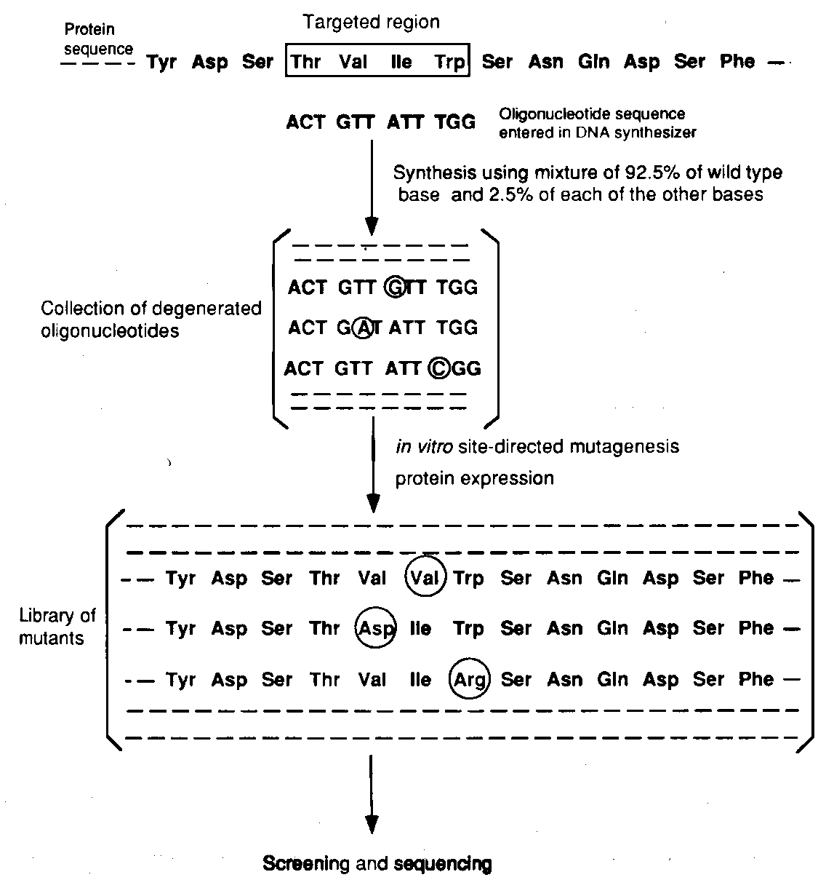
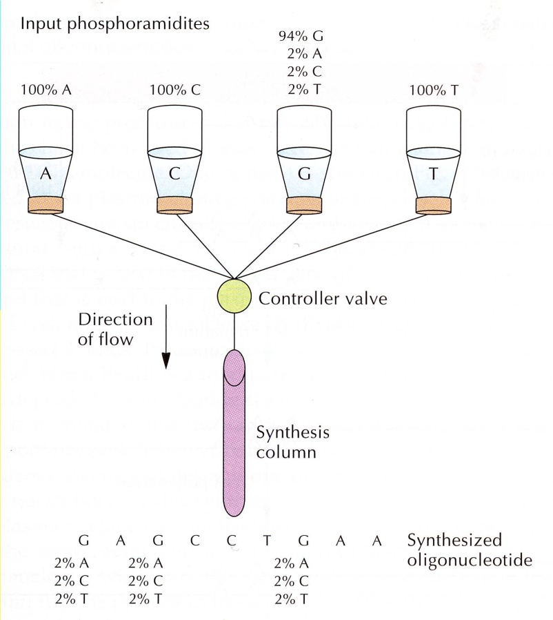
Random Mutagenesis (PCR based) with degenerated primers (saturation mutagenesis)

Slide 43
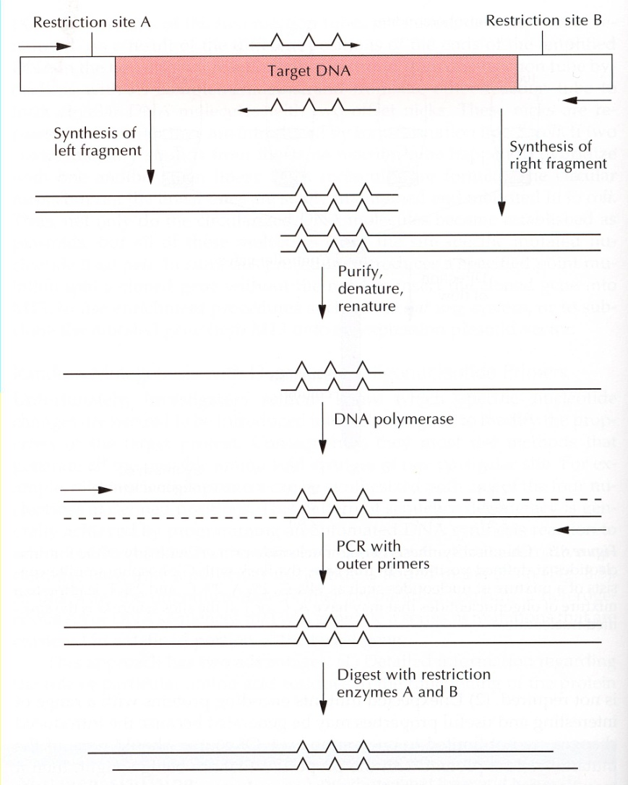
Random Mutagenesis (PCR based) with degenerated primers (saturation mutagenesis)

Slide 44
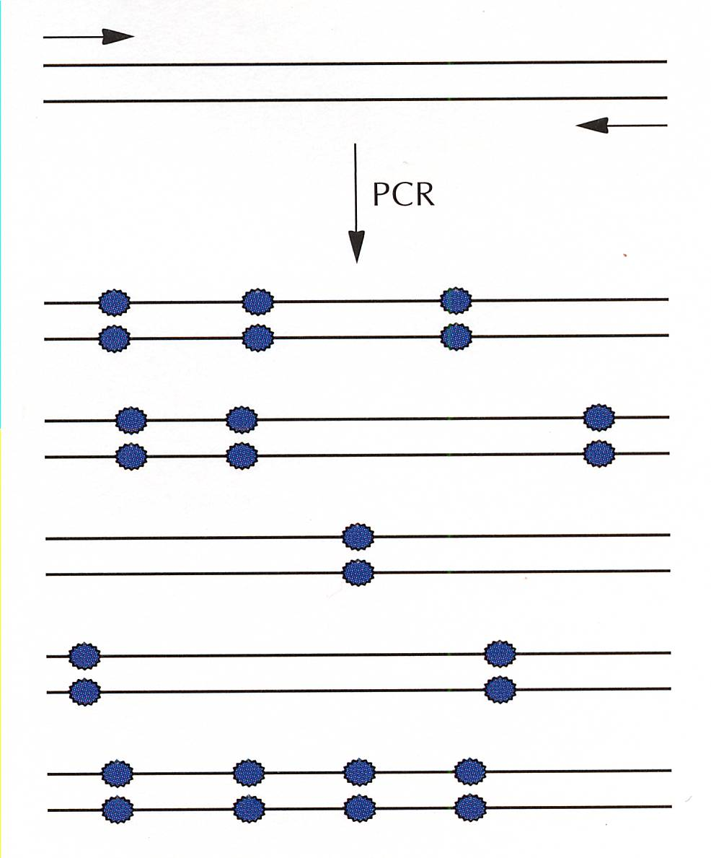
Random Mutagenesis (PCR based)
Error –prone PCR
-> PCR with low fidelity !!!
Achieved by:
- Increased Mg2+ concentration
- Addition of Mn2+
- Not equal concentration of the four dNTPs
- Use of dITP
- Increasing amount of Taq polymerase (Polymerase with NO proof reading function)

Slide 45
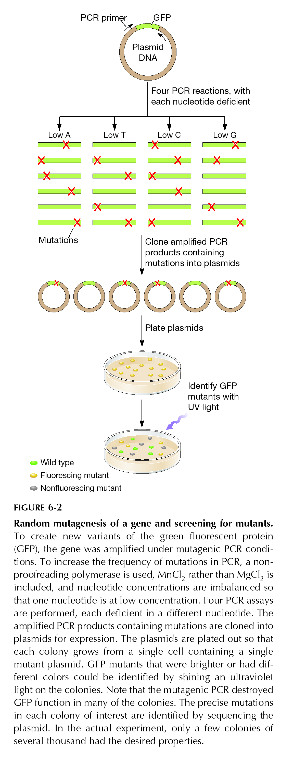
Random mutagenesis by PCR: the Green Fluorescent Protein
Screen mutants

Slide 46
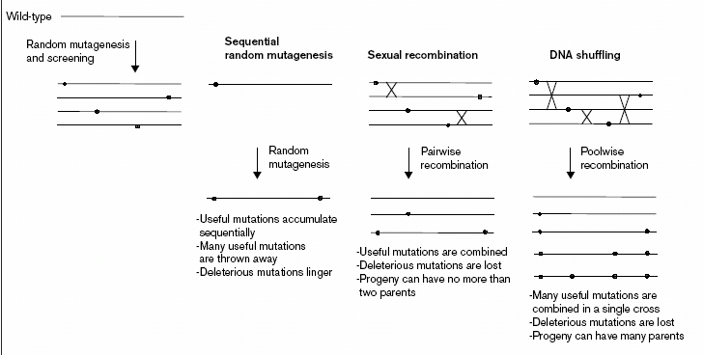

Slide 47
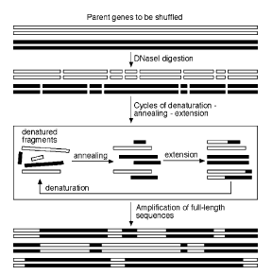
DNA Shuffling
3.7 crossovers per 2.1 kb gene (1%) with a low mutagenesis rate (0,01%)
successfully to recombine parents with only 63% DNA sequence identity

Slide 48
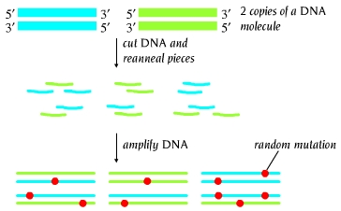
Gene shuffling: “sexual PCR”

Slide 49
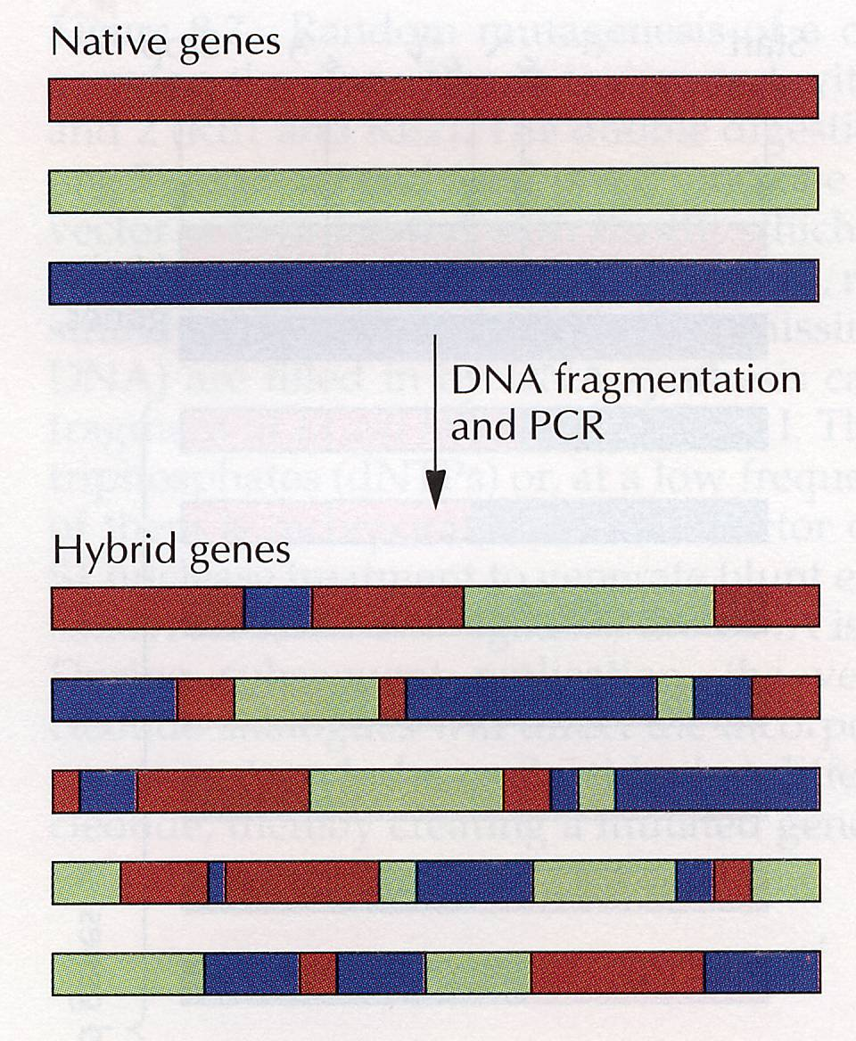
Family Shuffling
Genes coming from the same gene family -> highly homologous
-> Family shuffling

Slide 50
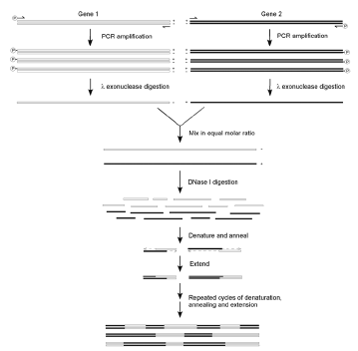
generated by cloning into phagemids
or by phosporilathed DNA digestion
14% rate of chimeric genes

Slide 51
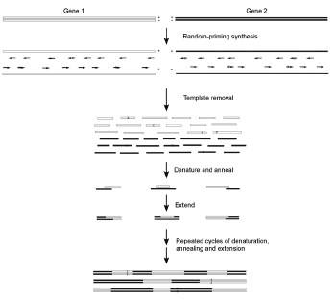
(RPR)
RPR has several potential
advantages over DNA shuffling:
random-priming DNA synthesis is independent of the length of the DNA template
It can be used single-stranded DNA or RNA templates
mutations introduced by misincorporation and mispriming can further increase the sequence diversity

Slide 52
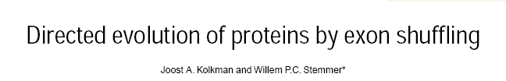

Slide 53
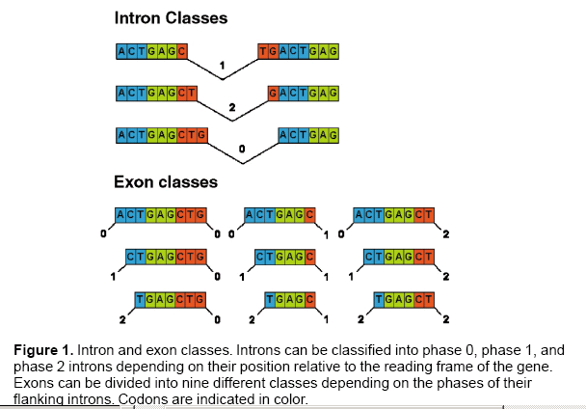

Slide 54
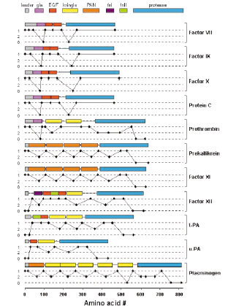
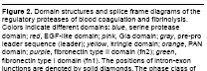

Slide 55
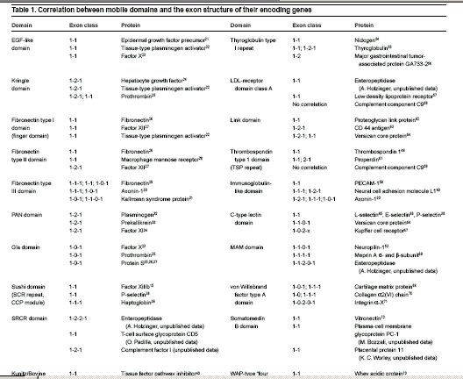

Slide 56
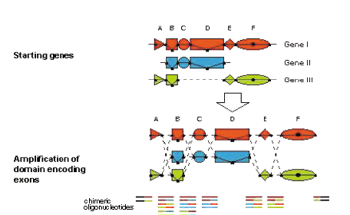
In Vitro Exon Shuffling

Slide 57
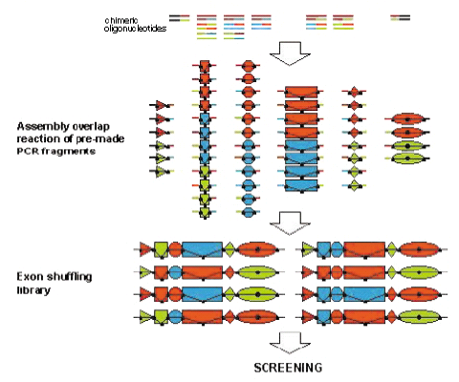

Slide 58
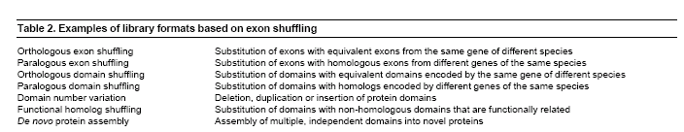

Slide 59
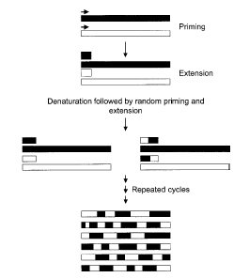
based on cross hybridization of growing gene fragments during polymerase-catalyzed primer extension
It is much easier than DNA shuffling

Slide 60
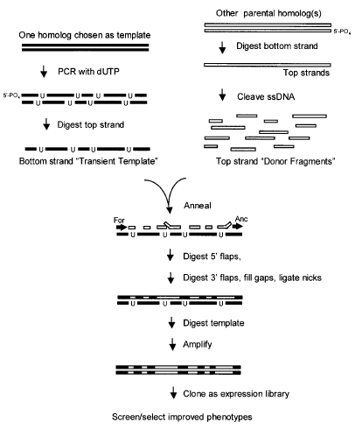
Gene Family Shuffling by Random Chimeragenesis
on Transient Templates
average 12 crossovers per gene in a single round
uracil-DNA glycosylase (UDG)

Slide 61
An ITCHY library created from a single gene consists of genes with internal deletions and duplications.
An ITCHY library created between two different genes consists of gene fusions created in a DNA-homology independent fashion.

Slide 62
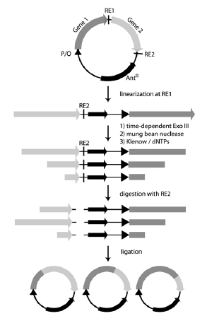
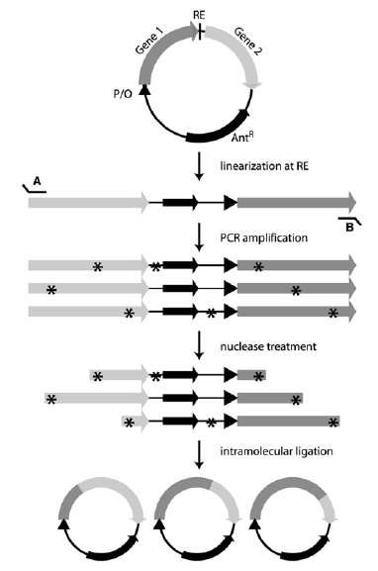
Using α-phosphorothioate dNTPs
Blunt ends
generation

Slide 63

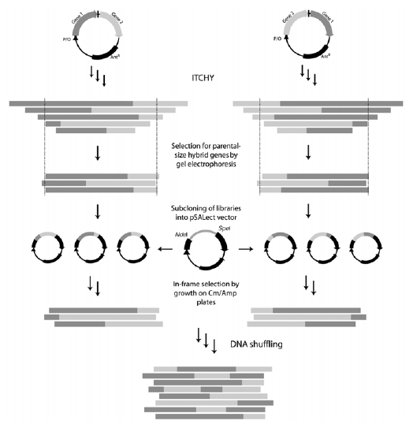
A combination between ITCHY and DNA shuffling

Slide 64
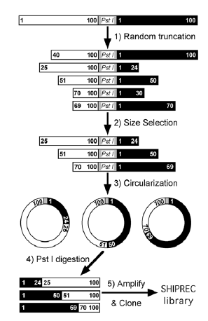
DNase I and S1 nuclease
DNA corresponding to the length of the parental genes is isolated and subsequently circularized
crossovers occur at structurally related sites
to generate all possible single-crossover chimeras, SHIPREC must be performed twice starting with both possible parental gene fusions, e.g., A–B and B–A.

