Slide 2
System Analysis and Design
Lecture 8

Slide 3
Agenda
Previous lecture recap
Extreme Programming (XP) introduction
XP values
XP principles
XP rules
Questions
Recommended reading

Slide 4
Recap
Main ideas from Scrum methodology.
What is the difference between Scrum and Kanban?

Slide 5
eXtreme Programming
Iterative & Incremental Models

Slide 6
Major Software Development Models
There a many Software Development Models with their strengths and weaknesses. But, they can be categorized into 3 major categories:
  Waterfall – Structured, top/down approach.
  Examples: Waterfall, Structured System Analysis and Development Methodology (SSADM).
  Iterative & Incremental – Iteratively go through important software development “steps” (analysis, design, build, etc.) and incrementally build the system.
  Examples: Spiral, RAD, Agile, etc.
  Prototyping – Build prototypes, get feedback, refine. Once get the final version – build the software and deploy.
  Examples: RAD, Prototyping.

Slide 7
Taking things to their extremes…
That’s basically is the idea!

Slide 8
eXtreme Programming
First introduced in 1996 by Kent Beck at Chrysler’s accounting system.
Formulated and published as a software development methodology in 1999. Later, in 2004, Kent Beck reviewed the methodology and published the second edition of “eXtreme Programming explained” book. (We have several copies in our LRC.)

Slide 9
eXtreme Programming
What is meant by “taking things to their extremes”?
Taking “good practices” to extreme.
For example:
  Code review improves code quality → make code review continues → Pair programming!
  Tests reduce errors, improve code → test everything → Cover all your code with unit tests, integration tests, etc.
  Etc.

Slide 10
XP: Values
Communication – promote among the team members, also involve end users actively.
Simplicity – design the simplest solution. Code for today, not tomorrow. "You ain’t gonna need it" (YAGNI) approach.
Feedback – from unit tests, acceptance tests, customer.
Courage – to change your code or throw it away.
Respect – your peers. Don’t commit a change that breaks tests or compilation. Make sure everyone feels appreciated and heard.

Slide 11
XP: Practices
Fine-scale feedback
  Pair programming
  Planning game
  Test-driven development
  Whole team
Continuous process
  Continuous integration
  Refactoring or design improvement
  Small releases
Shared understanding
  Coding standards
  Collective code ownership
  Simple design
  System metaphor
Programmer welfare
  Sustainable pace

Slide 12
XP: Rules
Planning
  User stories are written.
  Release planning creates the release schedule.
  Make frequent small releases.
  The project is divided into iterations.
  Iteration planning starts each iteration.
Managing
  Give the team a dedicated open work space.
  Set a sustainable pace.
  A stand up meeting starts each day.
  The Project Velocity is measured.
  Move people around.
  Fix XP when it breaks.
Design
  Simplicity.
  Choose a system metaphor.
  Use CRC cards for design sessions.
  Create spike solutions to reduce risk.
  No functionality is added early.
  Refactor whenever and wherever possible.
Coding
  The customer is always available.
  Code must be written to agreed standards.
  Code the unit test first.
  All production code is pair programmed.
  Only one pair integrates code at a time.
  Integrate often.
  Set up a dedicated integration computer.
  Use collective ownership.
Testing
  All code must have unit tests.
  All code must pass all unit tests before it can be released.
  When a bug is found tests are created.
  Acceptance tests are run often and the score is published.

Slide 13
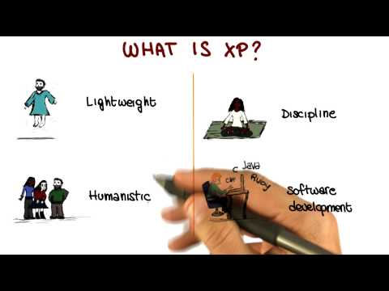
eXtreme Programming (video)
Source: https://www.udacity.com/course/viewer#!/c-ud805/l-1771718546/m-439898982

Slide 14
XP: Discussion
What are the advantages of adopting XP?
What are the disadvantages of adopting XP?
Source: https://www.scrumalliance.org/why-scrum

Slide 15
Questions

Slide 16
Recommended Reading
Beck, K. (2004). Extreme programming eXplained. 2nd ed. Reading, MA: Addison-Wesley.
Extreme Programming: A gentle introduction, (2015). The Rules of Extreme Programming. [online] Available at: http://www.extremeprogramming.org/rules.html [Accessed 10 Nov. 2015].
Georgia Tech (2015). Software Development Processes. [online] Udacity.com. Available at: https://www.udacity.com/course/software-development-process--ud805 [Accessed 10 Nov. 2015].
Wikipedia, (2015). Extreme programming. [online] Available at: https://en.wikipedia.org/wiki/Extreme_programming [Accessed 10 Nov. 2015].
Google…

