Slide 2
System Analysis and Design
Lecture 7

Slide 3
Agenda
Previous lecture recap
Scrum Methodology
Kanban
Coursework overview and questions
Recommended reading

Slide 4
Recap
Main ideas from Sprint methodology.
Main ideas from Rapid Application Development (RAD).

Slide 5
Scrum
Iterative & Incremental Models

Slide 6
Major Software Development Models
There a many Software Development Models with their strengths and weaknesses. But, they can be categorized into 3 major categories:
  Waterfall – Structured, top/down approach.
  Examples: Waterfall, Structured System Analysis and Development Methodology (SSADM).
  Iterative & Incremental – Iteratively go through important software development “steps” (analysis, design, build, etc.) and incrementally build the system.
  Examples: Spiral, RAD, Agile, etc.
  Prototyping – Build prototypes, get feedback, refine. Once get the final version – build the software and deploy.
  Examples: RAD, Prototyping.

Slide 7
Let’s start with a history…
Notes:
Here, I would talk about how Japan was agricultural nation first. Globalization, investments, labor intensive jobs, then how Japan started to concentrate on quality and made the “Made in Japan” a country’s brand. Along the way, they come up with several process management and product development methodologies that were then adopted by others (Lean manufacturing -> MVP/Lean startup, Kanban, new product development -> Scrum, etc.).

Slide 8
Scrum history…
In their book, “New Product Development Game”, Hirotaka Takeuchi and Ikujiro Nonaka explained the ideas of what we now call Scrum as:
  "a flexible, holistic product development strategy where a development team works as a unit to reach a common goal“.
In 1995 Jeff Sutherland and Ken Schwaber presented the main ideas at Object-Oriented Programming, Systems, Languages & Applications.

Slide 9
Roles
There are 3 roles in Scrum:
  Product owner
  Scrum master
  The team

Slide 10
Role: Product owner
The team member who knows the business and customer needs, as well as can make decisions on behalf of the client.
S/he is responsible for communication between the developer team and the business.
The main goal of Product Owner is successfully build the final product that meets business needs. The Product Owner must be “friends” with both: the business and the developer team.

Slide 11
Role: Scrum Master
Scrum Master has experience in managing Scrum projects and is responsible to make sure the team follows Scrum principles, also (tries to) removes any obstacles so that the developer team delivers the shippable product on time.
S/he is responsible for organizing daily scrum meetings, teaching stakeholders about the Scrum processes.
Scrum Master is not a Project Manager. Scrum Master does not deal with HR, Finances, etc.

Slide 12
Role: Developer team
The developer team is a group of self-organized people that do the work. A team may consist of a programmer, designer, tester, etc.
Usually the team members have interchangeable roles.
In order for this setup to work, your team members must be responsible, professional and understand the main goal – to deliver quality product to the client.

Slide 13
The process
The project is split into smaller manageable parts called Sprints.
The Scrum has the following stages:
  Product backlog
  Sprint planning
  Sprint backlog
  Sprint (daily scrum meeting)
  Potentially shippable product
Sprint is timeboxed (from 1 week to 1 month) and aims to produce a potentially shippable product.

Slide 14
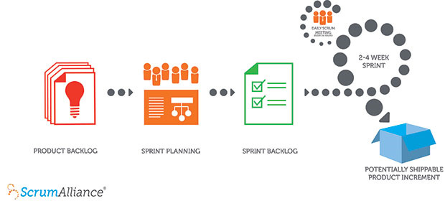
The Scrum process
Source: https://www.scrumalliance.org/why-scrum

Slide 15
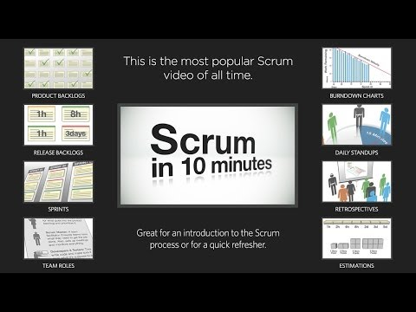
The Scrum process (video)
Source: http://youtube.com/watch?v=XU0llRltyFM

Slide 16
The Scrum process (video)
Please discuss:
  The main ideas in Scrum (roles, events, etc.)
  When would you consider using Scrum?
  Can you spot any of the “side effects” of the methodology?
Source: https://www.scrumalliance.org/why-scrum

Slide 17
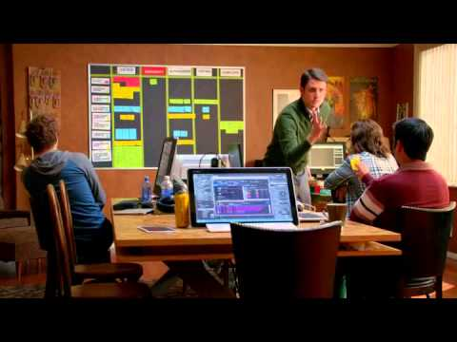
The Scrum “side-effects” (video)
Source: http://youtube.com/watch?v=oyVksFviJVE

Slide 18
Kanban

Slide 19

The Scrum process (video)
Source: http://youtube.com/watch?v=R8dYLbJiTUE

Slide 20
Coursework Overview &
Questions

Slide 21
Recommended Reading
Kent Beck, et.al., (2001). Manifesto for Agile Software Development. [online] Available at: http://www.agilemanifesto.org [Accessed 3 Nov. 2015].
Wikipedia, (2015). Scrum (software development). [online] Available at: https://en.wikipedia.org/wiki/Scrum_(software_development) [Accessed 3 Nov. 2015].
Wikipedia, (2015). Kanban (development). [online] Available at: https://en.wikipedia.org/wiki/Kanban_(development) [Accessed 3 Nov. 2015].
Google…

