Slide 2
System Analysis and Design
Lecture 6

Slide 3
Agenda
Previous lecture recap
Introduction to Iterative & Incremental Models
Spiral Methodology
Rapid Application Development Methodology
More Agile Methodologies: Kanban, Scrum, XP (if we have enough time)
Coursework overview and questions
Recommended reading

Slide 4
Recap
What qualities should requirements have? (ex: not vague)
List all requirement types.
What stages requirement gathering process has?

Slide 5
Iterative & Incremental Models

Slide 6
Major Software Development Models
There a many Software Development Models with their strengths and weaknesses. But, they can be categorized into 3 major categories:
  Waterfall – Structured, top/down approach.
  Examples: Waterfall, Structured System Analysis and Development Methodology (SSADM).
  Iterative & Incremental – Iteratively go through important software development “steps” (analysis, design, build, etc.) and incrementally build the system.
  Examples: Spiral, RAD, Agile, etc.
  Prototyping – Build prototypes, get feedback, refine. Once get the final version – build the software and deploy.
  Examples: RAD, Prototyping.

Slide 7
Before we move on,
let me tell you a story… ☺

Slide 8
Lessons learned…
What can we conclude about software development in real life?
  Projects fail and fail a lot – Remember Research paper from Tutorial 1.
  There are many factors that lead to project failure:
    Not clear, vague or changing requirements
    Undefined project scope
    Financial, technical, human resource aspects
    Developers postpone
    etc.
  What should we do? – Manage our projects and the whole process.
  How can we do it? – Use development methodologies that fit our context and address problems that we have (i.e. use them for their “side effects”).

Slide 9
One of the biggest problems…
Not clear, vague or changing requirements is one of the biggest problems in real life software development.
How can we address this problem?
What can we do to reduce the risk of project failure that is caused by (a) vague or (b) changing requirements?
  Devote a stage for requirements gathering; use different techniques we covered to gather quality requirements (involve end-users, prototyping, etc.); document requirements;
  Split the project into smaller parts; start with the most important functionalities; write system that considers possible code changes; etc.

Slide 10
New/Modern methodologies
So, this is where many of the Incremental and Iterative models, as well as many of the new/modern methodologies come in.
By splitting projects into smaller pieces, it is easier to manage and change them (compared to big plan ahead).
All methodologies, that we will see, base their ideas on this simple premise (divide and concur).
and our first Incremental & Iterative methodology is …

Slide 11
Spiral

Slide 12
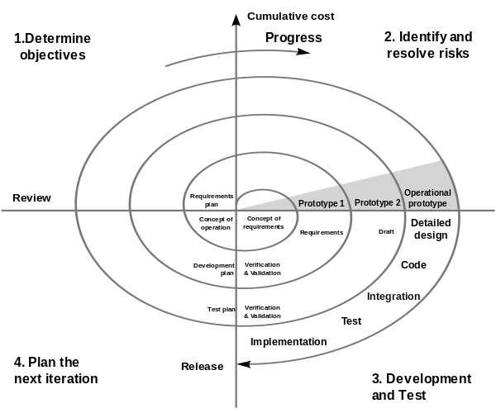
Spiral Methodology
"Spiral model (Boehm, 1988)" by Connyderivative work: Spiral_model_(Boehm,_1988).png: Marctroyderivative work: Conan (talk) -File:Spiralmodel_nach_Boehm.png,
Spiral_model_(Boehm,_1988).png. Licensed under Public Domain via Commons - https://commons.wikimedia.org/wiki/File:Spiral_model_(Boehm,_1988).svg

Slide 13
Spiral Methodology
Divide project into smaller ones.
Iterate through each using the following stages:
  Identify objectives, alternatives, and constraints;
  Evaluate alternatives, identify and resolve risks;
  Develop and verify deliverables;
  Plan the next iteration.

Slide 14
Spiral Methodology
What problems / risks are we addressing?
What are the “side effects”?
When would you use it?

Slide 15
Rapid Application Development (RAD)

Slide 16
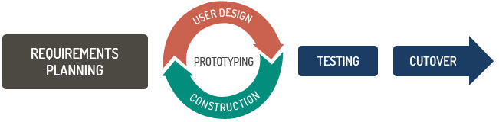
RAD Methodology
Source: TatvaSoft. Top 12 Methodologies. Available at: http://www.tatvasoft.com/blog/top-12-software-development-methodologies-and-its-advantages-disadvantages [Accessed ]

Slide 17
RAD Methodology
Rapidly and incrementally construct prototypes, instead of large up-front planning.
In each increment do:
  Identify and develop Data Models and Business Process Models;
  Verify and validate your Data Models and Business Process Models using prototyping.
  Define a deadline (“timebox”), develop, test and deploy. If you’re missing your deadline, don’t move it, throw away non critical system functionalities.
Source: TatvaSoft. Top 12 Methodologies. Available at: http://www.tatvasoft.com/blog/top-12-software-development-methodologies-and-its-advantages-disadvantages [Accessed ]

Slide 18
RAD Methodology
Advantages
  Reduce inherent upfront-planning project risk.
  Deliver working system fast, at a lower cost.
  Fulfils business needs first and not the technical.
  Involves end-users, which helps to improve the system quality.
Disadvantages
  Requires self-motivated and professional team.
  Works with the systems that can be modularized.
  May deliver a system that is not production-ready, if the prototype qualities are not monitored.
  Does not produce extended documentation.

Slide 19
RAD Methodology
What problems / risks are we addressing?
What are the “side effects”?
When would you use it?

Slide 20
Coursework Overview &
Questions

Slide 21
Recommended Reading
Wikipedia, (2015). Spiral model. [online] Available at: https://en.wikipedia.org/wiki/Spiral_model [Accessed 26 Oct. 2015].
Wikipedia, (2015). Rapid application development. [online] Available at: https://en.wikipedia.org/wiki/Rapid_application_development [Accessed 26 Oct. 2015].
Google…

