Slide 2
System Analysis and Design
Lecture 5

Slide 3
Agenda
Previous lecture recap
Prototyping
Recommended reading

Slide 4
Recap
What is SSADM?
What are their stages?
When would you use it?

Slide 5
Prototyping

Slide 6
Major Software Development Models
There a many Software Development Models with their strengths and weaknesses. But, they can be categorized into 3 major categories:
  Waterfall – Structured, top/down approach.
  Examples: Waterfall, Structured System Analysis and Development Methodology (SSADM).
  Iterative & Incremental – Iteratively go through important software development “steps” (analysis, design, build, etc.) and incrementally build the system.
  Examples: Spiral, RAD, Agile, etc.
  Prototyping – Build prototypes, get feedback, refine. Once get the final version – build the software and deploy.
  Examples: RAD, Prototyping.

Slide 7
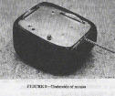
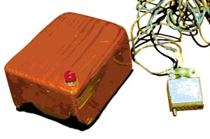
First point and click prototypes

Slide 8

Tale of Drew Houston & Dropbox
Source: http://blogs-images.forbes.com/victoriabarret/files/2011/10/dropbox-cover.jpg

Slide 9
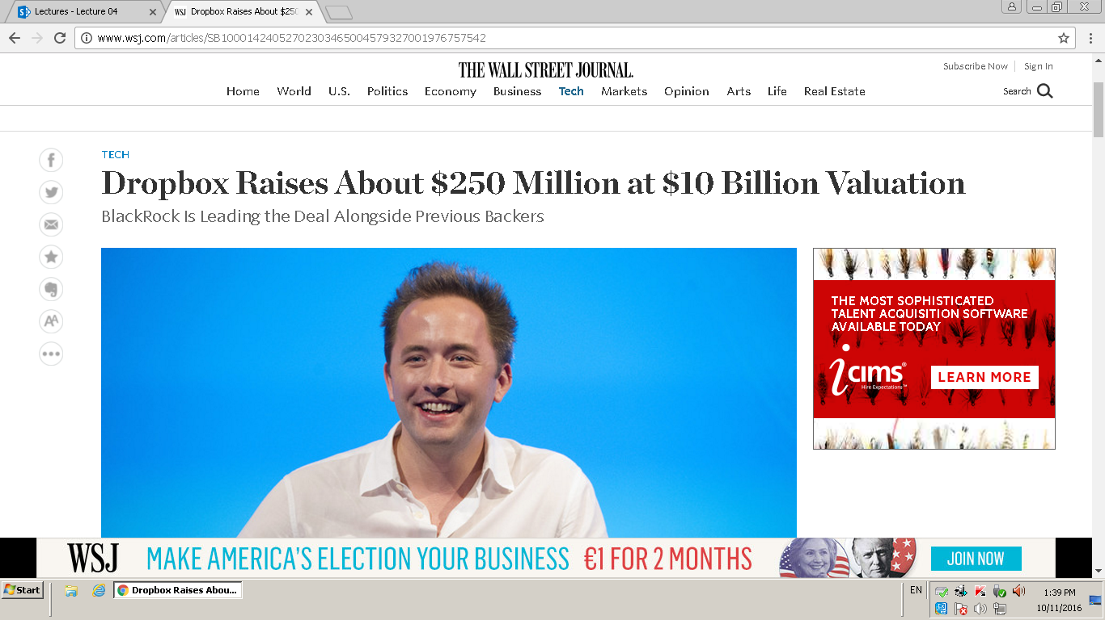

Slide 10

Tale of Drew Houston & Dropbox
Source: http://youtube.com/watch?v=7QmCUDHpNzE

Slide 11
Software Prototyping Process
Software prototyping is the process of creating an incomplete model of the future full-featured software
Process:
  Identify basic requirements
  Develop Initial prototype
  Review with customer’s users
  Revise and enhance

Slide 12
Types of Software Prototypes
Throwaway prototype – process of creating a rapid model (demonstration or marketing)
Evolutionary prototype – build a system then refine
Incremental – final product built as separate prototypes

Slide 13
Serial development is costly
The Longer You Wait for Feedback, the more costs are sunk.

Slide 14
Applications
Feasibility
Human Interface testing
Increases user involvement
Reduce time and cost
DSDM (Dynamic systems development method)
  Business prototypes (automation/mechanization)
  Usability prototypes
  Performance and Capacity
  Proof of concept

Slide 15
Benefits
Misunderstandings between software users and developers are exposed
Missing services may be detected and confusing services may be identified
A working system is available early in the process
The prototype may serve as a basis for deriving a system specification
The system can support user training and system testing
Results in higher quality system requirements

Slide 16
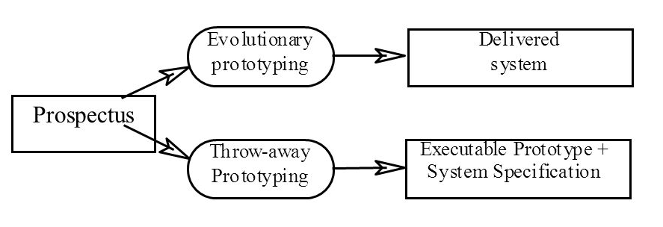
Prototyping Approaches
Source: http://images.slideplayer.com/16/5069771/slides/slide_54.jpg

Slide 17
Prototyping Approaches
The objective of evolutionary prototyping is to deliver a working system to end-users
  The development starts with those requirements which are best understood.
The objective of throw-away prototyping is to validate or derive the system requirements
  The prototyping process starts with those requirements which are poorly understood.

Slide 18
Evolutionary Prototyping
Source: http://images.slideplayer.com/16/5069771/slides/slide_56.jpg

Slide 19
Evolutionary Prototyping
Must be used for systems where the requirements specification cannot be developed in advance
Based on techniques which allow rapid system iterations
Verification is impossible as there is no specification
Validation means demonstrating the adequacy of the system

Slide 20
Evolutionary Prototyping
Advantages
Challenges
Technologies

Slide 21
Incremental Prototyping
Source: http://images.slideplayer.com/16/5069771/slides/slide_56.jpg

Slide 22
Incremental Prototyping
System is developed and delivered in increments after establishing an overall architecture
Requirements and specifications for each increment may be developed
Users may experiment with delivered increments while others are being developed
Intended to combine some of the advantages of prototyping
  More manageable process
  Better system structure

Slide 23
Incremental Prototyping
Advantages
Challenges
Technologies
Source: http://images.slideplayer.com/16/5069771/slides/slide_56.jpg

Slide 24
Throw-away Prototyping
Source: http://images.slideplayer.com/16/5069771/slides/slide_56.jpg

Slide 25
Throw-away Prototyping
Used to reduce requirements risk
The prototype is developed from an initial specification, delivered for experiment then discarded
The throw-away prototype must NOT be considered as a final system
  Some system characteristics may have been left out
  There is no specification for long-term maintenance
  The system will be poorly structured and difficult to maintain

Slide 26
Throw-away Prototyping
Advantages
Challenges
Technologies
Source: http://images.slideplayer.com/16/5069771/slides/slide_56.jpg

Slide 27
Recommended Reading
SlidePlayer, (2015). CS 551 – Requirements and Prototyping Thanks to Rand Edwards and Ian Summerville for this material. [online] Available at: http://slideplayer.com/slide/5069771/ [Accessed 12 Oct. 2015].
Wikipedia, (2015). Software prototyping. [online] Available at: https://en.wikipedia.org/wiki/Software_prototyping [Accessed 12 Oct. 2015].
Google…

