Slide 2
System Analysis and Design
Lecture 4

Slide 3
Agenda
Previous lecture recap
Structured Systems Analysis and Design Methodology (SSADM)
Systems Development Life Cycle (SDLC)
Recommended reading

Slide 4
Recap
Major categories
What are the steps in Waterfall methodology?
When would you consider using Waterfall methodology?
When would you NOT consider using Waterfall methodology?
  Projects that have clearly defined final product.
  Stable and clear requirements i.e. requirements do not change.
  Clearly defined and fixed scope.
  Large scale project. For small projects it is not as effective.

Slide 5
Structured Systems Analysis and
Design Methodology (SSADM)

Slide 6
Major Software Development Models
There a many Software Development Models with their strengths and weaknesses. But, they can be categorized into 3 major categories:
  Waterfall – Structured, top/down approach.
  Examples: Waterfall, Structured System Analysis and Development Methodology (SSADM).
  Iterative & Incremental – Iteratively go through important software development “steps” (analysis, design, build, etc.) and incrementally build the system.
  Examples: Spiral, RAD, Agile, etc.
  Prototyping – Build prototypes, get feedback, refine. Once get the final version – build the software and deploy.
  Examples: RAD, Prototyping.

Slide 7
SSADM
SSADM is a Waterfall methodology for Information Systems (IS).
It has the same “features” and follows the same ideas as Waterfall methodology:
  Structured
  Step-by-step
  Heavily promotes documentation
  Upfront planning and design
  Etc.
SSADM was rebranded as “Business System Development” in 2000.

Slide 8
SSADM Stages
Feasibility
Investigation of the current environment
Business systems options
Definition of requirements
Technical system options
Logical design
Physical design

Slide 9
Stage 1: Feasibility
In order to understand if a given project is feasible, you need to do a feasibility analysis.
There can be different feasibility analysis:
  No feasibility – for small projects, where the environment is well understood and no need for feasibility analysis is required.
  Informal – when the project doesn’t have enough time or resources to spend and it does not require documenting feasibility process.
  Formal – you talk to users, identify business needs, problems, requirements and document it all in feasibility analysis report. This usually requires you to do initial requirements gathering.

Slide 10
Stage 1: Feasibility
Concentrate on these areas:
  Technical – Is this project technically possible?
  Financial – Can the business effort it? Hardware, software, licenses, salaries for new staff, etc.
  Organizational – Will the organization adopt the new system? Is an organization willing to change/reorganize?
  Ethical – Will the final product raise ethical issues?
Also, don’t forget to also document the unfeasible/rejected solutions/versions of the project.

Slide 11
Stage 2: Investigate current env
One of the most important stages. This helps the system analyst to understand the current user needs and problems.
There are different techniques that you may employ:
  Current system analysis
  Read documentation
  Interview
  Questionnaires
  Surveys
  Etc. (we will talk more about these techniques in separate lecture)

Slide 12
Stage 3: Business system options
Equipped with the understanding of the current system in Stage 2, System Analyst tries to generate different “options” of the new system.
Possible options:
  Don’t do anything, leave the old system, everything is great
  Leave the old system, change business/operational rules
  Improve the existing system
  …
  At the very end – create a new system from scratch.

Slide 13
Stage 3: Business system options
You should try to get as many ideas and options as you can.
Compile several “options” taking into the consideration all the information you gathered in previous stages.
  Can the business afford this option?
  Will it suite the organization?
  Will users use it?
  What changes have to be made in organization?
  Etc.
The product of this stage is (a single) chosen option.

Slide 14
Stage 4: Definition of requirements
Defines concrete, unambiguous and concise system requirements.
At this stage you should produce:
  Logical Data Model – what the system will do, not how.
  Data Flow Diagram – what data is essential and its’ relations.
  Entity Event Model – what are system actions and how they change the data in it?

Slide 15
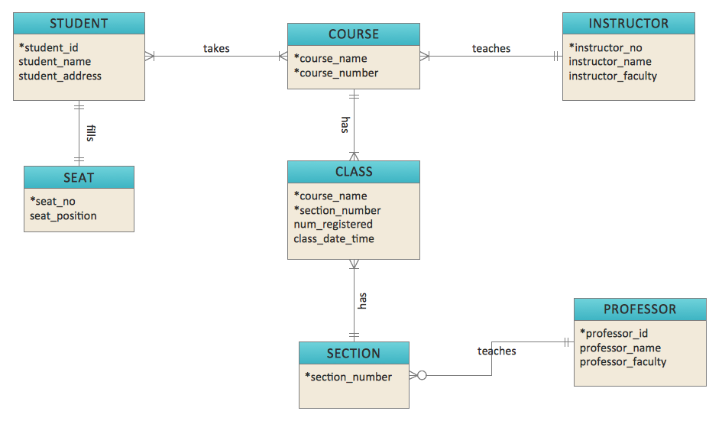
Stage 4: Definition of requirements
Logical Data Model Example:
http://www.conceptdraw.com/solution-park/resource/images/solutions/entity-relationship-diagram-(erd)/Diagramming-Crow's-Foot-ERD-Sample60.png

Slide 16
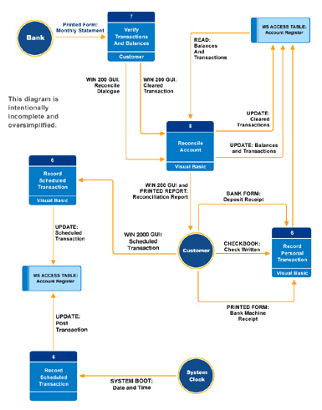
Stage 4: Definition of requirements
Data Flow Diagram Example:
http://www.jscgroup.com/images/ch-426-s.jpg

Slide 17
Stage 5: Technical system options
As in “Business system option” stage, you try to come up with several options to implement the new system. But, this time it is about technical aspects of the system.
At the end, you would decide which “option” will be used.

Slide 18
Stage 5: Technical system options
You might want to consider:
  What software will you use?
  What programming language?
  Hardware architecture
  Network architecture
  The cost of an option
  Etc.

Slide 19
Stage 6: Logical Design
This step identifies and produces the specification on how users will interact with the system.
In practice this means User Interface (UI).
What techniques can you use at this stage?

Slide 20
Stage 7: Physical design
The final stage, where the system is physically implemented.
Uses Logical Design stage outputs as an input. UI elements inherently contain business requirements defined in earlier stages.
Output is the working system.

Slide 21
Systems Development Life Cycle (SDLC)
Homework

Slide 22
Why learn SDLC?
It has defined all required steps in IS development process and put them in the right sequence.
It shows you what steps an IS development should have. Depending on your project context and requirements you may give more emphasis to one or another step.
It gives you a good basis for evaluating and comparing other methodologies.
It is a well known and still used methodology (especially in the UK).

Slide 23
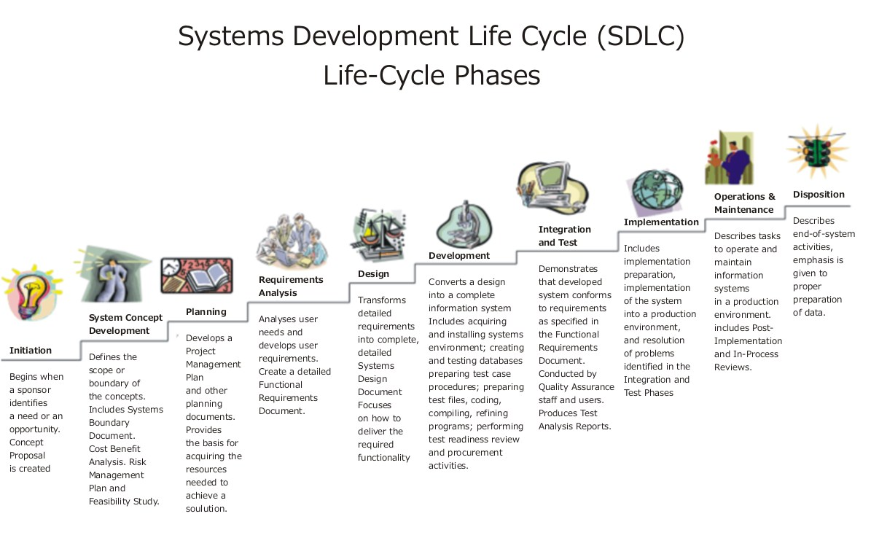
SDLC Stages
"Systems Development Life Cycle" by US Department of Justice (redrawn by Eugene Vincent Tantog) - INFORMATION RESOURCES MANAGEMENT.
Licensed under Public Domain via Commons - https://commons.wikimedia.org/wiki/File:Systems_Development_Life_Cycle.jpg#/media/File:Systems_Development_Life_Cycle.jpg

Slide 24
Recommended Reading
Wikipedia, (2015). Software development process. [online] Available at: https://en.wikipedia.org/wiki/Software_development_process [Accessed 2 Oct. 2015].
Wikipedia, (2015). Software development process. [online] Available at: https://en.wikipedia.org/wiki/Software_development_process [Accessed 2 Oct. 2015].
Booch, G., Maksimchuk, R., Engle, M., Young, B., Conallen, J. and Houston, K. (2007). Object-oriented analysis and design with applications. 2nd ed. Upper Saddle River, NJ: Addison-Wesley.
Google…

