Slide 2
System Analysis and Design
Lecture 3

Slide 3
Agenda
Previous lecture recap
Major Software Development Models / Categories
  Waterfall (structured, top/down)
  Iterative & Incremental (spiral)
  Prototyping
Methodologies & Frameworks (Kanban, Scrum, TDD, BDD, etc.)
Available tools (if we have enough time)
Waterfall model
Recommended reading

Slide 4
Recap
What qualities should requirements have? (ex: not vague)
List all requirement types.
What stages requirement gathering process has?

Slide 5
Major Software Development Models
There a many Software Development Models with their strengths and weaknesses. But, they can be categorized into 3 major categories:
  Waterfall – Structured, top/down approach.
  Examples: Waterfall, Structured Software Development Methodology (SSDM).
  Iterative & Incremental – Iteratively go through important software development “steps” (analysis, design, build, etc.) and incrementally build the system.
  Examples: Spiral, RAD, Agile, etc.
  Prototyping – Build prototypes, get feedback, refine. Once get the final version – build the software and deploy.
  Examples: RAD, Prototyping.

Slide 6
Approach: Waterfall
The waterfall model is a sequential design process,
used in software development processes, in which
progress is seen as flowing steadily downwards (like a waterfall) through the phases of:
  Conception
  Initiation
  Analysis
  Design
  Construction
  Testing
  Production/implementation
  Maintenance
Waterfall model, accessed 02 October 2015, <https://en.wikipedia.org/wiki/Waterfall_model>.

Slide 7
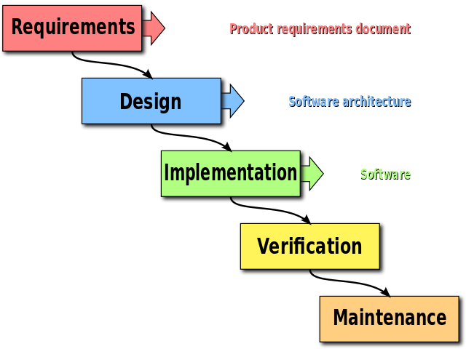
Approach: Waterfall
"Waterfall model" by Peter Kemp / Paul Smith - Adapted from Paul Smith's work at wikipedia.
Licensed under CC BY 3.0 via Commons - https://commons.wikimedia.org/wiki/File:Waterfall_model.svg#/media/File:Waterfall_model.svg

Slide 8
Approach: Iterative & Incremental
Instead of planning everything upfront, Iterative & Incremental approaches to software development utilize unique features of software.
Compared to other “products” in construction or manufacturing, software is easier and cheaper to change at later stages.
However, never forget, that it is always more expensive to change any product in later stages of development.
And the approaches and methodologies that we will learn, will help us reduce these risks (related to cost, time, resources, etc.) and help us increase our project success probability.

Slide 9
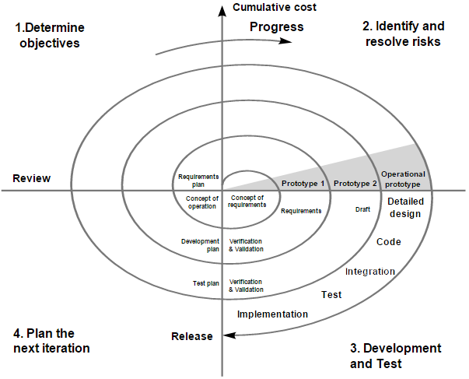
Approach: Iterative & Incremental - Spiral
"Spiral model (Boehm, 1988)" by Connyderivative work: Spiral_model_(Boehm,_1988).png: Marctroyderivative work: Conan (talk) File:Spiralmodel_nach_Boehm.png,
Spiral_model_(Boehm,_1988).png. Licensed under Public Domain via Commons - https://commons.wikimedia.org/wiki/File:Spiral_model_(Boehm,_1988).svg#/media/File:Spiral_model_(Boehm,_1988).svg

Slide 10
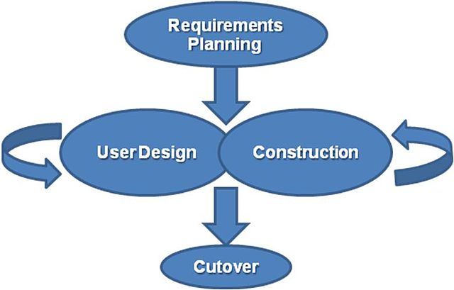
Approach: Iterative & Incremental - RAD
"RADModel" by Karenjoy toletol - Own work. Licensed under Public Domain via Commons - https://commons.wikimedia.org/wiki/File:RADModel.JPG#/media/File:RADModel.JPG

Slide 11
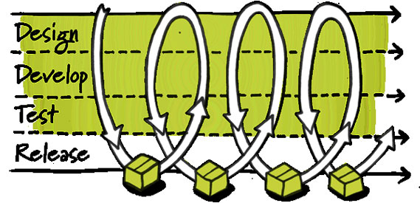
Approach: Iterative & Incremental - Agile
Jason Oh, Essential Resources, Services & Technologies for Your Startup. Accessed on 2 October 2015. <https://www.linkedin.com/pulse/essential-resources-services-technologies-your-startup-jason-oh>

Slide 12
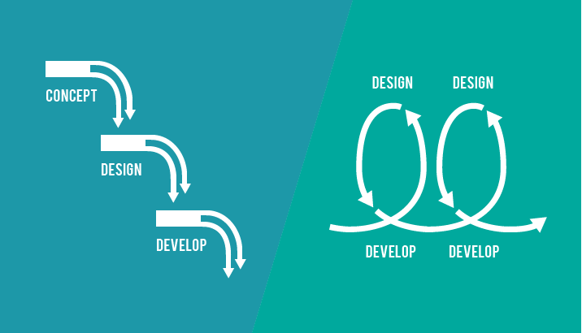
Difference – Structured vs. Iterative
Luke Clum, Understanding Agile Design and Why It’s Important. Accessed 02 October 2015, <http://designshack.net/articles/business-articles/understanding-agile-design-and-why-its-important/>.

Slide 13
Approach: Prototyping
It is hard to collect project requirements correctly right the first time.
Different approaches and methodologies of software development try to deal with this problem differently.
Some spend substantial time and resources to get it the first time (structured).
Some break down the project into smaller parts and iterate through them (iterative).
And, others try to solve it by showing the final user prototypes and get their feedback (prototyping).
Anything can be considered a prototype, working or not. For example: drawing, working software, video, HTML version of a desktop app.

Slide 14
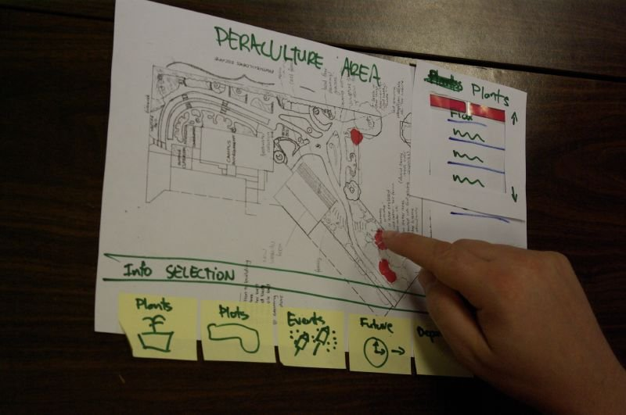
Approach: Prototyping - Prototyping
"ELiving Campus Paper Prototype 2" by Samuel Mann - originally posted to Flickr as eLiving Campus Paper prototype.
Licensed under CC BY 2.0 via Commons - https://commons.wikimedia.org/wiki/File:ELiving_Campus_Paper_Prototype_2.jpg#/media/File:ELiving_Campus_Paper_Prototype_2.jpg

Slide 15
Approaches
We will go though all of these and other methodologies available to you.
We will learn what problems each methodology solves, their strengths and weaknesses in different contexts, advantages and disadvantages.
Basically, when to use specific methodology and when not to!

Slide 16
Methodologies we will cover
Structural:
  Waterfall
  Structured Software Development Methodology (SSDM)
Iterative and Incremental (many Agile methodologies):
  Rapid Application Methodology (RAD)
  Spiral
  eXtreme Programming (EX)
  Scrum
  Etc.
Prototyping:
  Prototyping

Slide 17
Tools

Slide 18
Waterfall methodology

Slide 19
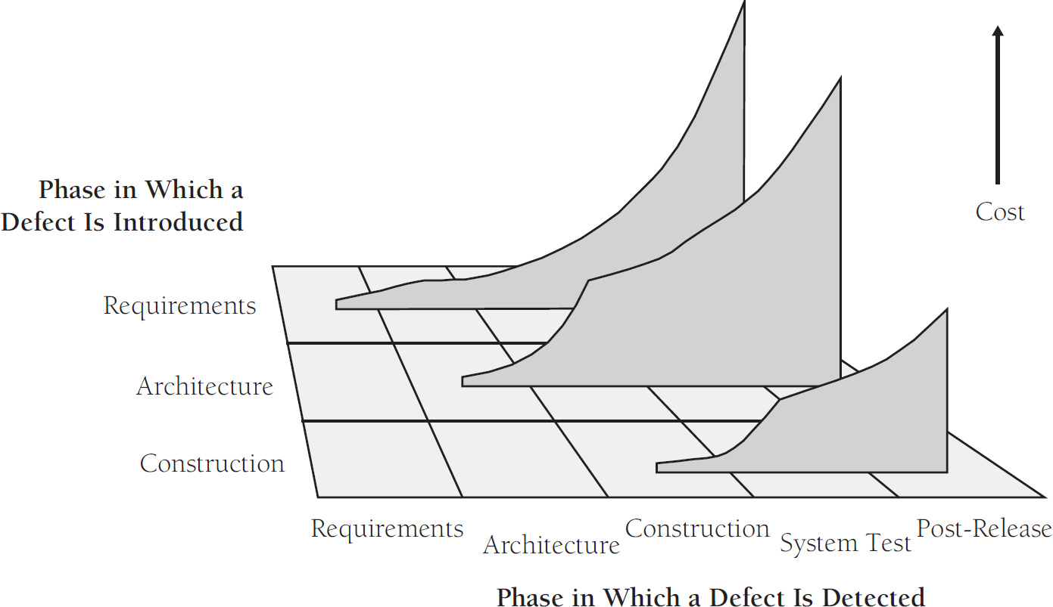
Waterfall Model

Slide 20
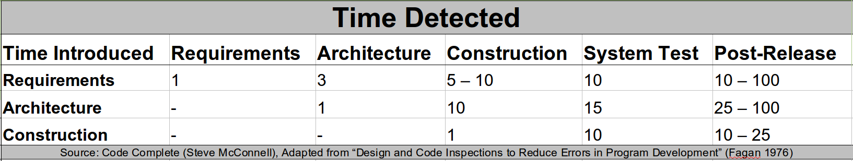
Waterfall Model

Slide 21
Waterfall Model
The waterfall model is a sequential design process, used in software development processes, in which progress is seen as flowing steadily downwards (like a waterfall) through the phases of conception, initiation, analysis, design, construction, testing, production/implementation and maintenance.
The waterfall development model originates in the manufacturing and construction industries: highly structured physical environments in which after-the-fact changes are prohibitively costly, if not impossible. Since no formal software development methodologies existed at the time, this hardware-oriented model was simply adapted for software development.
Waterfall model, accessed 02 October 2015, <https://en.wikipedia.org/wiki/Waterfall_model>.
Benington, Herbert D. (1983). "Production of Large Computer Programs" (PDF). IEEE Annals of the History of Computing.

Slide 22
Visual presentation
"Waterfall model" by Peter Kemp / Paul Smith - Adapted from Paul Smith's work at wikipedia.
Licensed under CC BY 3.0 via Commons - https://commons.wikimedia.org/wiki/File:Waterfall_model.svg#/media/File:Waterfall_model.svg

Slide 23
Problems it solves
Each step has an input and output.
A step’s input is an output of the previous step.
What problems does it address?
  Changing project later on is costly. Tens or hundreds of times costly. That’s why we need to spend time and resources to get them right at very first step.
  People may leave your team. They may be the carriers of the project related knowledge. That’s why you need to document everything in a standard way.
  Gives concrete steps, that are easy to understand. Everyone knows at what phase the project is, and is the main goal at the moment – synergy.

Slide 24
When to use it?
  Projects that have clearly defined final product.
  Stable and clear requirements i.e. requirements do not change.
  Clearly defined and fixed scope.
  Large scale project. For small projects it is not as effective.
  What else do you think?

Slide 25
Advantages & Disadvantages
From what you have heard so far…
What are the advantages of Waterfall methodology?
We will introduce disadvantages of the model, while introducing other methodologies. Usually, a new methodology is trying to solve specific problem in or that was not addressed in some methodology.

Slide 26
Recommended Reading
Wikipedia, (2015). Software development process. [online] Available at: https://en.wikipedia.org/wiki/Software_development_process [Accessed 2 Oct. 2015].
Wikipedia, (2015). Software development process. [online] Available at: https://en.wikipedia.org/wiki/Software_development_process [Accessed 2 Oct. 2015].
Booch, G., Maksimchuk, R., Engle, M., Young, B., Conallen, J. and Houston, K. (2007). Object-oriented analysis and design with applications. 2nd ed. Upper Saddle River, NJ: Addison-Wesley.
Google…

