Slide 2
System Analysis and Design
Lecture 3

Slide 3
Agenda
Previous lecture recap
Requirements definition
Requirement types
Requirement gathering process
Recommended reading

Slide 4
Recap
What the SAD module is all about?
What are the main duties of System Analyst?
What is a current situation with System Analysts in our local market?
Are most of IT projects successful or a failure?

Slide 5
Requirements &
Requirements Gathering

Slide 6
What is a requirement?
Something that the product must do or a quality that the product must have.
  Functional requirements – are things the product must do.
  Examples: Ability to create a new blog post, edit existing posts, allow users to login, etc.
  Non-functional requirements – are the qualities the product must have.
  Examples: Prevailing color must be our corporate color, website should be able to process 100 concurrent users, interface must be easy to use, etc.
  Constraints – are global issues that shape the requirements.
  Examples: Must be available in TAS-IX only, product must comply with ISO XXXX standard, legal constraints, etc.
NOTE: Collected/documented requirements must be unambiguous and non-vague.

Slide 7
Requirement types
Functional
Non-functional (Constraints are non-functional requirements)

Slide 8
Functional Requirements
Specifications of the product’s functionality
Actions the product must take – check, calculate, record, retrieve
Derived from the fundamental purpose of the product
Not a quality
Can you think of an example?

Slide 9
Non-functional requirements
Look and Feel – the spirit of the product’s appearance
Usability – the product’s ease to use, and any special usability considerations
Performance – the operating environment of the product, and what considerations must be made for this environment
Operational – the operating environment of the product, and what considerations must be made for this environment
Can you think of an example?

Slide 10
Non-functional requirements
Maintainability and Portability – expected changes and the time allowed to make them
Security – the security and confidentiality of the product
Cultural and Political – special requirements that come about because of the people involved in the product’s development and operation
Legal – what laws and standards apply to the product.
Can you think of an example?

Slide 11
Requirements Gathering Process

Slide 12
Requirements Gathering Process
Project Blastoff
Trawling for Knowledge
Prototyping and scenario modelling
Writing them down
Quality Gateway
Reusing requirements
Taking Stock of the specification
Post Mortem
Tailoring your process

Slide 13
1. Project Blast-off
Is a short burst of activity that puts together all the pieces that are necessary to get your project off to flying start and to ensure that your project is viable and well founded.
Determines the precise purpose that the product is to fulfil.
Deliverables:
Purpose of the project The client The customer The stakeholders The users Names | Constraints Relevant facts and assumptions The scope of the work The estimated cost The risks

Slide 14
2. Trawling for Knowledge
Studying the work that is currently done in response to a business event.
Learning the desires and aspirations of the adjacent systems involved in the business event.
Determining the best response that the organization can make to the business event.
Determining the way that the product will contribute to the desired response.
Determining and describing the requirements for the product.

Slide 15
3. Prototyping & scenario modelling
The purpose of the prototype is to simulate aspects of the product and to make it real enough to help users think of requirements that might otherwise be missed.
Scenario modelling is used to illustrate a situation. Contains a number of scenes or episodes that tell a detailed story of a specific situation.

Slide 16
4. Writing down
The process of documenting the requirements.
Does not have to be “officially” documented. As far as it is clear and easy to understand.

Slide 17
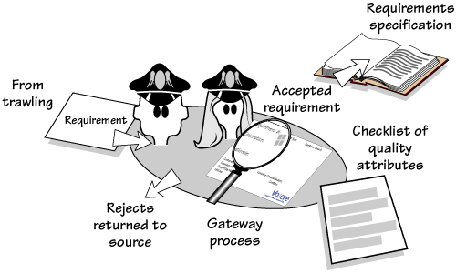
5. Quality Gateway
The process of filtering out non-feasible, incorrect or any requirement that does not fit your definition of quality requirement.
Robertson, J. and Robertson, S (2012). Mastering the Requirements Process. Addison-Wesley.

Slide 18
6. Reusing requirements
Entails making use of requirements that have been written for other projects.
They can come from a number of sources:
  a reuse library of specifications
  other requirements specifications that are similar or in the same domain
  informally from other people’s experience.

Slide 19
7. Taking stock of the specification
Considers all of the requirements and their effect on each.
The objective of the stock-take is to review the specification and find requirements that are:
  Missing
  Conflicting
  Ambiguous

Slide 20
8. Post Mortem
Self-reflection and post mortem analysis.
Questions you might want to ask:
  What did we do right?
  What did we do wrong?
  If we had to do it again, what would you do differently?

Slide 21
9. Tailoring your process
Once you understand the content and purpose of each deliverable, ask how each one would best be produced within your project environment using your sources.
The tailoring task is determining how your project will produce them.

Slide 22
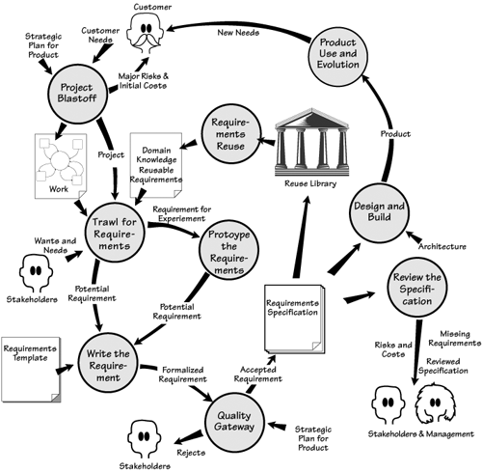
Visualizing Requirements Gathering
Robertson, J. and Robertson, S (2012). Mastering the Requirements Process. Addison-Wesley.

Slide 23
Requirements Quality Check

Slide 24
Can developer develop the feature just from reading my requirements and without contacting anyone else?

Slide 25
Recommended Reading
Robertson, S. and Robertson, J. (2013). Mastering the requirements process. Upper Saddle River, NJ: Addison-Wesley.
Wikipedia, (2015). Requirements analysis. [online] Available at: https://en.wikipedia.org/wiki/Requirements_analysis [Accessed 19 Oct. 2015].
Wikipedia, (2015). Software requirements specification. [online] Available at: https://en.wikipedia.org/wiki/Software_requirements_specification [Accessed 19 Oct. 2015].
Google…

