Slide 2
System Analysis and Design
Lecture 1

Slide 3
Agenda
Essential module information
Module assessment
Module outline
What is System Analysis & Design and Why do you need it?
Recommended reading

Slide 4
Essential Module Information
Module information
  Core module (You need to pass it to progress)
  Year long module (Semester 1 + Semester 2)
Module leaders:
  Semester 1: Said Abduvaliev
  Semester 2: TBA
Said Abduvaliev
  Email: sabduvaliev@wiut.uz
  Office hours: Thursdays, 17:00 – 18:00, Room ATB 102 (Blue room)

Slide 5
Module Assessment
Semester 1:
Coursework 1 – (50% of total) divided into 2 components
  Component 1 (30%) – group work
  Component 2 (20%) – individual
Semester 2:
Coursework 2 – 20% of total
Coursework 3 – 30% of total

Slide 6
Module Assessment
Coursework 1 stats:
  Average – 65
  Highest – 81
  Lowest – 43

Slide 7
Module outline
There are 8 lectures and tutorials (20 credit year long module)
Outline
  Information Systems
  Methodologies and frameworks
  Tools
  Techniques
  Programming perspective
  Object-oriented analysis and design
  BTW, nothing related to graphical design (Adobe Photoshop © :)

Slide 8
What is System Analysis & Design?
What do you think the following terms are?
  System (You’ve learnt it in detail in your DANIM module)
  Analysis => System Analysis
  Design => System Design, Software Design
What does “System Analyst” do?

Slide 9
What is an Information System?
A system has nine characteristics:
  Components/Subsystems
  Interrelated components
  A boundary
  A purpose
  An environment
  Interfaces
  Input
  Output
  Constraints
We will learn how to effectively analyze and document all the processes and requirements in the organization using different methodologies and tools.

Slide 10
What is System Analysis & Design?
What do you think the following terms are?
  System (You will learn it in more detail in your DANIM module)
  Analysis => System Analysis
  Design => System Design, Software Design
What does “System Analyst” do?

Slide 11
System analyst
A systems analyst studies the problems and needs of an organization to determine how people, data, processes, communications, and information technology can best accomplish improvements for the business. When information technology is used, the analyst is responsible for:
  Efficient capture of data from business source
  Flow of data to the computer
  Processing and storage of data by computer
  Flow of useful and timely information back to the business and its people

Slide 12
System Analyst Roles
Mediator or a bridge between business and “IT”
Social investigation
Understand and interpret business needs
System design
Communicating with clients, users, technical people
Sometimes Analyst is a Developer

Slide 13
System Analysts in Uzbekistan
IT market is developing very rapidly.
  Local
  International
High rate of project failure
  User requirements not understood
  Rejected by client/user
  High cost of maintenance/changes
  Over time
  Over budget
  No business benefit
Salaries and duties

Slide 14
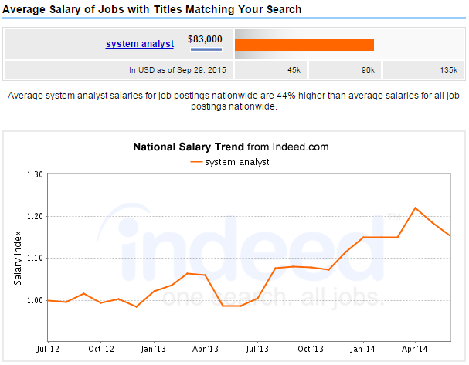
http://www.indeed.com

Slide 15
Recommended Reading
Booch, G., Maksimchuk, R., Engle, M., Young, B., Conallen, J. and Houston, K. (2007). Object-oriented analysis and design with applications. 2nd ed. Upper Saddle River, NJ: Addison-Wesley.
Fowler, M. (2004). UML distilled. 3rd ed. Boston: Addison-Wesley.
Beck, K. and Andres, C. (2000). Extreme programming eXplained. 2nd ed. Reading, MA: Addison-Wesley.

