Slide 1
Business Communication:
.
Presentation on:
Chap 3: Perception and Reality
Chap 4: The Filter of the Mind

Slide 2
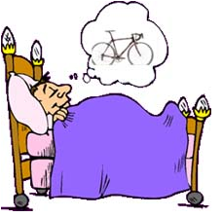
Perception and Reality
Reality is all that actually exists – whether our senses can perceive it or not, and not what exists only in our minds
Perception is the process of using the senses to acquire information about the surrounding environment or situation.

Slide 3
Four Aspects of Reality
Reality with Substance
- Things with physical shape and composition
Reality without Substance
- Elements without physical shape and composition
The reality of Events
- Changes of relationship among parts of reality
Position Relationships
- Everything must have a spatial relationship with other
things in reality

Slide 4
Three characteristics of Reality
The infinity of reality
Uniqueness in Everything
All in Process

Slide 5


The Infinity of Reality
It is humanly impossible to know all the facts encompassing any one object
Microscopic View
Normal View

Slide 6




The infinity of reality
Any object or event can be perceived in many different ways
I saw a house
that I want to buy
I see what
you mean

Slide 7
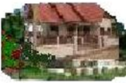
The infinity of reality
… with a lovely
lawn, a porch,
etc…
I see what
you mean
The receiver gets a clearer picture

Slide 8
Application in BC
It is important to recognize that other party of the communication does not detect the same features of what we communicated about
Acknowledgement about not mentioning all
Use of “etc” after all statement

Slide 9

Uniqueness in Everything
Every particle of sand is unique

Slide 10
All in Process
We forget that all objects in reality continuously change
We cannot step into the same river twice

Slide 11

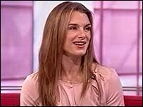
All in Process
Our minds and tastes change
Brook Shields₁₉₉₀
Brook Shields₂₀₀₀

Slide 12
All in Process
The Realities change

Slide 13
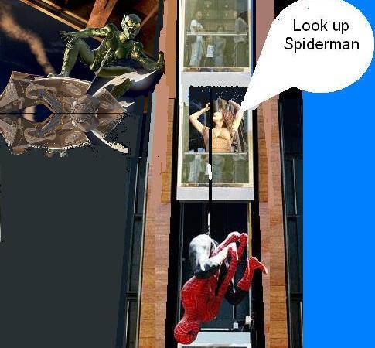
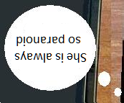
Perception due to relativity of Position
Look up Spiderman!

Slide 14
Application in
Business Communication
Alfred Korzybski has suggested dating all references to people and things with date subscripts
Because of its unique nature, we must emphasize on the differences in realities rather than similarities
It is important that we keep the relative position in mind

Slide 15
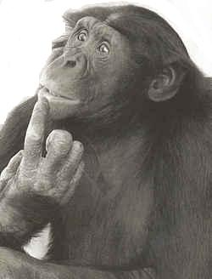

Truth and Reality
Real World is very complex to know anything for certain
How can you be so sure?
Believe me it’s the truth

Slide 16
The Filter of the Mind
A storehouse of knowledge
The Role of Opinions, Attitudes, and Beliefs
The Influence of Emotions

Slide 17

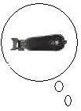
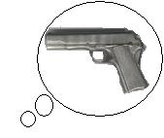

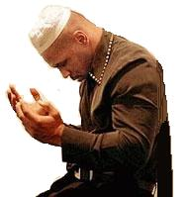
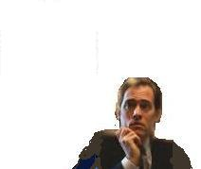
A storehouse of Knowledge
Knowledge stored in the mind at the time influences how we perceive the information

Slide 18
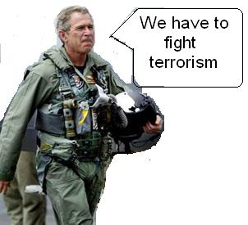
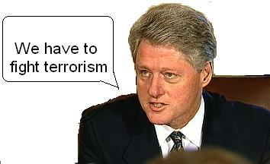

The Role of
Opinions, Attitudes & Beliefs
Opinions, attitudes and beliefs are basically our viewpoints about the reality that surrounds us
They vary in intensity, opinions being of lowest and beliefs being of highest

Slide 19
The Influence of Emotions
Emotions are essential
Emotions cannot be stopped, they can only be controlled
Our emotions determine the meaning of our perceptions

Slide 20


Our Emotions determine Meaning
She Likes
Me
Nice shirt Garfield
Me
Garfield is in a GOOD mood

Slide 21
Our Emotions determine Meaning
Nice shirt Garfield
Very
Funny
Garfield is in a BAD mood

Slide 22
The Filter Summarized
Knowledge, viewpoints and emotional state determine whether the incoming emotions are accepted or rejected
The three factors are forever changing and their content at the precise moment of information perception determines its meaning

Slide 23
Questions
What is reality? What are its types? Explain.
What is perception? Why and how does it differ from person to person?
What are some defining features of reality?
Explain mental filter and its role .

Slide 24

Thank You

