Slide 1
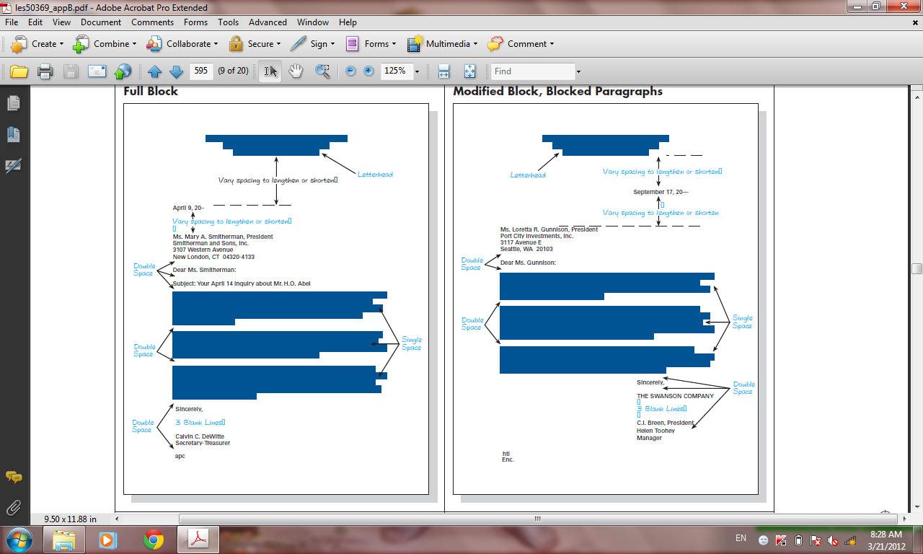

Slide 2
Your Present Address
City, Street, Zip Code
Date:
Name of Person, title
Organization Name
Address
Dear Mr. / Ms. / Last Name:
Subject: ……………………………………………………………………………………………………………
Describe ……………..a good fit in the organization and the field…… Also, offer a brief statement demonstrating specific knowledge of the company to which you are applying.
Use this……………….are most relevant. If you have related experience or specialized training, or specialized training, briefly mention it here. Think about all the transferrable s…………………….. volunteer experiences, campus activities, and research. Briefly summarize how those experiences are relevant to the position.
Refer the …………….employer to your resume for further details about your experiences and qualifications. Reiterate why you want to work at that specific company. …………………how you plan on following up on the submission of your cover letter.
Sincerely:
Name, title

