Slide 1
Nonverbal
Communication

Slide 2
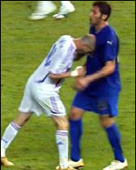
Action Speaks Louder than Words!!
ZIDANE
He’s probably very angry.

Slide 3
Nonverbal
Communication
All kinds of human messages/responses expressed without using words
Expressed both consciously and unconsciously

Slide 4
Types of Nonverbal
Communication
1. Kinesics
2. Paralanguage
3.Proxemics
4. time language
5. Physical context

Slide 5
Kinesics
Body language or kinesics:
- Body Movement
- Gestures
- Posture
- Facial Expressions
- Eye Contact
- body shape( ectomorph- thin and tall, endomorph, mesomorph
“Communication depends heavily on the actions, postures, movements and expression of our bodies“ – by Desmond Morris(1979).
Walzlawick wrote: You can not not communicate.

Slide 6

Be Aware About Your Body Language
In spite of your intelligence you may not get a job.
Even though you are not a best scorer, you may get a good job by your nonverbal behavior

Slide 7
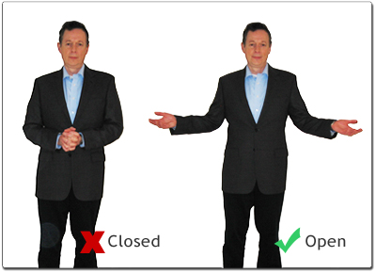
Before people started speaking languages.
Gestures were the only medium of communication & of revealing one’s intensions

Slide 8
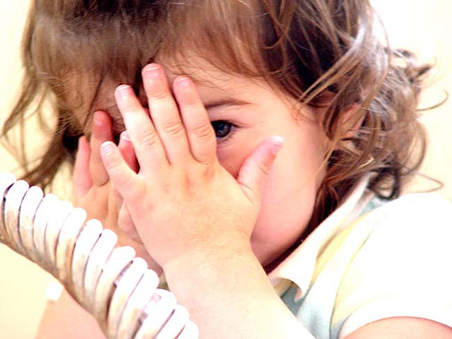
Gestures may not be inborn as crying , shouting etc.
Some gestures however are genetic; where as some are learnt and few are related to one’s culture

Slide 9
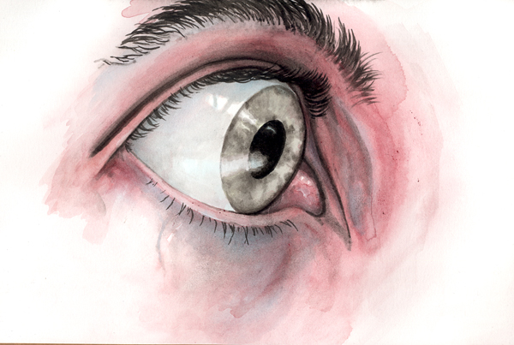
Fear

Slide 10
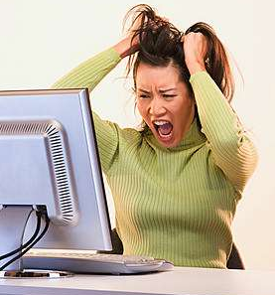
Anger

Slide 11
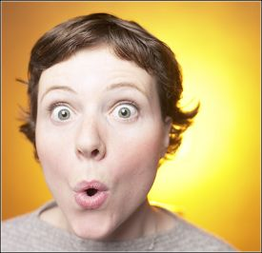
Surprise

Slide 12

Happiness

Slide 13
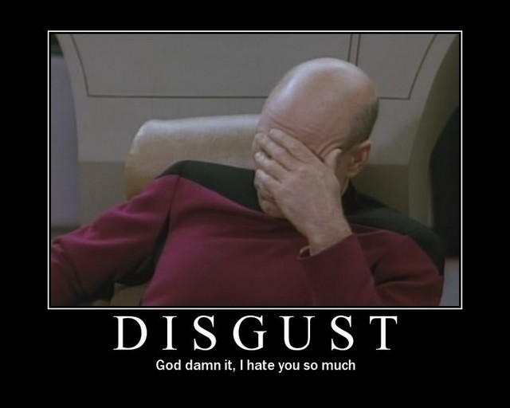
Disgust

Slide 14
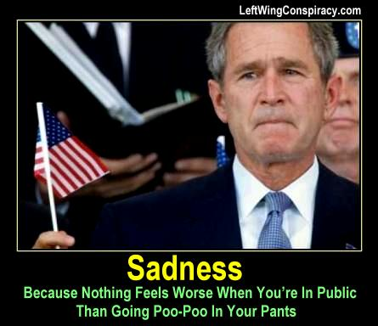
Sadness

Slide 15
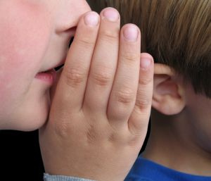
Telling a Lie

Slide 16
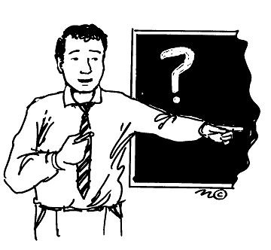
Attention

Slide 17

Fear or Frustration

Slide 18
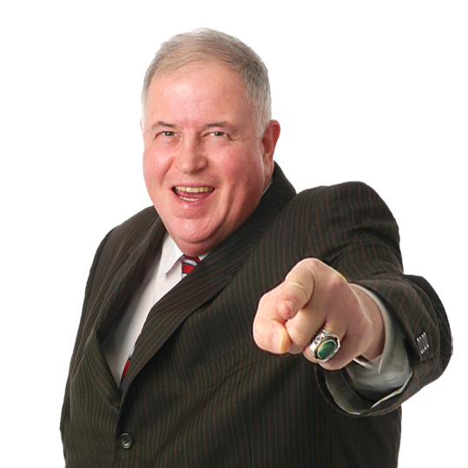
Winning Face

Slide 19
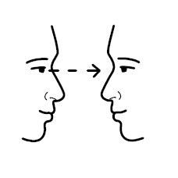
Eye Contact

Slide 20
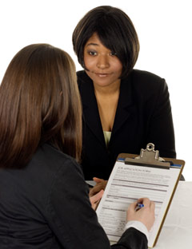
Eyes which can find out the behavior

Slide 21
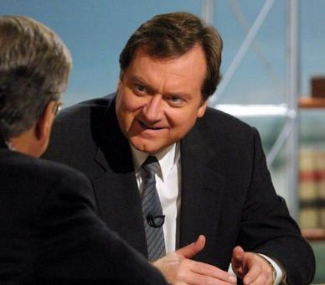

Slide 22

Eye is the window of the mind

Slide 23
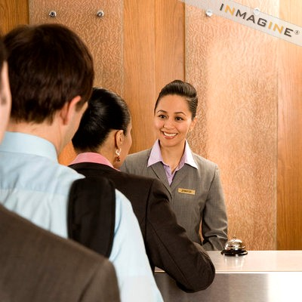
Maintaining good eye contact shows respect and interest in what they have to say.

Slide 24
• Western cultures — see direct eye to eye contact as positive (advise children to look a person in the eyes). But within USA, African-Americans use more eye contact when talking and less when listening.
• Nepal, Japan, Africa, Latin American, Caribbean avoid eye contact to show respect.

Slide 25
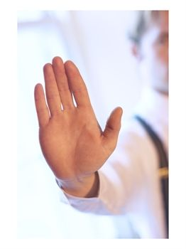
Palm facing down indicates
Telling some body to sit down
or
stopping some body

Slide 26
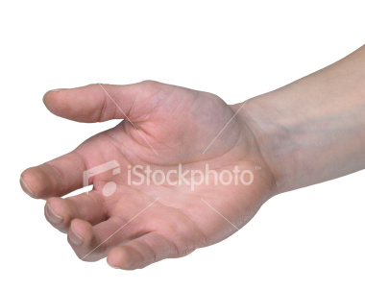

Facing down position
(request with authority )
Facing up position
(gesture of submission)

Slide 27

Equality

Slide 28
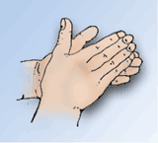
When a person rubs his palms together he is communicating something positive
News of success
Cheerful

Slide 29
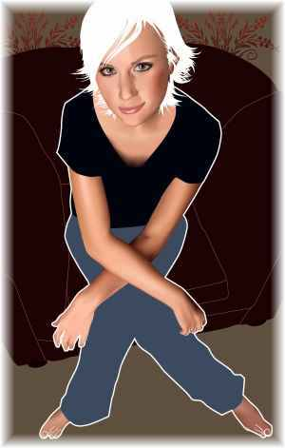
If a person Sits back , crosses her arms and legs, it is definite that her decision is negative

Slide 30

Gripping arms around the body tightly indicates
…the person is waiting for a call or anxious to know a thing that is unfamiliar

Slide 31

Folding arms indicates the social status also
Boss intends to speak to his juniors

Slide 32
2. Time language
• The study of our use of time
Ancient cultures have established their own system in measuring time which differs from one to another.
Example :
Muslims use moon-based calendar system.
The usage of time varies from culture to culture.
Example :
  Arabs engage in up to half an hour of informal conversation before turning to business.

Slide 33
3. Paralanguage(like language)
Paralanguage include the following:
- Vocal characterizers such as laughter and sobs.
- Vocal qualifiers, such as intensity(loud/soft), pitch (high/low), extent (clipping).
- Vocal segregates, such as “Uh“, “Um“ and “ Uh-huh“.
Examples:
• Loudness indicates strength in Arabic cultures, indicates confidence and authority to the Germans and softness indicates weakness;
• But it is opposite to Asian culture. Loudness indicates impoliteness to the Nepalese/Thais indicates loss of control to the Japanese. Generally, one learns not to “shout” in Asia for nearly any reason.
• Gender based as well: women tend to speak higher and more softly than men.

Slide 34
4. Proxemics
The study of our use of personal distance is proxemics.
“Cultures differ substantially in their use of personal space” – Edward Hall (1959).

Slide 35
Proxemics …
 | Distance | Description | Voice
Intimate | Touching to 18 inches | Private situation with people who are emotionally Close. | whisper
Personal | 18 inches to 4 feet | Handshake Distance. | Soft voice
Social | 4 to 12 feet | Distance between customers and people. | Full voice
Public | 12 feet | Teacher in a classroom. | voice

Slide 36
5. Physical Context
–.
How color, lay out , design etc. communicate
Color: it can project certain mood or feeling
Black, grey- negative
Blue, yellow- pleasant
Lay out and design
Carpeting, arrangement of desk and bench, office size, design etc. communicate a lot.
Pnyx
Agora

Slide 37
Nonverbal Issues and
Misinterpretation
Nonverbal communication is pervasive
Nonverbal actions and their different meaning due to cultural differences.

Slide 38
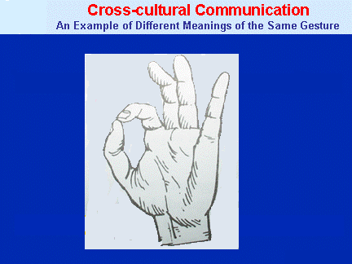
USA=OK
JAPAN=MONEY
RUSSIA=ZERO
BRAZIL=INSULT

Slide 39


Posture
• Bowing (not done, criticized, or affected in US; shows rank in Japan)
• Hands in pocket (disrespectful in Turkey)
• Sitting with legs crossed
(offensive in Ghana, Turkey)
• Showing soles of feet
(Offensive in Thailand, Saudi Arabia)
• Slouching (rude in most Northern European areas)

Slide 40
Touch
• Touch is culturally determined and each culture has a clear concept of what parts of the body one may not touch.
• In Western culture, handshake is common (even for strangers), hugs, kisses for those of opposite gender or of family (usually) on an increasingly more intimate basis.
• Most Africans touch on greeting but are annoyed if touched on the head (good boy, good girl overtones).

Slide 41
Touch …
Islamic and Hindu: typically don’t touch with the left hand. To do so is a social insult. Left hand is for toilet functions. In Nepal, India/Bangladesh (some other Asian countries) to receive anything from others is only allowed with right hand.
• Islamic cultures generally don’t approve of any touching between opposite-sex (even hand shakes). But consider such touching (including hand holding, hugs) between same sex to be appropriate.

Slide 42
Mind your body language.
Be an effective communicator.

