Slide 2
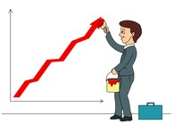

Introduction and History of Business

Slide 3

Agenda:
What is a business?
Reasons behind starting business.
Risks and Rewards of opening business.
Stakeholders.
Case Study.

Slide 4

What is a Business?

Slide 5
Match the words
Business is an enterprise that provides …
goods or services desired by customers.
Business is the profit seeking activities …
that are organized and directed to provide goods and services to customers.
Business is an organization or economic system …
where goods and services are exchanged for one another or for money.
Every business requires some form of investment …
and enough customers to whom its output can be sold on a consistent basis in order to make a profit.

Slide 6
Match the words Cont…
Business is an economic activity, which is related with …
continuous and regular production and distribution of goods and services for satisfying human wants.
The business is carried on with …
intention of earning a profit.
Business is nothing but a contract …
or an agreement between buyer and seller.

Slide 7

Why people decide to open the business?

Slide 8

Motives of starting the business:
To make money
To follow an interest or a hobby
To exploit a gap in the market
To market a new or innovative product
To be their own boss, be creative and make decisions
To work from home and reduce travelling time
To have a second career
Etc. ………

Slide 9
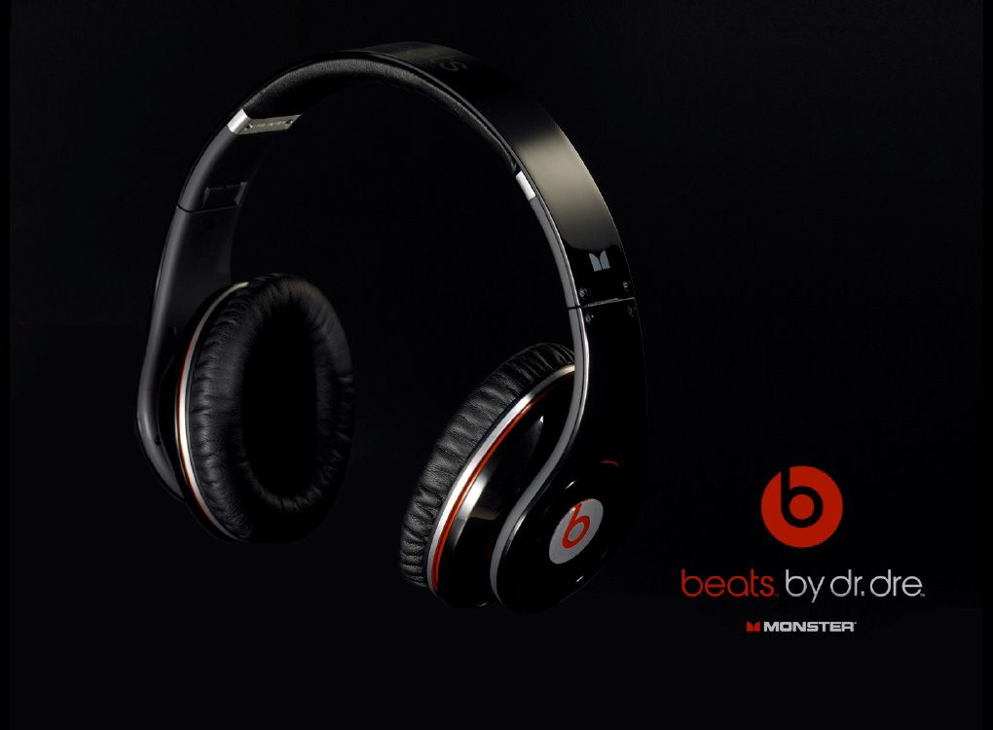

Slide 10

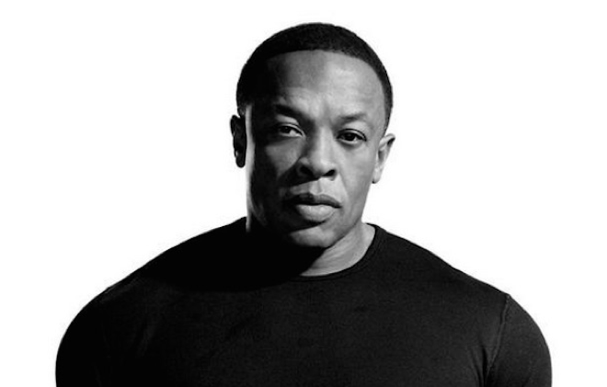
Motives behind the business
Beats was inspired by Apple's terrible earpods.
"Apple," he says, "was selling $400 iPods with $1 earpods”.
“They're making a beautiful white object with all the music in the world in it,"
"I'm going to make a beautiful black object that will play it back.”

Slide 11
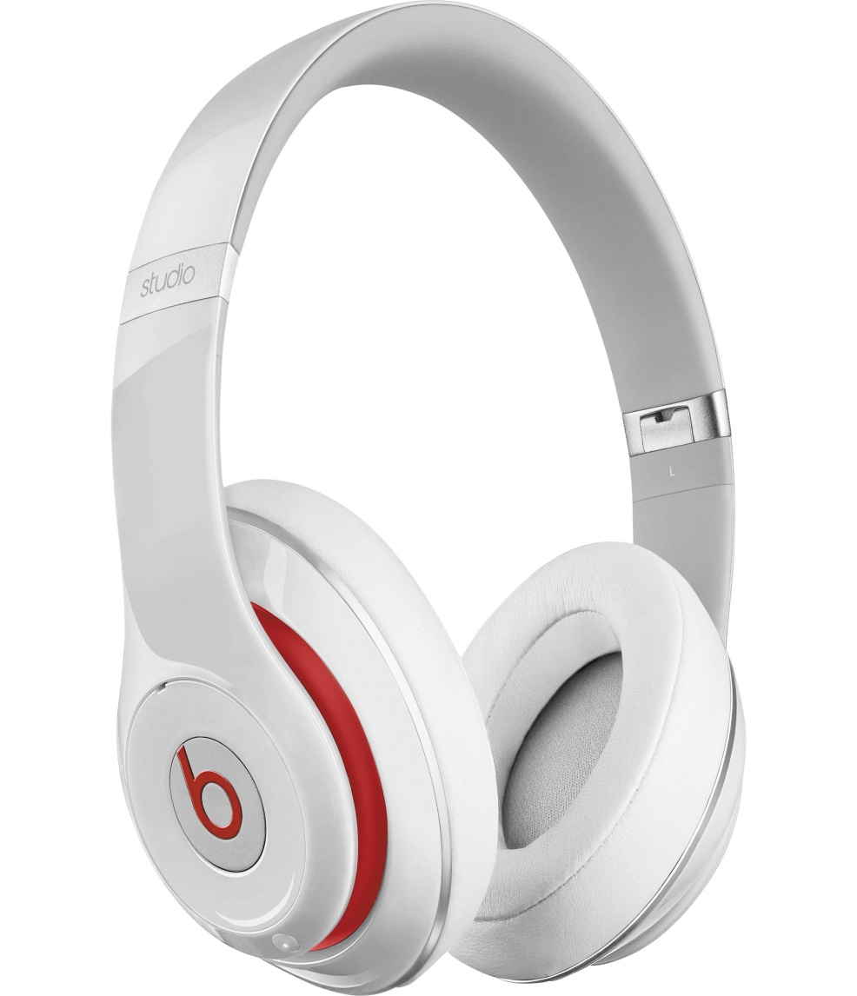
RESULTS:
Since it launched in 2008, the Beats by Dr. Dre brand has risen to a 53% share of the global headphones market.
After 6 years Apple bought Dr. Dre's Beats for 3 billion USD.

Slide 12

Task
Each group selects one business and then makes small presentation on the followings:
1. Name of business
2. Founder of business
3. Main idea of business
4. Motive / history behind

Slide 13


Slide 14

Risks of opening Business:
Personal Money
Inconsistent income
Bad clients
Little job security
Emotional stress

Slide 15

Rewards for opening the business:
Financial reward – profits
Independence
Flexible timing/schedule
Personal satisfaction
Etc. ……

Slide 16
Who are the stakeholders?

Slide 17
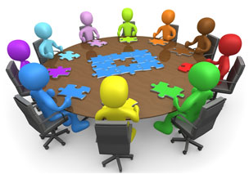
Stakeholder
A stakeholder is anyone with an interest in a business.
A Stakeholder is any person, organization, social group, or society at large that has a stake in the business.
Stakeholders are individuals, groups or organizations that are affected by the activity of the business

Slide 18
Stakeholders
Owners – individual or entity who owns a business entity in an attempt to profit from the successful operations of the company.
Creditors – many firms that need a funds borrow from financial institutions or individuals called creditors, who provide loans.
Employees – people within the firms which are hired in order to conduct the business operations.
Suppliers – provide the necessary goods and services for business to complete their tasks and goals.
Customers – people who buy and use products or/ and services manufactured by companies, and they are affected by the goods and services provided by the business.

Slide 19
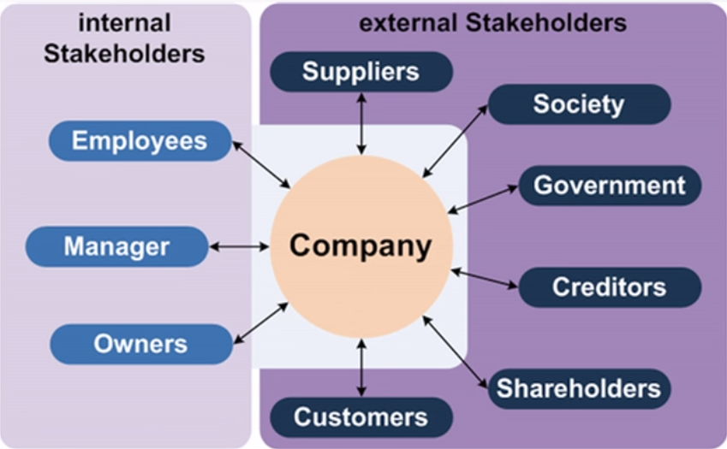
Internal and External Stakeholders:

Slide 20
Why do the Stakeholders are important?
Cause, Stakeholders can affect a business
Be affected by a business, or
Be both affected by a business and affect a business.

Slide 21


