Slide 2
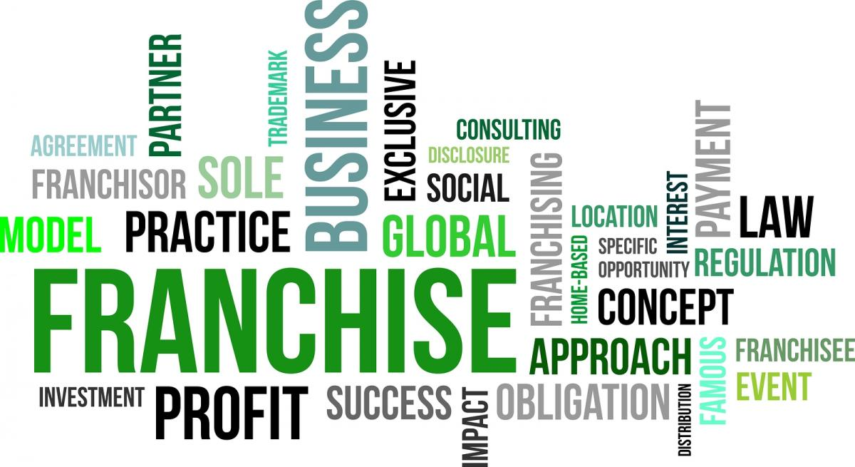
Forms of Business Ownership
Tutorial 3
By Pavel Galkin

Slide 3

Agenda
Ownership
Main Forms of Business Ownership
Case Studies
Test

Slide 4
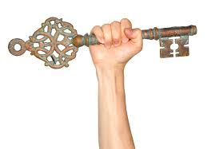
What is it mean ownership?
Ownership is the act, state, or right of possessing something.

Slide 5

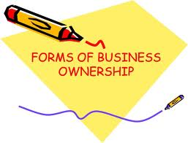
What are the main forms of business ownership?

Slide 6
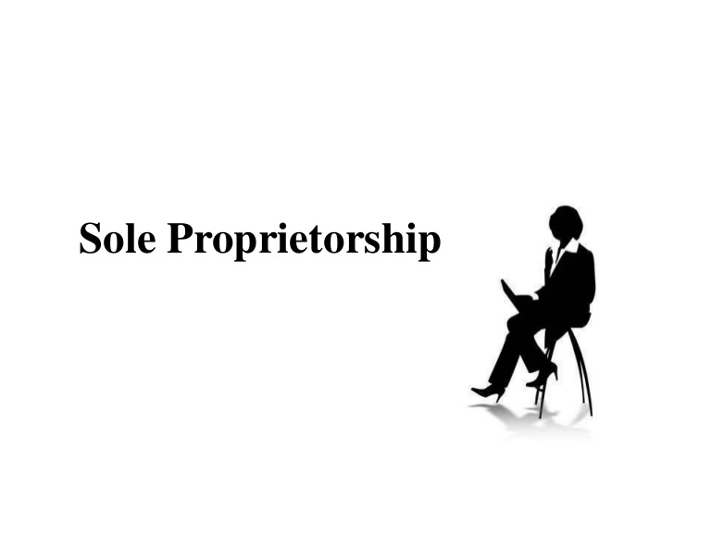
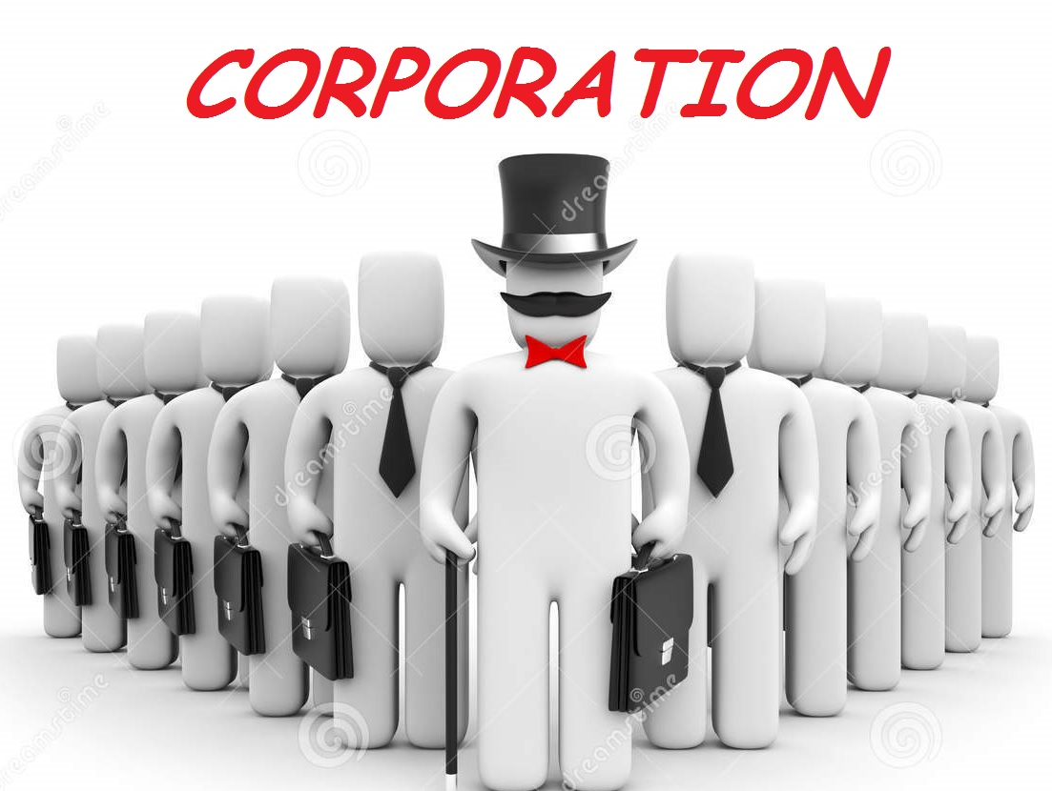

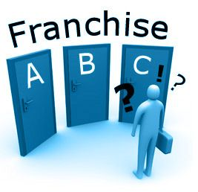
FORMS OF BUSINESS OWNERSHIP

Slide 7
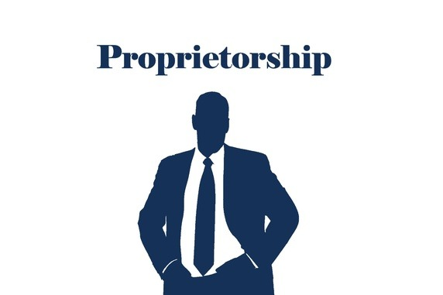
Sole Proprietorship
A Sole Proprietorship is a business owned by only one person.
Advantages of a sole proprietorship:
  Easy and inexpensive to form; few government regulations
  Complete control over your business
  Get all the profits earned by the business
  Don’t have to pay any special income taxes
Disadvantages of a sole proprietorship:
  Have to supply all the different talents needed to make the business a success
  If you die, the business dissolves
  Have to rely on your own resources for financing
  If the company incurs a dept or suffers a catastrophe, you are personally liable (you have unlimited liability)

Slide 8


Partnership
A general partnership is a business owned jointly by two or more people.
A partnership has several advantages:
It’s relatively inexpensive to set up and subject to few government regulations.
Partners pay personal income taxes on their share of profits; the partnership doesn’t pay any special taxes.
It brings a diverse group of people together to share managerial responsibilities.
Partners can agree legally to allow the partnership to survive if one or more partners die.
It makes financing easier because the partnership can draw on resources from a number of partners.
A partnership has several disadvantages:
Shared decision making can result in disagreements.
Profits must be shared.
Each partner is personally liable not only for his or her own actions but also for those of all partners—a principle called unlimited liability.

Slide 9

Corporation
A corporation (sometimes called a regular or C-corporation) is a legal entity that’s separate from the parties who own it.
Corporations are owned by shareholders who invest money in them by buying shares of stock.
They elect a board of directors that’s legally responsible for governing the corporation.

Slide 10
Corporation
A corporation has several advantages:
An important advantage of incorporation is limited liability: Owners are not responsible for the obligations of the corporation and can lose no more than the amount that they have personally invested in the company.
Incorporation also makes it easier to access financing.
Because the corporation is a separate legal entity, it exists beyond the lives of its owners.
Corporations are generally able to attract skilled and talented employees.
A corporation has several disadvantages:
The goals of corporate managers, who don’t necessarily own stock, and shareholders, who don’t necessarily work for the company, can differ.
It’s costly to set up and subject to burdensome regulations and government oversight.
It’s subject to “double taxation.” Corporations are taxed on their earnings. When these earnings are distributed as dividends, the shareholders pay taxes on these dividends.

Slide 11
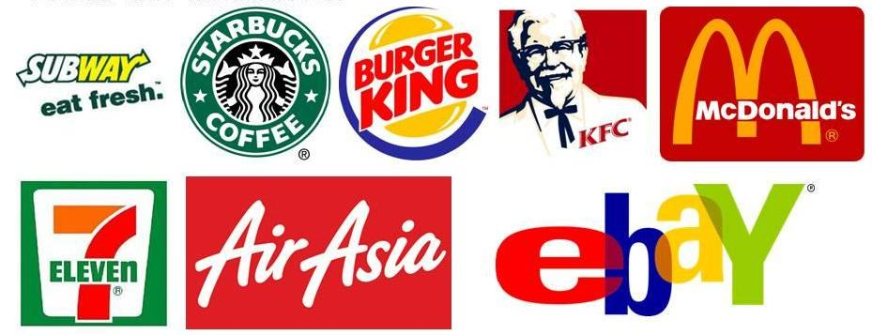
Franchise
An arrangement whereby a business owner allows others to use its trademark, trade name, or copyright, under specific conditions.
  E.g. McDonald’s, SubWay, Pizza Hut, etc.
  Advantages:
Styles of management and production provided by franchisor
Already recognized name
Some financial support
Disadvantages:
Profit is shared with franchisor
Less control

Slide 12


Slide 13



