Slide 2

Organizational Structure
By Pavel Galkin

Slide 3
Definition
Organizational Structure – identifies responsibilities for each job position and the relationships among those positions.

Slide 4
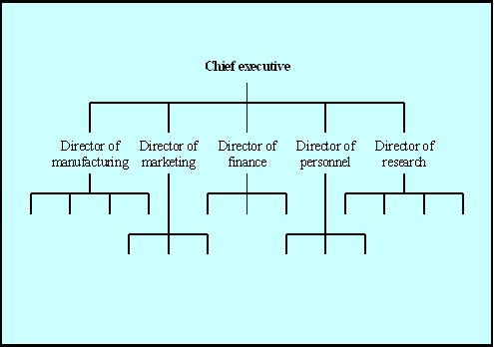
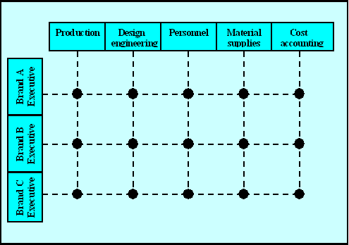
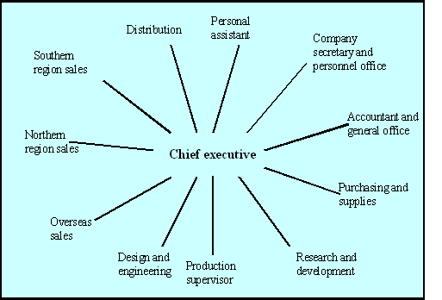
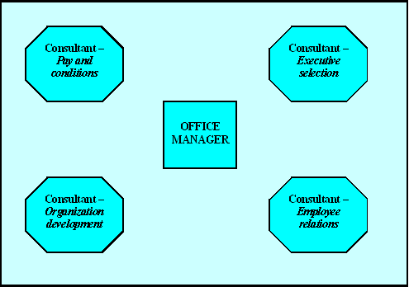
Organizational structure
BUREAUCRATIC
MATRIX
ENTREPRENEURIAL
INDEPENDENCE

Slide 5
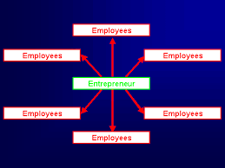
Entrepreneurial Structure

Slide 6
Bureaucratic

Slide 7
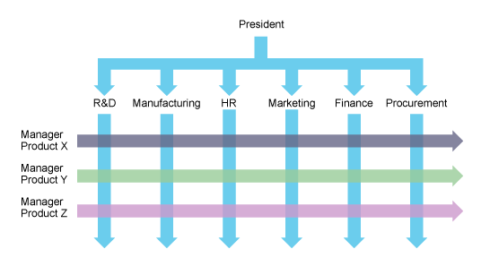
MATRIX structure

Slide 8

Independent or Informal org. structure
INDEPENDENCE

Slide 9
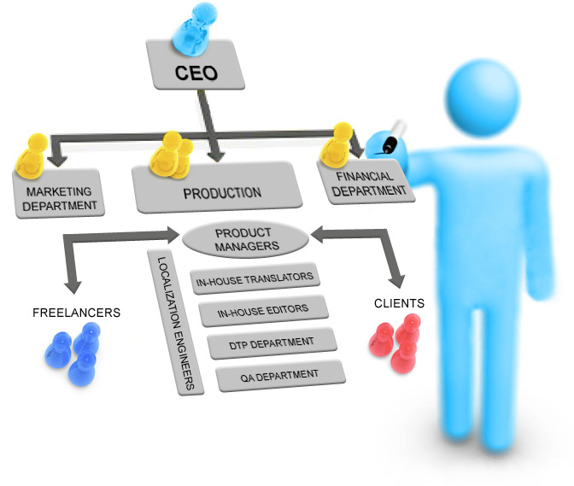
EXERCISE

