Slide 2

Organizing and Managing Business
By Pavel Galkin

Slide 3
AGENDA
Levels of management
Functions of Management
Managerial skills

Slide 4
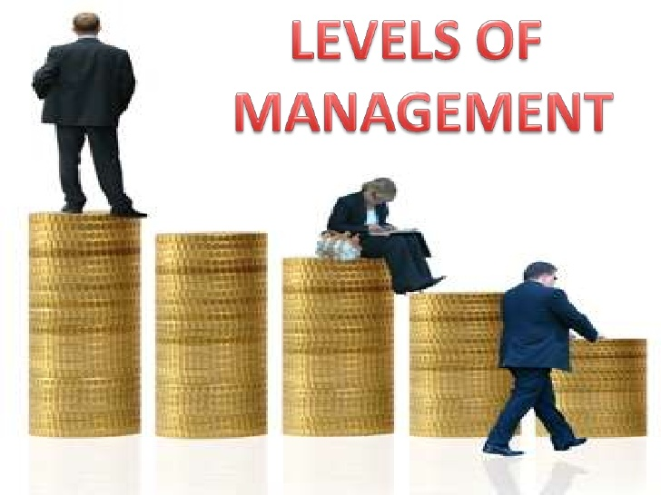
What are the main Levels of Managers in the companies?

Slide 5
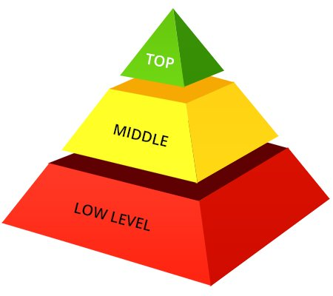
LEVELS of MANAGERS

Slide 6
WHAT ARE THE MAIN FUNCTIONS OF MANAGEMENT?

Slide 7

Managing Business Include:
  Planning
  Organizing
  Leading
  Controlling

Slide 8
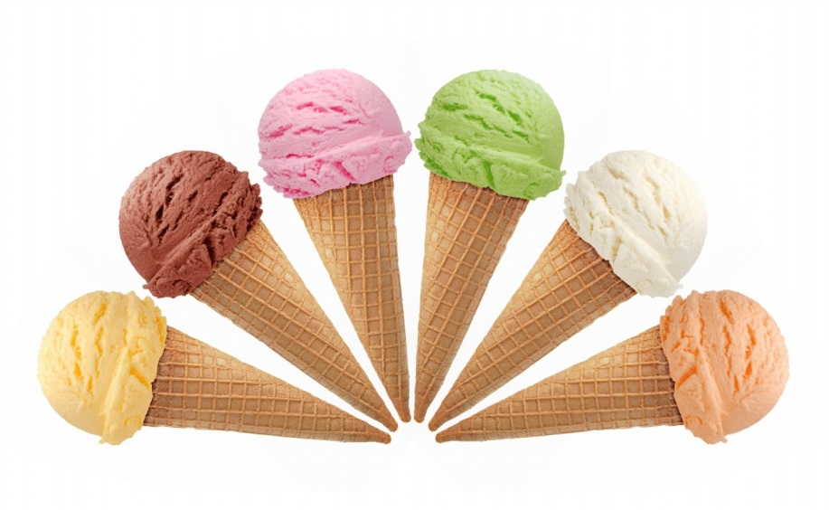
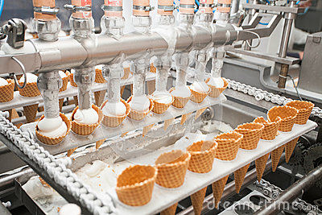
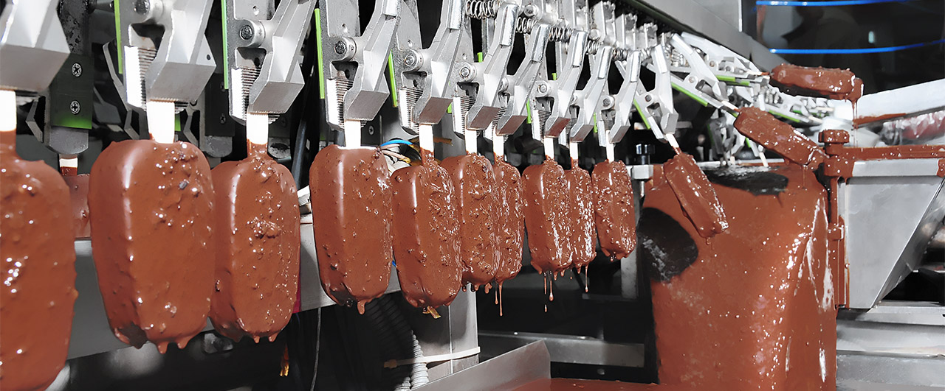
Think about Ice Cream Company

Slide 9

What are the main managerial skills?

Slide 10

Main Managerial Skills:
Conceptual
Interpersonal
Technical
Decision Making

Slide 11

CASE

