Slide 1
Finance
Lecture 9

Slide 2
Agenda
What is Finance?
Internal vs External Finance
Debt vs Equity Finance
Time value of the money
Financial terminologies

Slide 3
What is Finance?
Finance is the science that describes the management, creation and study of money, banking, credit, investments, assets and liabilities. (Investopedia.com)
Finance is the management of revenues; the conduct or transaction of money matters. (Dictionary.com)

Slide 4
Sources of Finance
Internal source of finance: Money raised from the business’s own assets or from profits left in the business
External source of finance: Money raised from sources outside the business

Slide 5
Methods of Financing
Debt Financing – the act of borrowing funds
Equity Financing – the act of receiving investment from owners (by issuing stock or retaining earnings)

Slide 6
Debt Finance
Commercial Banks
Savings Institutions
Finance Companies
Pension Funds
Insurance Companies
Mutual Funds
Bonds

Slide 7
Equity Finance
Issuing Stocks: Company may sell stocks to general public to raise money for further expansions and operations. Companies usually issue common and preferred stocks
Retained earnings: Company may decide to retain earnings from paying dividends and avoid double taxation and use that fund for further expansions and operations

Slide 8
Common vs Preferred Stocks
Common Stock – a security that represents partial ownership of a particular firm. Dividend payments vary.
Preferred Stock – a security that represents partial ownership of a particular firm and offers specific priorities over common stock such as getting paid first. Dividend payments are fixed

Slide 9
Investment Decisions
Capital - long-term funds
Capital budgeting - a comparison of the costs and benefits of a proposed project to determine its feasibility.
Capital budget - a targeted amount of funds to be used for purchasing assets, such as building, machinery and equipment that are needed for long-term projects.

Slide 10
Investment: Payback Period Method
Definition: Length of time it takes a project’s cash flows to recover its initial investment
Projects with shorter payback periods are preferred to longer ones

Slide 11
Limitations of Payback Period Method
Ignores the time value of money
Does not consider cash flows beyond the payback period

Slide 12
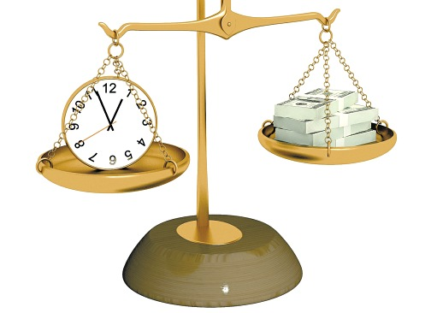
Time Value of Money
$1,000 today or $1,000 in 5 years?
Money received sooner rather than later allows one to use the funds for investment or consumption purposes.
This concept is referred to as the TIME VALUE OF MONEY

Slide 13

Future Value
Definition: The amount to which a cash flow or series of cash flows will grow over a given period of time when compounded at a given interest rate

Slide 14
Simple Interest
Definition: interest is only earned on the initial principal
FV=PV+PV * (i)*n
Note: PV refers to Present Value
Problem:
If you deposit $100 in an account earning 8%, how much would you have in an account after 5 years?

Slide 15
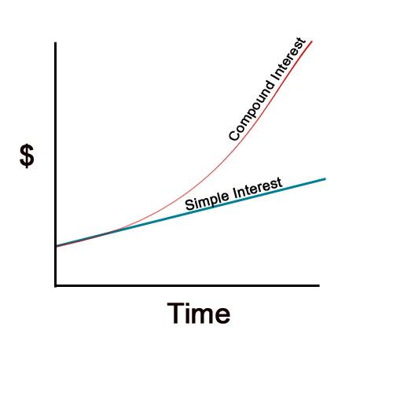
Simple VS Compound Interest
Solve this problem using both simple and compound interest:
Simple Interest: FV=PV+PV * (i) * n
FV=100+(100*0.08*5)
FV=140
Compound Interest: FV=PV * (1+i)^{n}
FV=100 * (1+0.08)⁵
FV=146.9

Slide 16
Financial Terminologies
Income Statement
Revenue - the amounts earned by a firm from selling goods, providing services, and performing business activities.
Operating expenses - costs of marketing activities (selling costs) and costs incurred in managing the business (general costs).
Net Income - occurs when revenues exceed expenses.
Balance Sheet
Assets - anything owned by a firm.
Liability - anything owed by a firm.
Equity - stated value of all common stock issued plus retained earnings (reinvested earnings).
Assets = Liabilities + Equity

Slide 17
Indicative Reading
Madura, J. (2010) Introduction to Business, 5th edn., Paradigm Publishing, Chapter 16-17
Pride, W. M., Hughes, R. J. & Kapoor J. R. (2016) Foundations of Business, 5th edn., Cengage Learning, Chapter 15-16

Slide 18


