Slide 1
HRM
Lecture 10

Slide 2
Agenda
HRM planning
  Forecasting
  Analyzing
  Recruitment
Equal opportunity
Compensation
Training and development
Performance evaluation
Motivation
  Maslow’s hierarchy of needs

Slide 3

Human Resource Planning
Human resource planning involves planning to satisfy a firm’s needs for employees and it consists of three stages:
1. Forecasting
2. Job analysis
3. Recruiting

Slide 4
Forecasting
Forecasting staffing needs - planning to satisfy a firm’s needs for employees
Happens due to retirement, expansions, taking other jobs or promotions
Firms must be able to forecast needs for employees in order to eliminate shortage
Companies must be careful not to hire permanent workers for
temporary positions
This can be solved by hiring part-time or seasonal workers

Slide 5

Job Analysis
Job analysis - the analysis used to determine the tasks and the necessary credentials or a particular position
This process allows the supervisors and managers to develop the job specifications and descriptions
Job specification - states the credentials necessary to qualify for the job position
Job description - states the tasks and responsibilities of the job position.

Slide 6
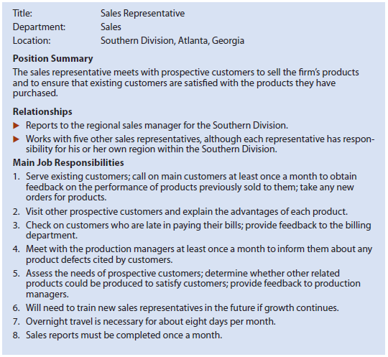
Job description

Slide 7
Recruiting
Companies recruit through social media and company websites
Internal - efforts to fill open positions with persons already employed by the firm
Promotion - part of internal recruitment
Internal promotion creates motivation for current workers and allows the firm to hire proven employees
External - efforts to fill positions with applicants from outside the firm
Allows to hire more specialized and new employees but it limits the information on applicants compared to internal recruitment

Slide 8
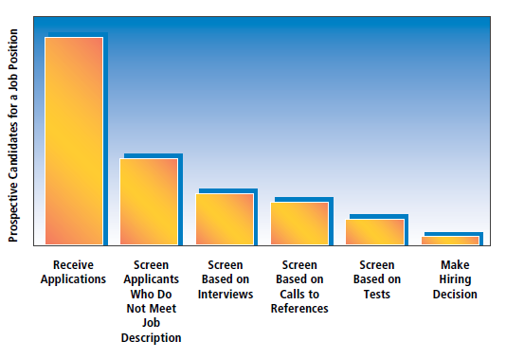
Recruitment process

Slide 9

Equal opportunity
When hiring, firms must base the judgement on performance of the employee rather than other factors such as race/gender/disability
Discrimination is illegal and reduce the work performance of the employees
Benefits of diversity: innovation and different points of view

Slide 10
Compensation
Salary - the dollars paid for a job over a specified period of time.
Stock options - employees purchase shares of the company at a specified price.
Commission and bonuses
Employee benefits - additional privileges beyond compensation payments (e.g. health, life insurance, pension programs, etc.)
Profit sharing
Perquisites (“perks”) - privileges beyond payment and employee benefits offered to high-level employees.

Slide 11
Training and Development
Managers must determine if training is needed and what type of training exist. Training needs vary and may focus on technical skills, product information, customer service, business ethics, etc.
Training types:
On-the-job methods - learning by doing under supervision
Simulations - work situation is simulated in a separate area, away from day-to-day pressures of work.
Conferences and seminars
Role playing - participants act out others’ roles to better understand them.
e-Learning (videos, “how-to” guides, take online quizzes)

Slide 12
Performance Appraisal: Definition and Purpose
Definition: Evaluation of employees’ current and potential levels of performance
Purposes:
Inform workers on how well they are doing and how they can improve
Provides basis for distributing rewards (i.e. pay raises, promotions)
Helps organization monitor employee selection, training and development activities

Slide 13
Performance Appraisal: Techniques
Objective methods - use some measurable quantity as a basis for assessment.
Example: sales, number of defective products
2. Judgemental methods - requires a manager estimate the employee’s performance level. Based on employee ranking (best to worst) and rating scales
Example: “This employee always does high-quality work”
From “Strongly agree” - 5 to “Strongly disagree” - 1

Slide 14

Motivation

Slide 15

Improving Employee Motivation
Method
Adequate compensation program
Job security
Flexible work schedule
Employee involvement programs
Description
Align raises and bonuses with performance
Provide stock as partial compensation
2. Encourage employees to have long-term commitment to the firm
3. Allow employees flexibility on the timing of their work schedules
4. Job enlargement, job rotation, empowerment, teamwork and open-book management

Slide 16
Indicative Reading
Madura, J. (2010) Introduction to Business, 5th edn., Paradigm Publishing. Chapters 10-11
Pride, W. M., Hughes, R. J. & Kapoor J. R. (2016) Foundations of Business, 5th edn., Cengage Learning.
Chapters 9-10

