Slide 1
Product promotion
Lecture 11

Slide 2
Agenda
Product Promotion
Advertising
Personal selling
Sale promotions
Public relations

Slide 3

4. Promotion Mix
Definition: the combination of promotion methods that a firm uses to increase acceptance of its products
Advertising
Personal selling
Sale promotions
Public relations

Slide 4


Promotion: Advertising
Definition: a non-personal sales presentation communicated through media or non-media forms to influence a large number of customers.
Forms of advertising:
Print media
Radio, television
Internet
E-mail
Telemarketing
Outdoor ads, transportation ads
Specialty ads

Slide 5
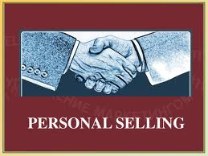
Promotion: Personal Selling
Definition: a personal sale presentation used to influence one or more customers
Identify the target market
Contact potential customers
Make the sales presentations
Answer questions
Close the sale
Follow up

Slide 6
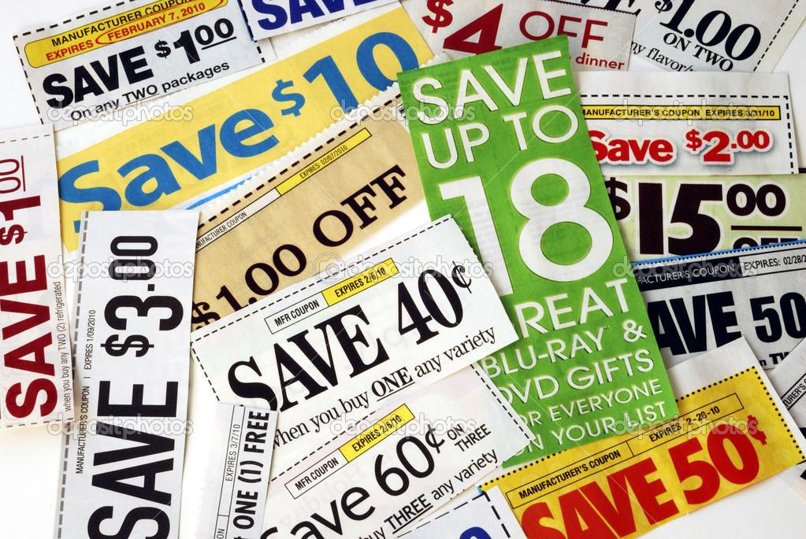
Promotion: Sales Promotion
Definition: the set of activities that is intended to influence consumers
Rebates - a potential refund by the manufacturer
Coupons - a promotion device used in newspapers, and ads to encourage the purchase of a product
Sampling - offering free samples to encourage consumers to try new brand or product
Displays
Premiums - a gift or prize provided free to consumers who purchase a specific product

Slide 7
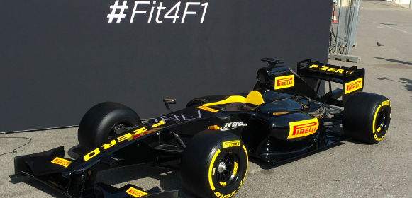
Promotion: Public Relations
Definition: actions taken with a goal of creating or maintaining a favourable public image.
Special events (e.g. marathons, race, festivals, etc.)
News release - a brief written announcement about a firm provided by that firm to media.
Press release - an oral announcement about a firm provided by that firm to the media.

Slide 8
Indicative Reading
Madura, J. (2010) Introduction to Business, 5th edn., Paradigm Publishing
Pride, W. M., Hughes, R. J. & Kapoor J. R. (2017) Foundations of Business, 5th edn., Cengage Learning

Slide 9


