Slide 1
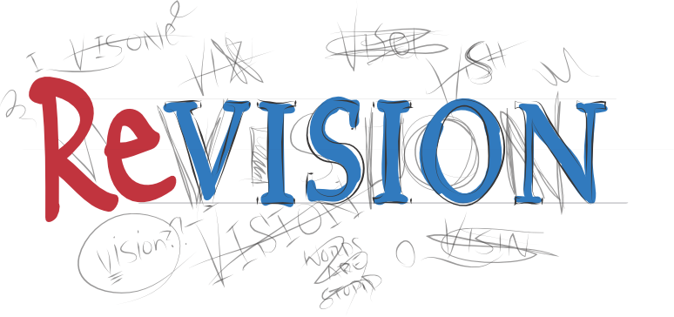
HRM Revision

Slide 2
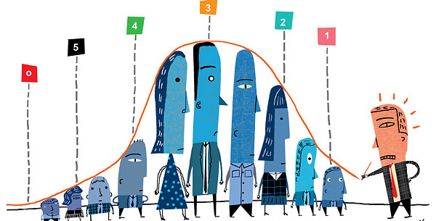
What is Performance Management?
The management of employees, departments, and organizations to ensure that goals and objectives are being reached efficiently and effectively.
Performance management involves defining what effective performance looks like, as well as developing the tools and procedures necessary to measure performance.

Slide 3

Criteria for Effective PA Systems:
Objectives should be clear
Data should be valid and reliable
Performance criteria should be well defined
Economical and less time consuming
Should initiate follow up

Slide 4
What’s Reward Management?
Reward management is concerned with the formulation and implementation of strategies and policies in order to reward people fairly, equitably and consistently in accordance with their value to the organization.
It deals with the design, implementation and maintenance of reward systems
Reward can be regarded as the fundamental expression of the employment relationship

Slide 5

Why do we need Reward Management?
Mutually beneficial
Motivation
Absenteeism
Loyalty
Morale
Teamwork

Slide 6
Job Evaluation
Job evaluation is the process of analyzing and assessing various jobs systematically to ascertain their relative worth in an organization.
Job evaluation is an assessment of the relative worth of various jobs on the basis of a consistent set of job and personal factors, such as qualifications and skills required.

Slide 7
Job evaluations may be carried out in order to help businesses:
Produce a fair pay framework
Reduce inefficiencies in remuneration e.g. two people on the same ‘level’ with different salaries
Compare remuneration with other companies
Design new jobs, departments and functions
Rework their pay framework after a company re-organisation

Slide 8

Career Management is…
..the process through which employees:
Become aware of their own interests, values, strengths and weaknesses.
Obtain information about job opportunities within a company.
Identify career goals.
Establish action plans in order to achieve
career goals

Slide 9
Career Management process
Self-Assessment
Reality Check
Goal Setting
Action Planning

Slide 10
What else? Sample questions.
What HR Planning consists of? What is recruitment/selection?
Training and Development? etc
What is Talent Management?
What is reward management and it’s aims? What to do if you have problems with the reward management in your company?
How and why to introduce policies and procedures? What to do with them? What are the sections of policies?

