Slide 2

Job Evaluation

Slide 3

Agenda for the Lecture:
What is Job Evaluation?
Aims and Approaches of Job Evaluation
Job Evaluation Methods

Slide 4
Job Evaluation
Job evaluation is the process of analyzing and assessing various jobs systematically to ascertain their relative worth in an organization.
Job evaluation is an assessment of the relative worth of various jobs on the basis of a consistent set of job and personal factors, such as qualifications and skills required.

Slide 5
Job evaluations may be carried out in order to help businesses:
Produce a fair pay framework
Reduce inefficiencies in remuneration e.g. two people on the same ‘level’ with different salaries
Compare remuneration with other companies
Design new jobs, departments and functions
Rework their pay framework after a company re-organisation

Slide 6
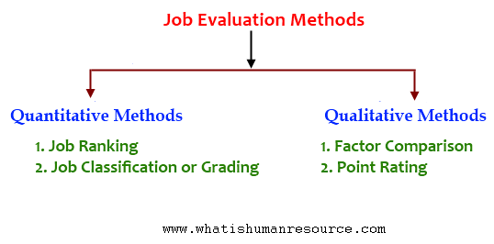


Job Evaluation methods

Slide 7
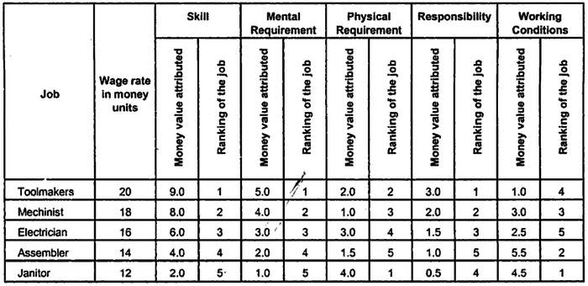
Ranking Method
The ranking method ranks each position within your organization, from highest to lowest.

Slide 8
The application of the Ranking Method involves the following procedure:
Analyze and describe jobs, bringing out those aspects which are to be used for purpose of job comparison.
Identify bench-mark jobs (10 to 20 jobs, which include all major departments and functions). The jobs may be the most and least important jobs, a job midway between the two extremes, and others at the higher or lower intermediate points.
Rank all jobs in the organization around the bench-mark jobs until all jobs are placed in their rank order of importance.
Finally, divide all the ranked jobs into appropriate groups or classifications by considering the common features of jobs such as similar duties, skills or training requirements. All the jobs within a particular group or classification receive the same wage or range of rates.

Slide 9
Merits versus Demerits of Ranking Method
Merits
1. It is the simplest method.
2. It is quite economical to put it into effect.
3. It is less time consuming and involves little paper work.
Demerits:
1. The main demerit of the ranking method is that there are no definite standards of judgment and also there is no way of measuring the differences between jobs.
2. It suffers from its sheer unmanageability when there are a large number of jobs.

Slide 10

Job Classification or Grading Method
A job grade is defined as a group of different jobs of similar difficulty or requiring similar skills to perform them. Job grades are determined on the basis of information derived from job analysis.

Slide 11
Merits versus Demerits of Grading Method
Merits
1. This method is easy to understand and simple to operate.
2. It is economical and, therefore, suitable for small organisations.
3. The grouping of jobs into classifications makes pay determination problems easy to administer.
4. This method is useful for Government jobs.
Demerits:
1. The method suffers from personal bias of the committee members.
2. It cannot deal with complex jobs which will not fit neatly into one grade.
3. This method is rarely used in an industry.

Slide 12
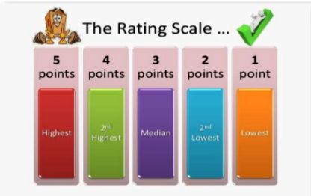
Points Rating
Under this method, jobs are broke down based on various identifiable factors such as skill, effort, training, knowledge, hazards, responsibility, etc. Thereafter, points are allocated to each of these factors.

Slide 13

The procedure involved in determining job points is as follows:
Determine the jobs to be evaluated
Decide on the factors to be used in analysing and evaluating the jobs
Define the factors clearly in written
Determine degrees of each factor and assign point value to each degree
Finally, money values are assigned to points

Slide 14
Merits versus Demerits of Points Rating
Merits
1. It is the most comprehensive and accurate method of job evaluation.
2. Prejudice and human judgment are minimised, i.e. the system cannot be easily manipulated.
3. Being the systematic method, workers of the organisation favour this method.
4. The scales developed in this method can be used for long time.
5. Jobs can be easily placed in distinct categories.
Demerits:
1. It is both time-consuming and expensive method.
2. It is difficult to understand for an average worker.
3. A lot of clerical work is involved in recording rating scales.
4. It is not suitable for managerial jobs wherein the work content is not measurable in quantita­tive terms.

Slide 15

Factor Comparison Method
This method is a combination of both ranking and point methods in the sense that it rates jobs by comparing them and makes analysis by breaking jobs into compensable factors.

Slide 16
The mechanism for evaluating jobs under this method involves the following steps:
1. First of all, the key or benchmark jobs are selected as standards. The key jobs selected should have standards contents, well accepted pay rates in the community, and should consist of a representative cross-section of all jobs that are being evaluated-from the lowest to the highest paid job, from the most important to the least important—and cover the full range of requirements of each factor, as agreed upon by a Committee representing workers and management.
2. The factors common to all jobs are identified, selected and defined precisely. The common factors to all jobs are usually five, viz., mental requirements, physical requirements, skill requirements, working conditions and responsibility.
3. Once the key jobs are identified and also the common factors are chosen, the key jobs are, then, ranked in terms of the selected common factors.
4. The next step is to determine a fair and equitable base rate (usually expressed on an hourly basis) and, then, allocate this base rate among the five common factors as mentioned earlier.
5. The final step in factor comparison method is to compare and evaluate the remaining jobs in the organisation.

Slide 17
Merits versus Demerits of Factor Comparison Method
Merits
1. It is more objective method of job evaluation.
2. The method is flexible as there is no upper limit on the rating of a factor.
3. It is fairly easy method to explain to employees.
4. The use of limited number of factors (usually five) ensures less chances of overlapping and over-weighting of factors.
5. It facilitates determining the relative worth of different jobs.
Demerits:
1. It is expensive and time-consuming method.
2. Using the same five factors for evaluating jobs may not always be appropriate because jobs differ across and within organisations.
3. It is difficult to understand and operate.

