Slide 2

Compensation Schemes
INCENTIVES AND BENEFITS

Slide 3

Questions to be covered today:
Traditional vs Contingent Pay
Types of Contingent Pay and Reasons for introducing
Challenges
What are Benefits? Intangible/Flexible Benefits
Classification of Benefits
Key Factors and Communication of Benefits

Slide 4




Traditional vs Contingent Pay
Salary and salary increases are based on
  Position
  Seniority
Salary and salary increases are based on
  Job performance
  Contribution

Slide 5

Contingent Pay (CP)
Consists of payments related to individual or team performance, contribution, competence or skills.
A distinction can be made between performance (what a person achieves) and contribution (the impact made by that person on the performance of the team and the organization).
If not added to Base Pay: called Variable Pay

Slide 6
Types of contingent pay
Performance-related pay (Pay for Performance)
Competence-related pay
Contribution-related pay
Skill-based pay
Service-related pay
Bonus schemes
Executive bonus and incentive schemes
Employee and executive share schemes
Team pay
Gainsharing
Profit sharing
Recognition schemes
Shop-floor incentive and bonus schemes
Other cash payments

Slide 7
Reasons for Introducing CP
Performance management is more effective when rewards are tied to results
CP Plans force organizations to:
  Clearly define effective performance
  Determine what factors are necessary
Supervisors and employees are better able to understand what really matters
CP plans enhance employee motivation to accomplish goals that match organizational needs
CP plans help to recruit and retain top performers
CP plans project good corporate image

Slide 8
The rationale for pay for performance
Establish a clear relationship between pay and performance
Build on the benefits of performance management by recognizing achievement in a tangible way
Reinforce a performance-orientated culture
Reward and therefore reinforce team as well as individual effort
Concentrate effort in priority areas, clarifying key issues
Attract and retain people who are confident in their ability to deliver results but expect to be rewarded accordingly
Improve pay competitiveness
Improve employees’ commitment by enabling them to share in the success of the organization

Slide 9

P4P: the challenges
The “do only what you get paid for” syndrome
Quantity over the quality
Unethical Behaviors
Negative effects on the spirit of cooperation
Lack of control
Difficulties in measuring performance
Job dissatisfaction and stress
Potential reduction of intrinsic drives
Money may not be the main motivator for everybody
The effort is stopped after the target is achieved
The effort is only directed to reward generating activities

Slide 10

Meeting the P4P challenges
Link pay and performance appropriately
  Straight piecework: A fixed sum is paid for each unit the worker produces under an established piece rate standard. An incentive may be paid for exceeding the piece rate standard.
  Standard hour plan: The worker gets a premium equal to the percent by which his or her work performance exceeds the established standard.
Use pay-for-performance as part of a broader HRM system
Build employee trust
Promote the belief that performance makes a difference
Use multiple layers of rewards
Increase employee involvement
Stress the Importance of Acting Ethically
Use motivation and non-financial incentives

Slide 11
The criteria for a successful PFP scheme
Individuals and teams know the targets and standards they are required to meet.
The reward is clearly and closely linked to accomplishment.
People know what they will get if they achieve targets or standards and can track their performance against them.
Fair and consistent means are available for measuring or assessing performance.
People must be able to influence their performance by changing their behaviour and/or they should be able to develop their competences and skills.
The rewards should be meaningful.
The reward should follow as closely as possible the accomplishment that generated it.

Slide 12
Types of Employee Benefits
Pension schemes
Personal security: ( illness, health, accident or life insurance).
Financial assistance: ( loans, house purchase schemes, relocation assistance and discounts on company goods or services)
Personal needs: (holidays and other forms of leave, child care, career breaks, retirement counseling, financial counseling and personal counseling in times of crisis; fitness and recreational facilities, etc.)

Slide 13
Types of Employee Benefits (cont)
Educational allowances (for expatriates’ children)
Company cars and petrol
Other benefits that improve the standard of living of employees: (subsidized meals, clothing allowances, refund of telephone costs, mobile phones, credit card facilities, etc. )

Slide 14

Personal Needs
Holidays
Maternity leave
Paternity and partner leave
Parental leave
Career breaks
Sabbaticals (Time-off)

Slide 15

Intangible Benefits
Status and Power
Recognition for achievement
Training opportunities
Career progression
Good working conditions
A well-managed organization
Recognition of the need to balance work and family responsibilities
Flexibility

Slide 16
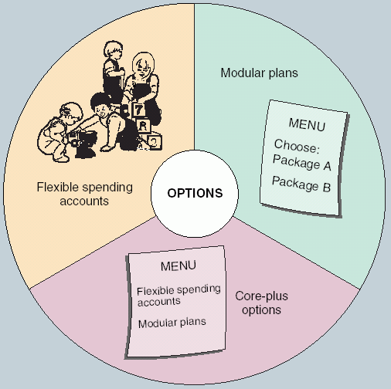
Flexible Benefits
Flexible benefit schemes (sometimes called ‘cafeteria systems’) allow employees to decide, within certain limits, on the make-up of their benefits package.

Slide 17
Allowances
Payments for special circumstances.
Location allowances (cost of leaving)
Overtime payments
Shift payments
Working conditions allowances
Subsistence allowances may be paid for accommodation and meals when working away from home
Stand-by and call-out allowances may be made to those who have to be available to come in to work when required

Slide 18
Classification of Employee Benefits:
Five Traditional Categories of Employee Benefits
Legally required social insurance programs
  Social Security, Workers’ Compensation
Payments for private insurance and retirement plans
  Medical, disability, life insurance
Payments for time not worked
  Vacations, parental leave, sabbaticals
Extra cash payments to employees
  Educational expenses, suggestion awards
Cost of services to employees
  Subsidized cafeterias, adoption assistance, parking

Slide 19
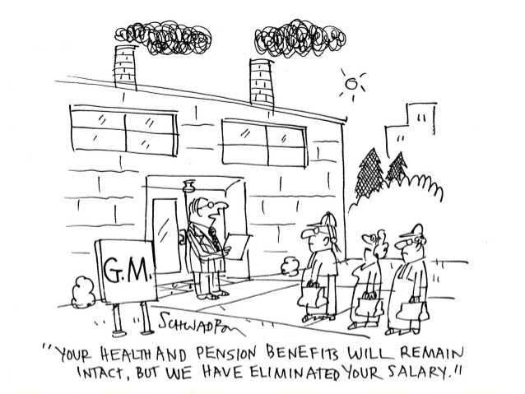
Classification of Employee Benefits:
Legal vs Discretionary benefits
Legally required benefits
  Unemployment insurance
  Worker compensation
  Social security
Discretionary benefits
  Health-care plans
  Supplemental insurance
  Retirement savings
  Family friendly benefits
  Other discretionary benefits

Slide 20
Developing employee benefit strategies – key factors
Employee benefit strategies should:
be part of the total reward management strategy and support the achievement of its business objectives;
be in line and supportive of the culture of the organization and its value;
demonstrate to employees that they are members of a caring and enabling organization
meet the needs of the organization to increase the commitment of its members

Slide 21
Developing employee benefit strategies – key factors
meet the real needs of individual employees rather than those needs which management believes they should have;
help the organization to recruit and retain high-quality and well motivated staff by being competitive in the market place;
ensure that benefits are cost effective in the sense that the increase they produce in commitment and improvement in recruitment and retention rates justify their cost;
take account of relative tax efficiencies in structuring the package;

Slide 22
Developing employee benefit strategies – key factors
establish an appropriate degree of flexibility in operating the benefit package;
bear in mind the importance of the non-tangible benefits as well as those which provide extra remuneration or financial assistance;
be creative – not simply offering what competitors offer but devising new approaches to structuring the package and to providing individual benefits which are tailored to the strategic needs of the organization

Slide 23
Communicating Benefits to Employees
Organizations must communicate benefits information to employees so that they will appreciate the value of their benefits.
This is essential so that benefits can achieve their objective of attracting, motivating, and retaining employees.
Employees are interested in their benefits, and they need a great deal of detailed information to take advantage of benefits.

Slide 24
Summary
Like a pay, benefits help employers attract, retain, and motivate employees. The variety of possible benefits also helps employers tailor their compensation packages to attrackt the right kinds of employees.
Employees expect at least a minimum level of benefits, and providing more than the minimum helps an organization compete in the labor market
Benefits are also a significant expense, but employers provide them because employees value them and many benefits are required by law.
The major categories of paid leave are vacations, holidays and sick leave.

Slide 25
Summary (cont)
To manage the costs of health insurance, many organizations offer coverage through a health maintenance organization or preferred provider organization, or they may offer flexible spending accounts.
Employers have responded to work-family role conflicts by offering family-friendly benefits.
In deciding the contents of a benefits package, organizations need to establish objectives and select benefits that support those objectives.
Organizations should also consider employees’ expectations and values.

Slide 26

Summary (cont)
Employers must comply with the numerous laws and regulations affecting how they design and administer benefits programs.
Communicating information about benefits is important so that employees will appreciate the value of the benefits.
Communicating their value is the main way benefits attract, motivate and retain employees.

