Slide 2
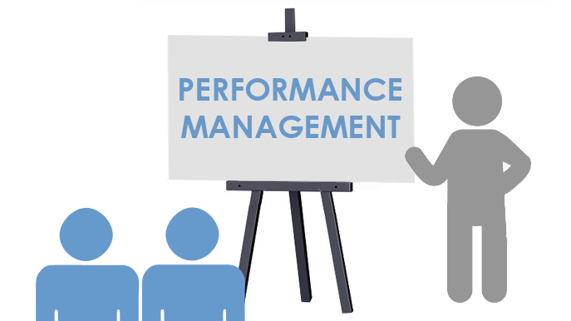

Slide 3

Globalization

Slide 4
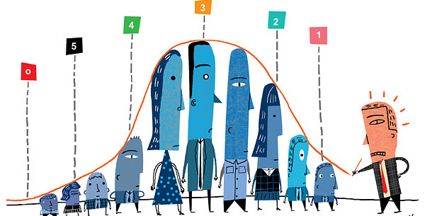
What is Performance Management?
The management of employees, departments, and organizations to ensure that goals and objectives are being reached efficiently and effectively.
Performance management involves defining what effective performance looks like, as well as developing the tools and procedures necessary to measure performance.

Slide 5
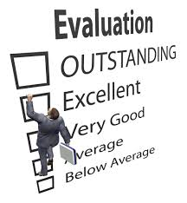
What is a purpose of performance appraisal?
Evaluation
Provide continuous feedback
Provide clarity of expectation and actual result
Identify area of weakness of employees
Determine training and developmental needs
Provide career path
Determine promotion of employees
Decide retention and termination of employees
Decide salary and rewards
Motivate superior performance

Slide 6
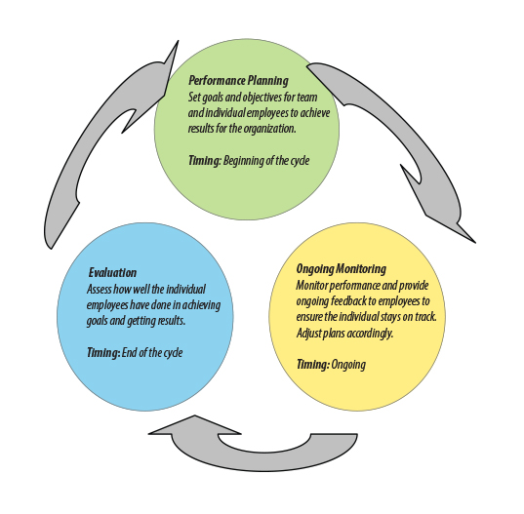
Performance Management Cycle

Slide 7
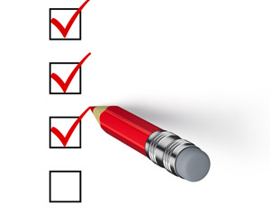
Criteria for Effective PA Systems:
Objectives should be clear
Data should be valid and reliable
Performance criteria should be well defined
Economical and less time consuming
Should initiate follow up

Slide 8

Performance Appraisal Methods
TRADITIONAL METHODS:
Rating Scale Method
Paired Comparison Method
Essay Method
Grading
Forced distribution method
Forced choice method
Checklist method
Field Review Method
Confidential Report
MODERN METHODS:
Management by Objective
Behaviourally anchored rating scales
Assessment centres
360-degree appraisal
Cost accounting method

Slide 9
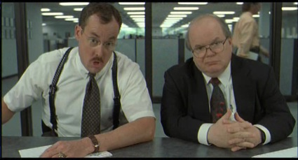
Performance Raters (Evaluators)
Question to you:
Who should be asked to evaluate the job performance of an employee?
Performance evaluators need to have:
Opportunity to observe the employee’s job performance
Ability to translate observations of performance into an evaluation of performance
Motivation to do a good job of observing & evaluating

Slide 10

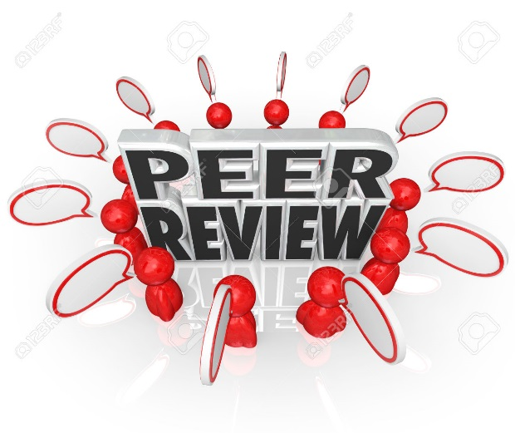


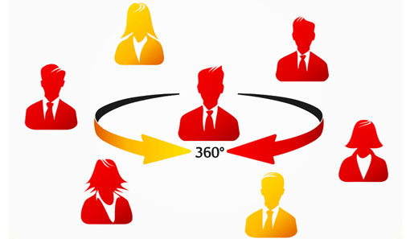
Performance Raters (Evaluators)
Options for Job Performance Evaluators
Supervisors
Self-evaluation
Peers (co-workers)
Subordinates
Customers
360-Degree Appraisals

