Slide 1
HR Planning and Job Analysis
Lecture 2

Slide 2
Agenda
HR Planning
  Job analysis
    Factors and definitions
  Job forecasting
    Stages of forecasting and its factors

Slide 3
Human Resource Planning
Human Resource Planning is a part of strategic approach to management, laying the foundation for a methodical and systematic approach to the personnel or human resource management function, but also integrated with all activities undertaken by the organisation.
Margaret Foot & Caroline Hook (1996)

Slide 4
The need for planning
Identifies future personal needs
Creating and maintaining professional staff
Meeting the departmental needs
Keeping up with constant changes

Slide 5
Planning Structure
Job Analysis
  Work descriptions
  Work specifications
Job Forecasting

Slide 6
Job Analysis
Description
  Establish tasks and duties of the specific position in the department or organization
  Establish expected results and responsibilities
Specification
  Establish specific skills and abilities for a position in the department

Slide 7
How to analyze?
Observations
Questionnaires
Interviews
Employees reports and comments

Slide 8
Forecasting
Internal
  Searching for potential candidates from within the organization
  We look at the internal staff first
    They know the culture
    They know the tasks directly
    No need for further training
External
  Searching for potential candidates from outside the organization
    Advertisement and interviews

Slide 9
Competency Inventory
Searching for specific abilities in the organization
Commonly used internally
  Using searching engine with the organizations to search for a specific employee with needed skills and encouraging them to apply for a new position
Can be also applied to externally to certain extent

Slide 10
Replacement Chart
It is a succession planning tool
Helps to identify potential candidates within the organization for further training and promotions
As soon as department manager retires or leaves we have a potential successor

Slide 11
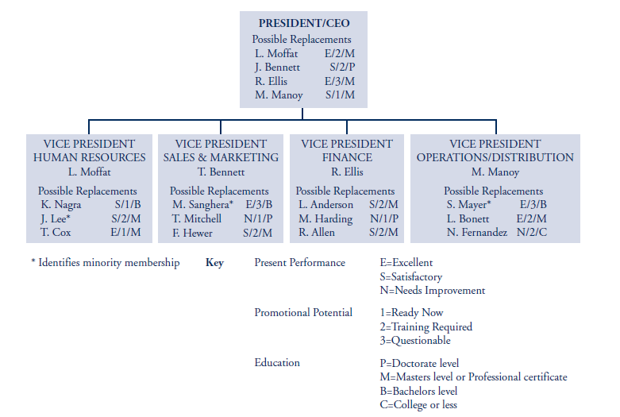

Slide 12
Factors that affect forecasting
Financial performance of the company
Turnover rate
  How people are leaving/average number employed times 100
Technology
  Due to technological changes come positions can be eliminated or created

Slide 13
Resources
* Armstrong’s Handbook of HRM Practice
* Human Resource Management (Derek Torrington et al.)

Slide 14


