Slide 2
Introduction to Web, Publishing and Technologies.
BIS. Web Technologies.

Slide 3
Agenda
About the module
  Aims
  Outcomes
  Assessment
Web publishing
Web design
Web technologies

Slide 4
Web technology
Web ?
Technology?
Publishing?
Design?

Slide 5
Summary of module content
The module provides theoretical introduction with Internet infrastructure, history and services as well as practical introduction to concepts and terminology used in design and implementation of web based information systems, i.e. study of fundamental languages of the web today - including HTML5, CSS3, JavaScript and JQuery libraries.
The module provides a solid skills of building websites working with WYSIWYG editors and CMSs.

Slide 6
Learning outcomes
After completing this module the student should be able to:
  1. Design a Web site satisfying a simple specification
  2. Discuss the elements of good website design
  3. Develop a site design and implementation plan
  4. Use a text editor to create several linked HTML documents, following certain style guidelines
  5. Incorporate and develop JavaScript to create interactive documents
  6. Select and use a website construction tool
  7. Evaluate the design of commercial websites
  8. Discuss the use of the Internet in e-Commerce and its associated issues

Slide 7
BEFORE – publishing to Web
You should have your website ready
You should have your domain name bought

Slide 8
Web publishing
Web publishing, or "online publishing," is the process of publishing content on the Internet
It includes creating and uploading websites, updating webpages, and posting blogs online
The published content may include text, images, videos, and other types of media

Slide 9
Web publishing
In order to publish content on the web, you need two things:
  Internet connection - serves as the medium for uploading the content to the web server
  web server - Large sites may use a dedicated web host, but many smaller sites often reside on shared servers, which host multiple websites. Most blogs are published on public web servers through a free service like Blogger

Slide 10
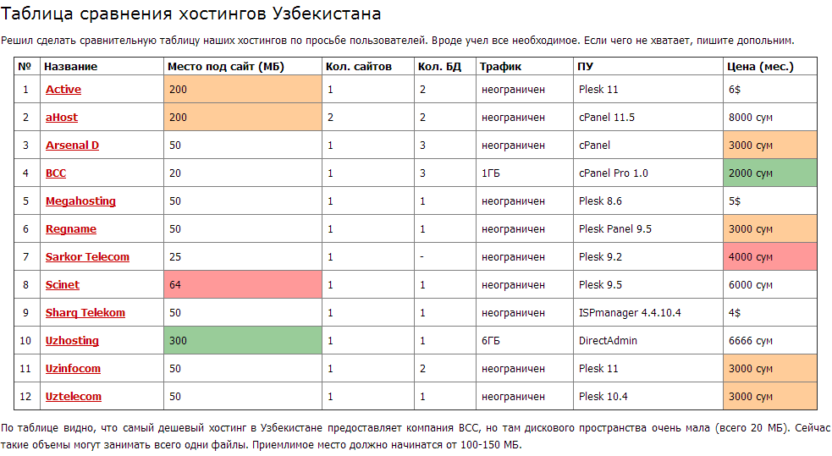
Uz hosting www.hosting-obzor.uz
The cheapest hosting

Slide 11
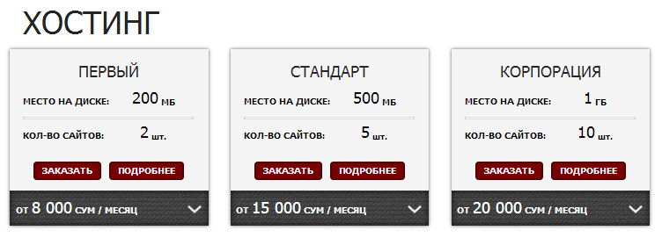
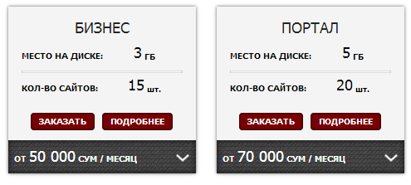
Uz hosting Example: ahost.uz

Slide 12

Web publishing
WordPress is a free and open source blogging tool and a content management system (CMS) based on PHP and MySQL
Runs on a web hosting service
Features include a plug-in architecture and a template system.
WordPress is used by more than 18.9% of the top 10 million websites as of August 2013.
WordPress is the most popular blogging system in use on the Web, at more than 60 million websites

Slide 13
Statistics
Hit – request for any file from web server
Page view – a request to load a single HTML file of an Internet site.
Unique visitors – cookie or IP
Google Analytics: currently in use on around 55% of the 10,000 most popular websites (AdWords, AdSense)

Slide 14



Calendar and platforms
The module will be delivered through the series of Lectures, Tutorials and Workshops – 12 Weeks
Where to take Materials?
  Intranet http://intranet.wiut.uz/SitePages/Lectures%20and%20Tutorials.aspx
  Moodle https://moodle.wiut.uz/course/view.php?id=185

Slide 15


Assessment methods and weightings
Individual - 60%
Final Exam - 40%

Slide 16
Essential reading list
Don’t Make Me Think! a common sense approach to web usability, Second Edition, Steve Krug. New Riders Publishing, 2006
Homepage Usability:50 Websites Deconstructed, Second Edition. Jakob Nielsen, Marie Tahir. New Riders, 2001
Basics of Web Design HTML5 & CSS3, Second Edition. Felke-Morris, Terry. Addison-Wesley, 2014
Programming the World Wide Web, 8th Edition, by Robert Sebesta, Addison-Wesley, 2014
Internet & World Wide Web, Paul Deitel, Harvey Deitel, Abbey Deitel, 5th edition, UK. Pearson, 2012
Learning Web Design, Learning Web Design, 4th, UK: O'reilly, 2012
Single Web Applications, Michael Mikowski, Josh C. Powell, USA : Manning Publication CO, 2014
The Internet For Dummies, 2015, John Wiley & Sons; 14th Edition

Slide 17
Online resources
http://www.htmlgoodies.com
http://www.webmonkey.com
http://www.w3.org/Style/CSS/
http://www.w3schools.com
http://www.javascript.com
http://www.jquery.com
http://www.codecademy.com

