Slide 1
Professional English in Use
Khasan Akhmadjonov
University of World Economy and Diplomacy

Slide 2
Objectives
Manufactures’ pricing strategies
Retail pricing strategies
AOB

Slide 3
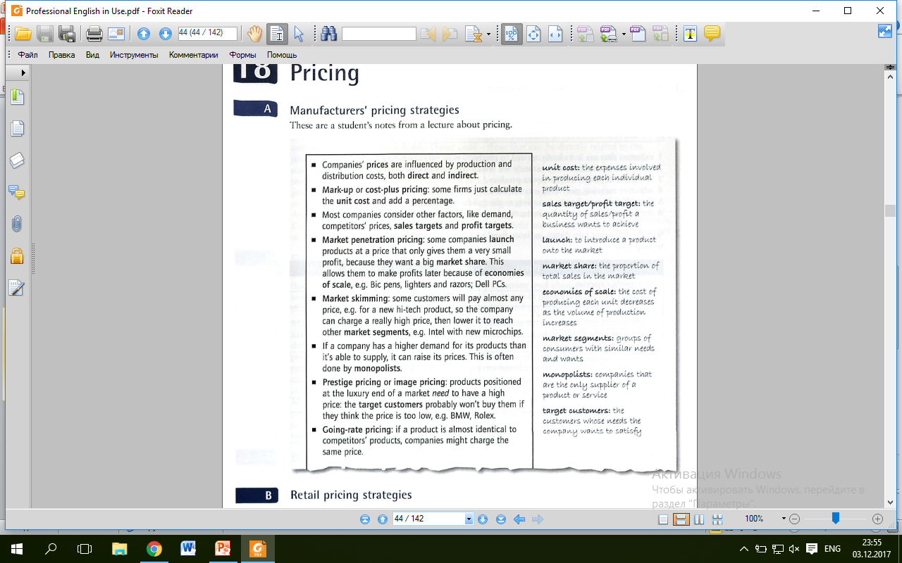
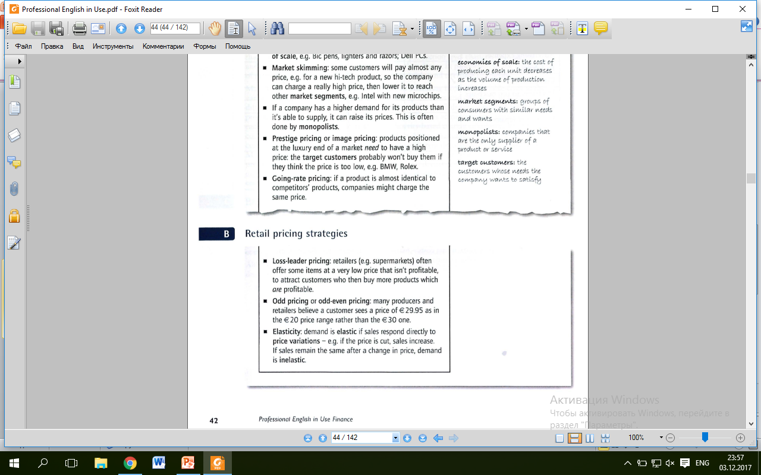

Slide 4
References
Ian MacKenzie Professional English in Use. Finance, Cambridge University Press, 2009
Web sources

Slide 5
Thank you!!!

