Slide 1
Professional English in Use
(International Banking and Finance)
Khasan Akhmadjonov
University of World Economy and Diplomacy

Slide 2
Objectives
Types of financial ratio
Liquidity and solvency ratios
Earnings and dividends
AOB

Slide 3
Types of ratios
relationships bet. two or more items
Ratios measure:
Liquidity – turn cash
Solvency – pay short-term debts
Efficiency – using resources

Slide 4
Liquidity and solvency
Current ratio
Current assets
Current liabilities
Quick ratio or acid test
Liquid assets
Current liabilities

Slide 5
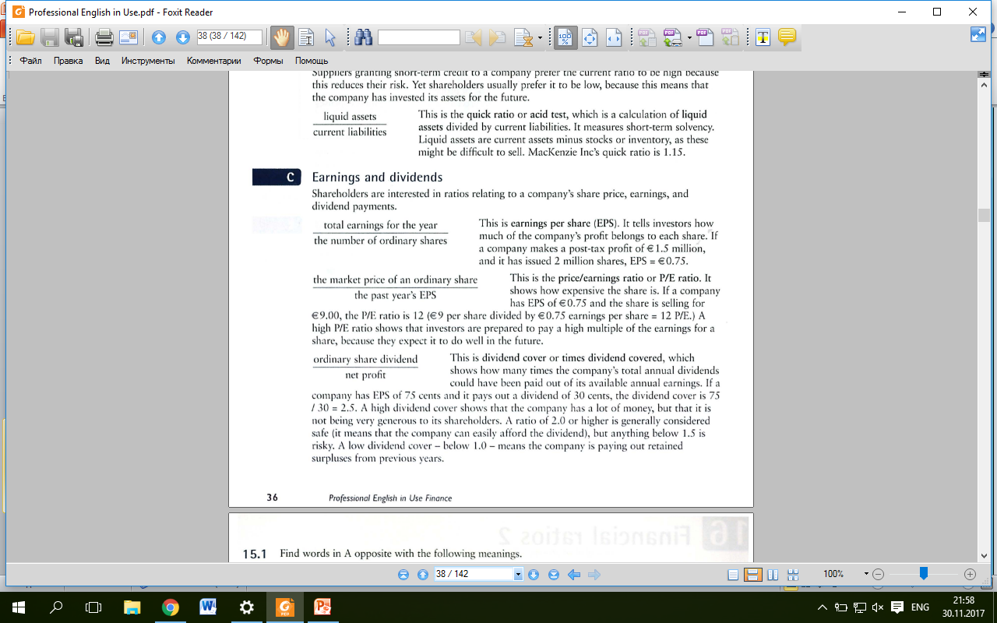
Earnings and dividends
EPS (earnings per share) – profit vs share
P/E ratio
Dividend cover

Slide 6
References
Ian MacKenzie Professional English in Use. Finance, Cambridge University Press, 2009
Web sources

Slide 7
Thank you!

