Slide 1
Professional English in Use
(International Banking and Finance)
University of World Economy and Diplomacy
Khasan Akhmadjonov

Slide 2
Objectives
Key concepts of balance sheet
Assets
Liabilities
Capital
Shareholders

Slide 3
The balance sheet
Statements for shareholders &creditors
A document (two halves) total always the same
Does not show how much money a comp. spent or received
Am E. Statement of financial position

Slide 4
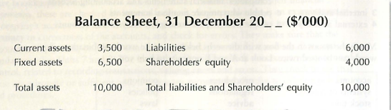
Balance sheet
Business assets
Second half
Things owned by a comp.
Factories
Machines
Liabilities
Capital
Shareholders (stockholders)

Slide 5
Liabilities
Obligations to pay organ-ns or people
Money company owes
Loans

Slide 6
Shareholders’ equity
All the money belonging to shareholders
The same as the company’s net assets or assets minus liabilities
Share capital
Retained earnings

Slide 7
References
Ian MacKenzie Professional English in Use. Finance, Cambridge University Press, 2009
Web sources

Slide 8
Thank you for your time!

