Slide 1
Professional English in Use
(International Banking and Finance)
University of World Economy and Diplomacy
Khasan Akhmadjonov

Slide 2
Money and income
Currency (euros, dollars, sums, yen, etc.)
notes (banknotes), coins=cash
Bank deposits (on paper)
Personal finance
Income: salary, wages, overtime, commission, bonus, fees, social security (welfare), pension
Salaries&wages (deductions: social security charges and pension contributions)
Outgoings: living expenses, bills, rent, mortgage, health insurance, tax
Budget (financial plan)

Slide 3
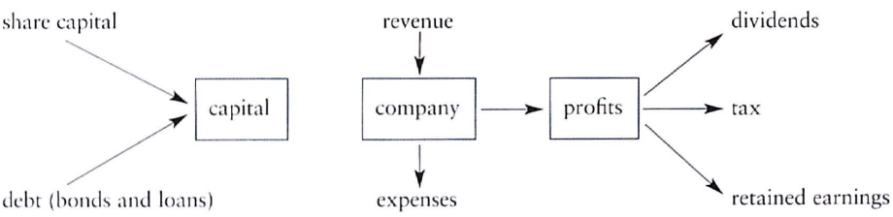
Business Finance
Companies borrow money (loan)
Capital can come from issuing shares or equities
People who invest money in shares (shareholders)
Investors (individuals, financial institutions)
Investors lend money by buying bonds (loans)
Liabilities (companies’ debts)
A business uses money for everyday expenses (working capital or funds)
shares=stocks

Slide 4
Financial statements
Information about financial situation
Balance sheet (company’s assets, liabilities, capital)
Profit and loss account (company’s revenues and expenses)
income statement (AmE)

Slide 5
References
Ian MacKenzie Professional English in Use. Finance, Cambridge University Press, 2009
Web sources

Slide 6
Thank you for your time!!!

