Slide 1
Company law
Khasan Akhmadjonov
Univercity of World Economy and Diplomacy

Slide 2
Content
Partnerships
Limited liability
Founding companies
Private and public companies
AGMs

Slide 3
Partnerships
A business arrangement
Share risks and profits
Not legal entities
Individual partners are sued
A sole traider business
Enterprise
Unlimited liability for debts

Slide 4
Limited liability
Company – business, a legal entity
Has a separate legal existence
Enter into contracts
Can be sued
Limited liablity (not fully responsible for business’s debts (limited companies) limited to the value of the share capital
directors=qualified managers, senior managers=executive directors run the company
Chairman=president
Managing director=CEO (chief executive officer)

Slide 5
Founding companies
Articles of association
Memorandum of Association
Rights and duties of the shareholders
Relationships among different classes of shareholder
Relationships between shareholders, company, directors
Company’s name
Location of the company’s registered office
Company’s purpose
Authorised share capital

Slide 6
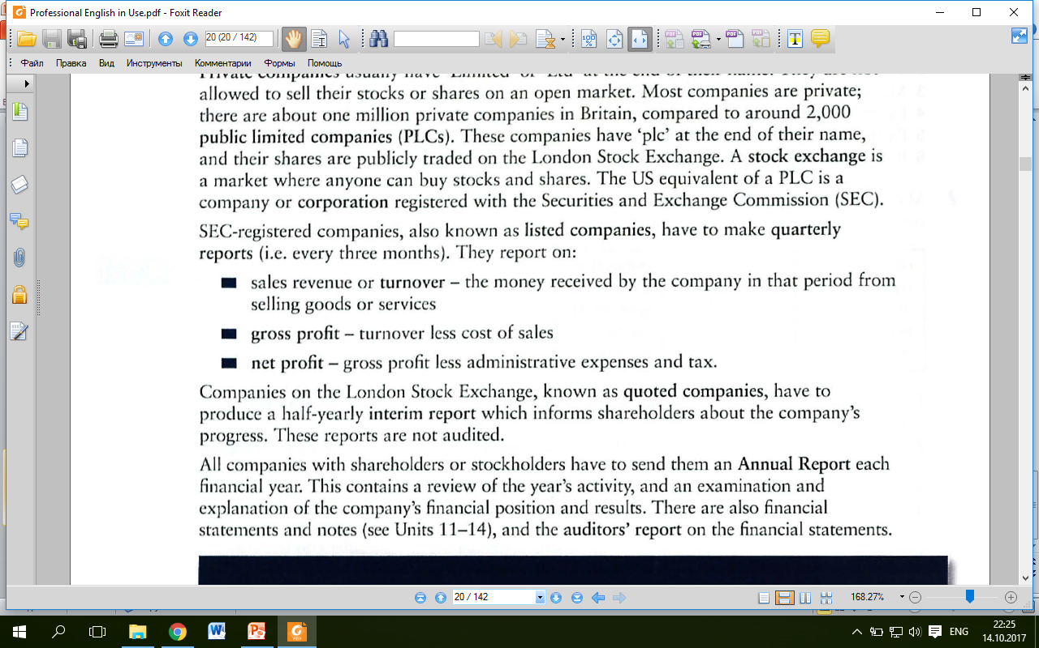
Private and public companies
Limited ‘Ltd’
Not allowed to sell stock and shares
PLCs ‘plc’
Shares are publicly traded
Stock exchange (market)
Annual report (a review of the year activity, explanation, examination

Slide 7
AGMs
Annual General Meeting
AmE: Annual Meeting of Stockholders
Shareholders question directors
Vote to accept or reject the dividend
Vote on replacements for retiring members
Extraordinary General Meeting
a crisis
AmE: Special Meeting

Slide 8
References
Ian MacKenzie Professional English in Use. Finance, Cambridge University Press, 2009
Web sources

