Slide 2
Website planning and design. Web Accessibility

Slide 3
Basic steps
Regardless of the scale, the process for developing a site involves the same basic steps:
Conceptualize and research.
Create and organize content.
Develop the “look and feel.”
Produce a working prototype.
Test it.
Launch the site.
Maintain

Slide 4
depending on the nature and scale of the site vary in
sequence,
proportion,
number of people required

Slide 5
Conceptualize and Research
Idea - result of someone wanting to get something online:
Start:
  core idea
  then brainstorm on how it’s going to manifest itself as a web site
Things to define:
  Strategy
  General Site Description
  Target Audience
  Content
  Resources
  Graphic Look and Feel

Slide 6
Strategy
Why are you creating this web site? What do you expect to accomplish?
What are you offering your audience?
What do you want users to do on your web site?
After they’ve left?
What brings your visitors back?

Slide 7
General Site Description
What kind of site is it? (Purely promotional? Info-gathering? A publication? A point of sale?)
What features will it have?
What are your most important messages?
Who are your competitors? What are they doing right?
What could be improved upon?

Slide 8
Target Audience
Who is your primary audience?
How Internet-savvy are they? How technically savvy?
Can you make assumptions about an average user’s connection speed? Platform? Monitor size?
Browser use?
How often do you expect them to visit your site? How long will they stay during an average visit?

Slide 9
Content
Who is responsible for generating original content?
How will content be submitted (process and format)?
How often will the information be updated (daily, weekly, monthly)?

Slide 10
Resources
What resources have you dedicated to the site (budget, staff, time)?
Does the site require a full content management system?
Can maintenance be handled by the client's staff?
Do you have a server for your site?
Have you registered a domain name for your site?

Slide 11
Graphic Look and Feel
Are you envisioning a certain look and feel for the site?
Do you have existing standards, such as logos and colors, that must be incorporated?
Is the site part of a larger site or group of sites with design standards that need to be matched?
What are some other web sites you like? What do you like about them? What sites do you not like?
Many web development and design firms spend more time on researching and identifying clients’ needs than on any other stage of production.

Slide 12
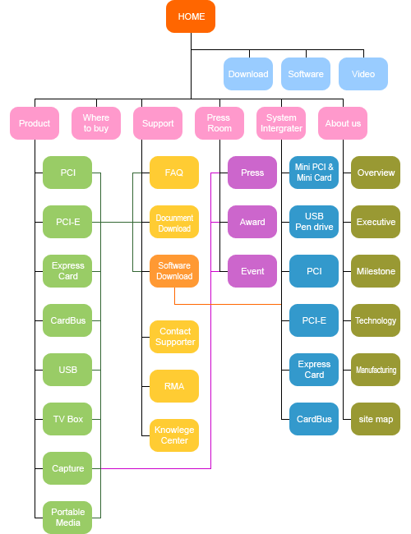
Create and Organize Content
Content creation: you need to immediately establish who will be responsible for generating the content that goes on the site.
Information design: to organize the content so it will be easily and intuitively accessible to your audience. Organize it by importance, timeliness, category, and so on.
The result of the information design phase may be a diagram (often called a site map) that reveals the overall “shape” of the site.

Slide 13
Develop the “Look and Feel”
Design
The look and feel of a site refers to its graphic design and overall visual appearance, including its color scheme, typography, and image style
You may also hear the visual design of a site referred to as the theme or skin.

Slide 14
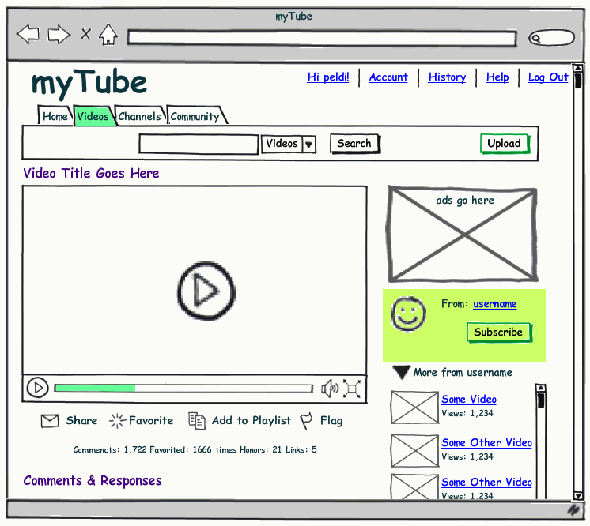
Sketch it

Slide 15
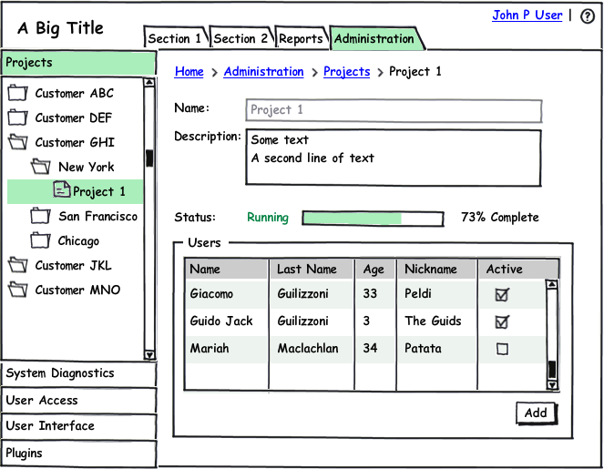
Sketch it

Slide 16
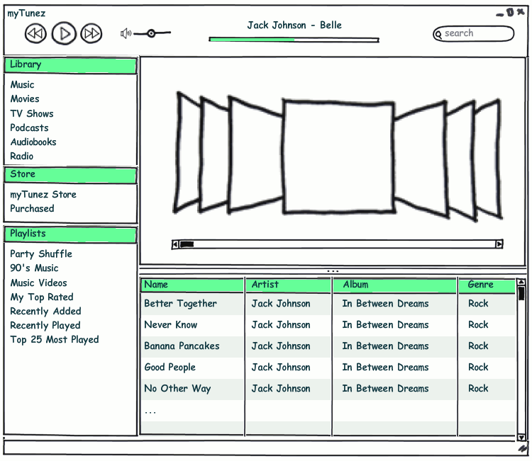
Sketch it

Slide 17
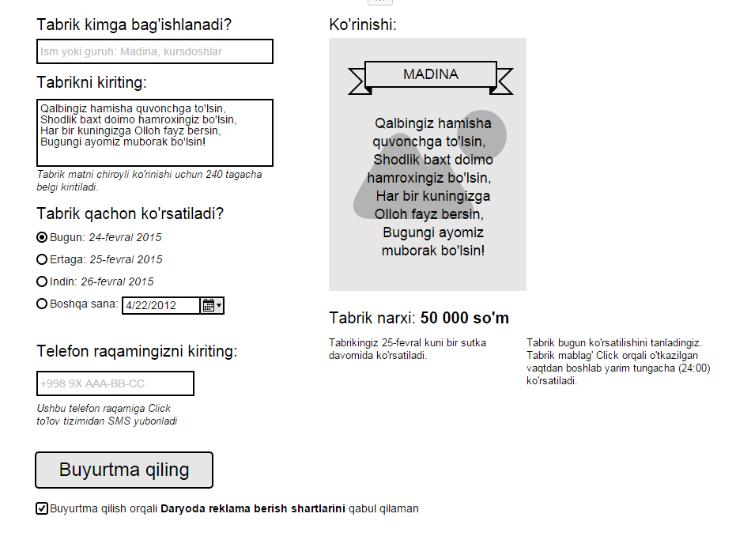
Sketch it

Slide 18
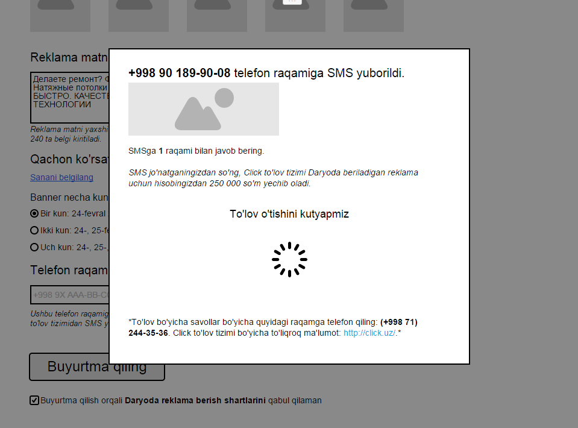
Sketch it

Slide 19
The art direction process
A set of look-and-feel studies created for women’s web site

Slide 20
Produce a Working Prototype
Development
The art department uses its graphics tools to create all the graphics needed for the site.
The production department marks up the content with (X)HTML and formats the text with style sheets. They may create final pages or simply templates that get filled out with content on the fly.
Programmers write the scripts and server-side applications necessary to make the site function as intended.
The First prototype is often called the “alpha” release
The second release is called the “beta.”

Slide 21
Test It
formally or informally, sites should be tested for basic functionality, performance in different browsing environments, and how easy they are to use

Slide 22
Basic quality check
Quality Assurance (QA):
  Is all the content there?
  Are there typos or grammar errors?
  Do all the links work?
  Are all the images showing?
  Are all the scripts and applications functioning properly?

Slide 23
Browsing environment testing
How does the page look in different browsers?(https://www.browserling.com/)
How does the site work in different browsers?
What happens to the pages when the browser window is resized very large?Very small?
Is the site usable on a text-only browser?
Is the site usable with the graphics turned off?
What happens if the user is not able to view the multimedia elements?
What is it like to look at your site on a dial-up modem connection?

Slide 24
User testing: observed behavior testing
you sit the testing subject down with the site and let them explore it on their own. They provide feedback as they go along, noting what they like, don’t like, what’s clear, what’s confusing.

Slide 25
User testing: task-oriented testing
users are given a series of tasks of varying difficulty to perform on the site, such as “Find out if there are any upcoming workshops on glassblowing,” or, ”Find out who is offering the best price on camcorders.”
An observer takes notes on how efficiently the task is completed, as well as the links the user followed in the course of completing the task.

Slide 26
Launch the Site
it’s time to upload it to the final server and make it available to the world

Slide 27
Maintain the Site
A web site is never truly “done”
important to have a strategy for what will happen with the site after its initial launch
what parts of the site will be updated, and how frequently?

Slide 28
People to know
Graphic designer
User experience designer - ensuring the entire experience with the site is favorable
Interaction designer - is to make the site as easy, efficient,and delightful to use as possible
User interface designer - narrowly focused on the functional organization of the page as well as the specific tools (buttons, links, menus,and so on) that users use to navigate content or accomplish tasks.
Content Strategist - makes sure that every bit of text on a site, from long explanatory text down to the labels on buttons, supports the brand identity and marketing goals of the company.
Information Architect – organizes the content logically and for ease of findability

Slide 29
Fixed websites have a set width, and resizing the browser or viewing it on different devices won’t affect on the way the website looks. This can require horizontal scrolling and a site that doesn’t look good on tablets or smartphones.
Fluid websites are built using percentages for widths. As a result, columns are relative to one another and the browser, allowing it to scale up and down fluidly.
Adaptive websites introduce media queries to target specific device sizes, like smaller monitors, tablets, and mobile.
Responsive websites are built on a fluid grid and use media queries to control the design and its content as it scales down or up with the browser or device.

Slide 30
To read
The site development process – Chapter 20
Learning Web Design, Jennifer Niederst Robbins
www.learningwebdesign.com
Prototypes — http://moqups.com
http://www.webdesignstarter.com/design.php
http://www.idesignstudios.com/blog/web-design/phases-web-design-development-process/

