Slide 1
Bookkeeping
Khasan Akhmadjonov
University of World Economy and Diplomacy

Slide 2
Content
Double – entry bookkeeping
Day books and ledgers
Balancing the books
Terminology

Slide 3
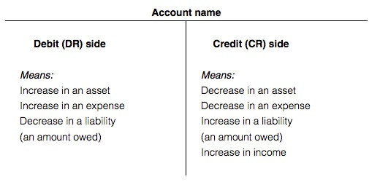
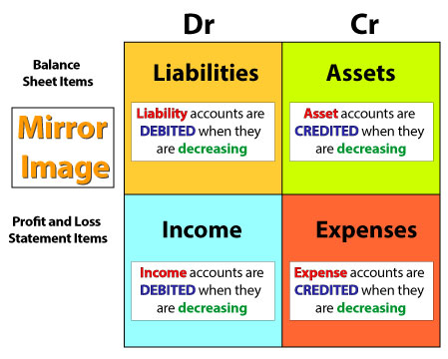
Bookkeeper
Record company’s daily transactions
A separate account
Double-entry b. –records two aspects of every tran-n
Debit – deduction
Credit – addition
Debtors=accounts receivable (AmE)
Creditors=accounts payable (AmE)
Stock=inventory (AmE)

Slide 4
Bookkeeping
Day books and ledgers
Balacing the books
Large number of transactions
Journals
Daily or weekly summary in double entry records
Nominal ledgers
A bought ledger
End of an accounting period
Trial balance
Debit and credit balances
Total debits equal total credits
Financial statements

Slide 5
Terminology
Raw materials – substances and components
Stock – goods ready for sale
Debtors – customers who owe money

Slide 6
References
Ian MacKenzie Professional English in Use. Finance, Cambridge University Press, 2009
Web sources

Slide 7
Thank you for your time!

