Slide 1
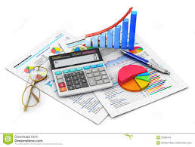
Accounting policies and standards

Slide 2

Content
Accounting Policies
Valuation and measurement
Accounting Standards
Historical cost and inflation accounting

Slide 3
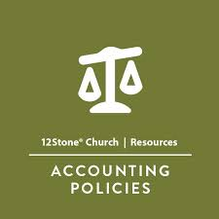
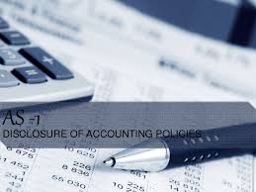

What is accounting policies?
Accounting policies are a way of doing accounts and are used to prepare financial statements.
Methods
measurement systems
procedures for presenting disclosures.

Slide 4
Accounting policies
Investors, shareholders, bondholders, tax authorities want to know the value of assets and liabilities, profits and losses
Valuation – how much sth is worth
Measurement – how big sth is
GAAP vs IFRS
Consistency principle
Policies need to be disclosed
Annual report
Depreciation (amortization)

Slide 5
Historical cost and inflation accounting
provide shareholders with information to make financial decisions
many countries follow the historical cost principle
more objective
Inflation accounting systems?
Replacement cost accounting
Current replacement cost

Slide 6
Terminolgy
Depreciation – reducing the value of assets
Disclosed – revealed
Stock – inventory

Slide 7
References
Ian MacKenzie Professional English in Use. Finance, Cambridge University Press, 2009
Web sources

Slide 8
Thank you for your time!

