Slide 1
Accounting and accountancy
Khasan Akhmadjonov
University of World Economy and Diplomacy

Slide 2
Content
Terminology
Accounting
Auditing
Laws, rules and standards

Slide 3
Terminology
Accounting – recording and summarizing
Bookkeeping – day to day recording
Creditors – people and organizations
Auditing – examining
Fraud - errors
Creative accounting – a false result
Standards - rules

Slide 4

Accounting
Transactions
Business deals (purchases, sales
Financial statements
FA (financial accounting) bookkeeping and preparing financial statements for shareholders
MA – making decisions and plans

Slide 5
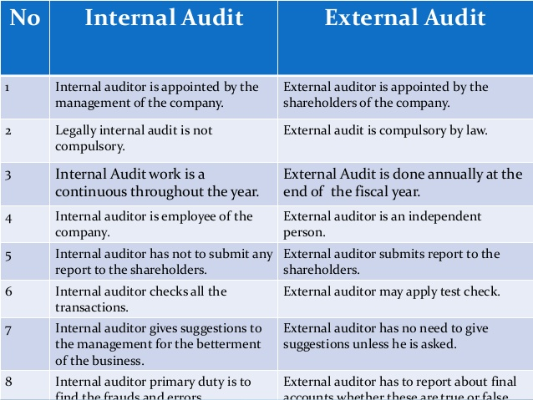
Auditing

Slide 6
Laws, rules and standards
The government
Independent organizations
SEC
ASB
Accounting profession
Annual accounts

Slide 7
References
Ian MacKenzie Professional English in Use. Finance, Cambridge University Press, 2009
Web sources

Slide 8
Thank you for your time!

