Slide 2
Types of sites. Intro to CSS

Slide 3
Availability of services
Open — all services are open for users.
Semi open — should register (usually free)
Closed — closed official websites for organizations, corporations, personal. Available for a limited number of users.

Slide 4
Physical location
Public Internet sites.
Local sites - available only within the local network.

Slide 5
Presentation of information
Web–portal - brings information together from diverse sources in a uniform way (AOL, Yahoo, MSN) – personal, government, corporate, cultural, search web portals
Information resources – thematic
Business – business card site, online shop, quest, catalog, promo
Web service – catalog of sites, search engines, email, forum, blog, peer-to-peer, cloud service, photo hosting, social media, social sites (combined web-services)

Slide 6
Technically
Static
Dynamic
Flash - ?

Slide 7
Types of layouts
Take your handheld devices: afisha.uz, mail.ru
Fixed
Fluid
Adaptive
Responsive

Slide 8
Broad categories
Non-editable brochure website (often referred to as static site).
Editable brochure website (requiring a content management system).
Editable, dynamic website, with more user engagement (login areas etc) and self managed through a content management system.
E-commerce site – integrated with a payment gateway such as Paypal, Worldpay or banks like Barclays or HSBC.
A web application – when a website requires lots of bespoke functionality or processes it generally falls under the web application category.
https://www.methodandclass.com/article/what-are-the-different-types-of-website

Slide 9
Cascading Style Sheets
W3C standard for defining the presentation of documents written in HTML
Presentation, again, refers to the way the document is displayed or delivered to the user:
  computer screen
  cell phone display
  printed on paper
  read aloud by a screen reader.

Slide 10
The Benefits of CSS
Precise type and layout controls
  You can achieve print-like precision using CSS. There is even a set of properties aimed specifically at the printed page (but we won’t be covering them in this book).
Less work
  You can change the appearance of an entire site by editingone style sheet.
More accessible sites
  When all matters of presentation are handled by CSS, you can mark up your content meaningfully, making it more accessible for non-visual or mobile devices.
Reliable browser support
  Every browser in current use supports CSS Level 2 and many cool parts of CSS Level 3.

Slide 11
Writing the rules
one or more style instructions (called rules or rule sets) - describe how an element or group of elements should be displayed
Each rule selects an element and declares how it should look
p {
  font-size: small;
  font-family: sans-serif;
}

Slide 12
Selectors
Element type selector – h1, p, footer
ID selectors allow you to target elements by their id values
<li id="catalog1234">Happy Face T-shirt</li>
li#catalog1234 { color: red; }
Class selector - (<p class=“sidebar”>)
p.sidebar { color: orange; }
Validator: jigsaw.w3.org/css-validator/

Slide 13
The Universal Selector
selector (*) that matches any element (like a wildcard in programming languages).
* {color: gray; }

Slide 14
Contextual selector
div p { color: gray; }

Slide 15
Grouped selectors
h1 { border: 1px solid blue; }
h2 { border: 1px solid blue; }
p { border: 1px solid blue; }
em { border: 1px solid blue; }
img { border: 1px solid blue; }
h1, h2, p, em, img { border: 1px solid blue; }

Slide 16

Types of style sheets
Inline style sheets - override any other styles

Slide 17
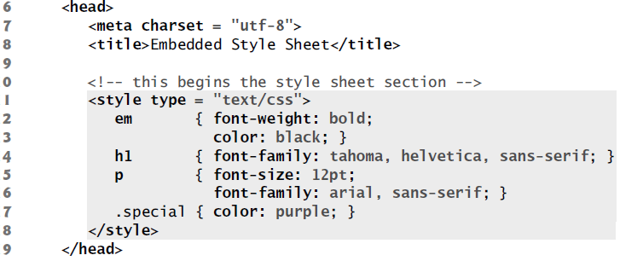
Embedded style sheets – CSS3 document in an HTML5 document’s head section

Slide 18
External style sheets - separate file, uniform look and feel, reuse, style changes across all the pages

Slide 19
Conflicting
Styles cascade (and hence the term “Cascading Style Sheets”), or flow together, such that the ultimate appearance of elements on a page results from combining styles defined in several ways.
• Styles defined by the user take precedence over styles defined by the user agent.
• Styles defined by authors take precedence over styles defined by the user.
user - person viewing your web page,
Author - the person who writes the document
user agent - the program used to render and display the document
Exception – important!

Slide 20
Inheritance
Descendants, child, parent, ancestor

Slide 22
Style Sheet Hierarchy
Style information can come from various sources, listed here from general to specific.
Items lower in the list will override items above them:
Browser default settings
User style settings (set in a browser as a “reader style sheet”)
Linked external style sheet (added with the link element)
Imported style sheets (added with the @import function)
Embedded style sheets (added with the style element)
Inline style information (added with the style attribute in an opening tag)
Any style rule marked !important by the author
Any style rule marked !important by the reader (user)

Slide 23
Rule order
if there are conflicts within style rules of identical weight, whichever one comes last in the list “wins.”
<style>
p { color: red; }
p { color: blue; }
p { color: green; }
</style>

Slide 24
Specificity
The more specific the selector, the more weight it is given to override conflicting declarations
ID selectors are more specific than (and will override)
Class selectors, which are more specific than (and will override)
Contextual selectors, which are more specific than (and will override)
Individual element selectors
strong { color: red;}
h1 strong { color: blue; }

Slide 25
Reading
Learning Web Design, 4th edition. A Beginner’s Guide to HTML, CSS, JavaScript, and Web Graphics. Jennifer Niederst Robbins (p.207→)
Internet & World Wide Web. How to program. 5th edition. Paul Deitel (p.105→)

