Slide 2
Usability basics

Slide 3
Outcomes
Understand usability
Some usability issues
How to evaluate usability
Usability tips

Slide 4
Usability is
Usability is the measure of the quality of a user's experience when interacting with a product or system — whether a Web site, a software application, mobile technology, or any user-operated device.
http://www.usability.gov

Slide 5
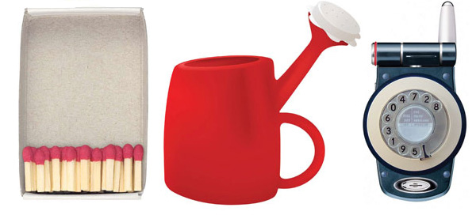
Usability is
An approach to website design intended to enable the completion of user tasks.
www.theidm.com/index.cfm

Slide 6
Why do usability?
85% of visitors abandon a new site due to poor design. (cPulse)
Only 51% of sites complied with simple web usability principles. (Forrester study of 20 major sites)
64% ineffectively use of space on page layout.
66% failed to provide in-depth overview of site contents on the home page.

Slide 7
What usability really is?
Learnability: the ease of learning the functionality and the behavior of the system.
Efficiency: the level of attainable productivity, once the user has learned the system.
Memorability: the ease of remembering the system functionality, so that the casual user can return to the system after a period of non-use, without needing to learn again how to use it.
Few errors: the capability of the system to feature a low error rate, to support users making few errors during the use of the system, and in case they make errors, to help them to easy recover.
User’s satisfaction: the measure in which the user finds the system pleasant to use

Slide 8
Utility vs. usability
Utility = whether it provides the features you need
Usability = how easy & pleasant these features are to use

Slide 9
Important terms
User-Centered Design
Ergonomics
User Interface Design
Human-Computer Interaction
Human Factors

Slide 10
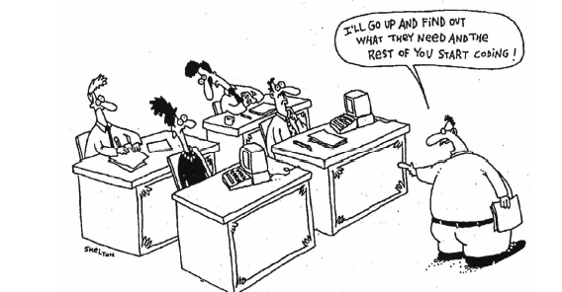
Traditional web development

Slide 11
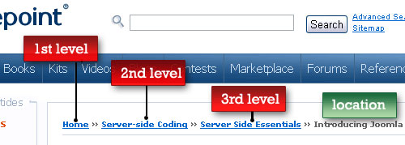
Some usability: menus
Information is found more quickly in Index menus than in cascading menus.
The use of the "breadcrumb" menus may help reduce user disorientation within the structure of a site.
Homepage > First level > Second level > presently viewed level

Slide 12
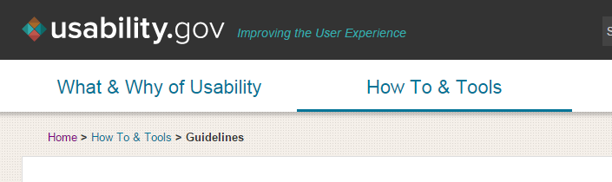
Some usability: menus

Slide 13
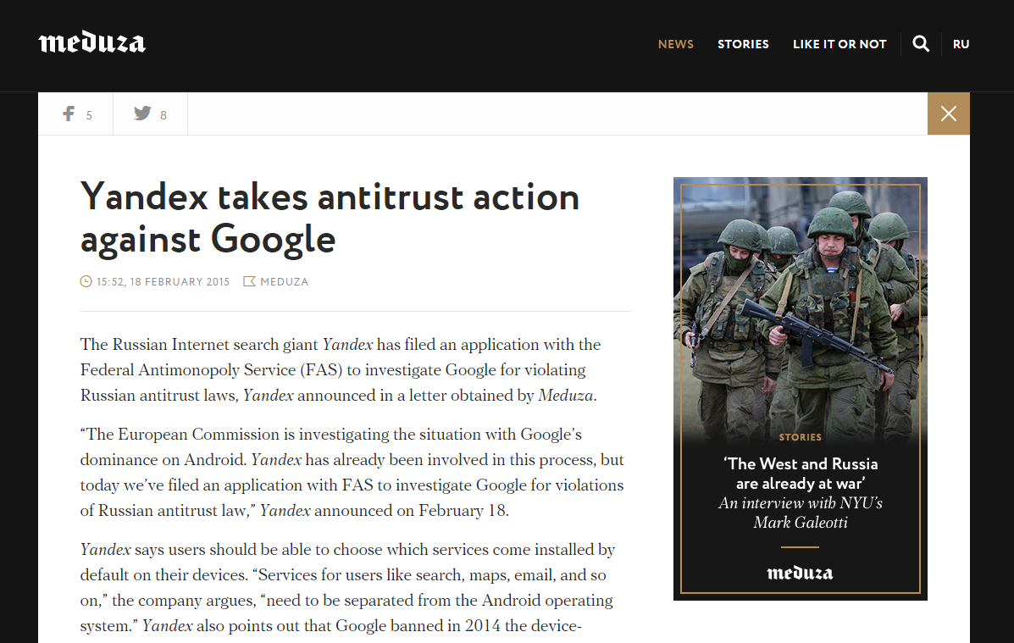
Text Presentation
Study shows that Verdana is the most preferred font (http://psychology.wichita.edu/optimalweb/text.htm )
Older Adults are more accurate with, and prefer larger font sizes. They also prefer sans serif fonts over serif fonts.
The optimal text line length :
  Approximately 55—75 characters per line
  The average line length is 538.64 pixels (excluding margins and padding)

Slide 14
Contrast
contrast between the text and the background: the more textured the background, the greater the contrast should be between them.
contrast between the text and the background: the more textured the background, the greater the contrast should be between them.

Slide 15

Images and Animation
Things that appear unneeded are tuned out
Images that do not get attention:
  generic/stock art (cheesy)
  off-putting, cold, fake, too polished
  boring
  not related to content
  look like ads

Slide 16
Images and Animation
Images that get attention:
  related to content
  clear/right size
  have approachable/real people (faces, smiling, looking at camera)
Animations:
  looked at only if they are helpful e.g. instructional animations
  talking heads bore
  those not related to content distract

Slide 17
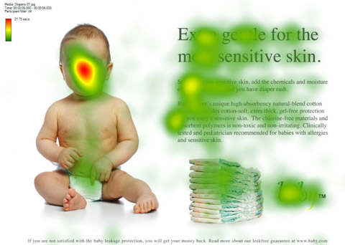
Eye Tracking
One of the Usability testing methods

Slide 18
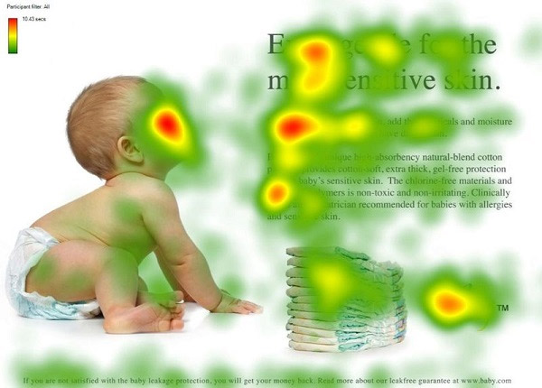
Eye Tracking

Slide 19
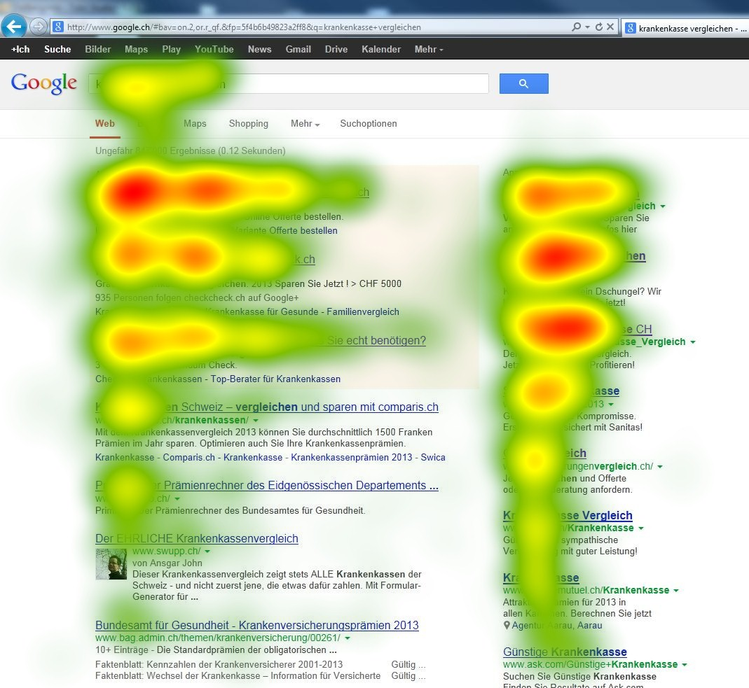
Eye Tracking

Slide 20
Layout and navigation
Wrong/confusing link names can alienate users
Go with conventional navigation layouts and elements (don’t reinvent the wheel).
Related links work if placed correctly (top right hand corner for those who are just scanning and bottom of page for readers who read whole article)

Slide 21
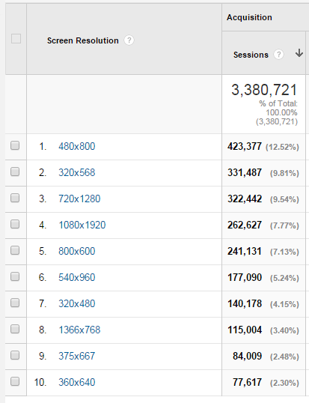
Layout and navigation
Tables are useful for summarizing lots of content
Usability levels do not vary between users with low and high web experience
Frontload content with important info. If it doesn’t have important info, users will skip it and go straight to info they want
Small chunks of text are read more

Slide 22
Remember
Your website should be easy to navigate
Pages must download quickly
Information should be easy to retrieve
Any task should be completed effectively

Slide 23
First Things First
Usability is a commonsense!
There is no - “the right way”!

Slide 24
Some Facts About the Web Users
We don’t read, we scan
We don’t make optimal decisions
We click on what looks almost right
We want to get what we want, fast
We don’t like when we are lost
We don’t’ like when something looks hard
Websites are like billboards at 100km/h!

Slide 25
Some Evolved “Usability Rules”*
* and a little footnotes on their effectiveness

Slide 26
Usability Rules
Nothing important should be 2 clicks away (It depends )
Speak the users’ language
Be Consistent
Don’t Make Me Think!® (If anything is difficult/hard, user’s are less likely to do it)
Use Short Sentences (Remove unnecessary text and then remove the half of what is left)
Clear Visual Hierarchy (I am a less important text in this hierarchy, because I am using smaller text and I come after the main header)
Answer you visitors’ common questions

Slide 27
Users’ Questions
Where am I?
Where should I begin?
Where did they put ___?
What are the most important things are?
What does ____ mean?

Slide 28
5 seconds
What was on that billboard that we just passed?
If users treat our websites like a billboard,
let’s design a great billboards!

Slide 29
Web Accessibility
What is accessibility?
Why care about accessibility?
How to ensure accessibility?

Slide 30
Accessibility
Web accessibility means that people with disabilities can use the Web. More specifically, Web accessibility means that people with disabilities can perceive, understand, navigate, and interact with the Web, and that they can contribute to the Web. Web accessibility also benefits others, including older people with changing abilities due to aging.
Web accessibility encompasses all disabilities that affect access to the Web, including visual, auditory, physical, speech, cognitive, and neurological disabilities. The document "How People with Disabilities Use the Web" describes how different disabilities affect Web use and includes scenarios of people with disabilities using the Web.
Millions of people have disabilities that affect their use of the Web. Currently most Web sites and Web software have accessibility barriers that make it difficult or impossible for many people with disabilities to use the Web. As more accessible Web sites and software become available, people with disabilities are able to use and contribute to the Web more effectively.
Web accessibility also benefits people without disabilities. For example, a key principle of Web accessibility is designing Web sites and software that are flexible to meet different user needs, preferences, and situations. This flexibility also benefits people without disabilities in certain situations, such as people using a slow Internet connection, people with "temporary disabilities" such as a broken arm, and people with changing abilities due to aging. The document "Developing a Web Accessibility Business Case for Your Organization" describes many different benefits of Web accessibility, including benefits for organizations.

Slide 31
Accessibilité
l'affichage reste correct sur tous les navigateurs classiques, ainsi que sur les navigateurs en mode texte, les lecteurs "braille"... En outre, les sites sont accessibles via tous les supports actuels et futurs qui respectent et respecteront ces normes (WebTV, Ordinateur de poche...)

Slide 32
Accessibility
Accessibility is a general term used to describe the degree to which a product (e.g., device, service, environment) is accessible by as many people as possible.

Slide 33
Accessibility
Web accessibility encompasses all abilities that affect access to the Web, including
  visual,
  auditory,
  physical,
  cognitive,
  neurological
  technological.

Slide 34
Why Accessibility is important?
According to a 2005 report from the United States Census Bureau, there were approximately 54 million people with disabilities in the U.S. at that time, constituting 18.7 percent of the total population.
Equal opportunities for all people
Improves website quality for all

Slide 35
Accessibility technology
Screen readers
Braille keyboards
Screen Magnification
Speech recognition

Slide 36
Is my site accessible?
http://wave.webaim.org/
http://usabilitygeek.com/10-free-web-based-web-site-accessibility-evaluation-tools/
https://www.w3.org/WAI/ER/tools/
http://www.508checker.com/

Slide 37
HTML for Web Content Accessibility
Document must:
  Have a title
  Have a !DOCTYPE
  Be valid
  Have content broken into manageable chunks
  Use headings (not restyled normal text)
  Use lang attribute if changes in the language occur:
<p>And with a certain <span lang="fr">je ne sais quoi</span>, she entered both the room, and his life, forever. <q>My name is Natasha,</q> she said. <q lang="it">Piacere,</q> he replied in impeccable Italian, locking the door.
Use CSS to control layout and presentation.
Use markup rather than images to convey information, e.g. mathematical equations

Slide 38
Tables must
Use summary attribute
Provide caption via Caption element
Not be used for Layout, unless can be linearized
  <TABLE border="1"
  summary="This table gives some statistics about fruit flies: average height and weight, and percentage with red eyes (for both males and females).">
  <CAPTION><EM>A test table with merged cells</EM></CAPTION>
  <TR><TH colspan="2">Average</TH> </TR>
  </TABLE>

Slide 39
Links and images
Links must
  Provide a text equivalent for every non-text element
  <a href="routes.html"> <img src="topo.html" alt="Current routes at Boulders Climbing Gym“/> </a>
  Group related links
Images must
  Have an alt-text attribute
<img src="magnifyingglass.gif" alt="Search“ />

Slide 40
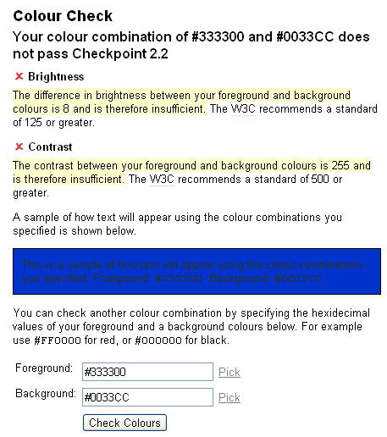
CSS Techniques
CSS: Colors
  Ensure that foreground and background color combinations provide sufficient contrast when viewed by someone having color deficits or when viewed on a black and white screen.
Accessibility Color
  http://www.fujitsu.com/global/accessibility/assistance/cs/ //Color selector
  http://www.etre.com/tools/colourcheck/
  http://colorschemedesigner.com/

Slide 41
CSS: accessibility
CSS2's aural properties provide information to non-sighted users and voice-browser users much in the same way fonts provide visual information.
H1 { voice-family: paul;
stress: 20;
richness: 90;
cue-before: url("ping.au")
}

Slide 42
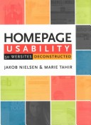

Reading
Homepage Usability:
50 Websites Deconstructed
By Jakob Nielsen, Marie Tahir
Edition: 2, illustrated
Published by New Riders, 2001
ISBN 073571102X, 9780735711020
Don't make me think!:
A common sense approach to web usability
By Steve Krug
Edition: 2, illustrated
Published by New Riders, 2006
ISBN 0321344758, 9780321344755

Slide 43
Web resources
http://drpete.co/blog/25-point-website-usability-checklist
https://stayintech.com/info/UX
https://www.nngroup.com/articles/usability-101-introduction-to-usability/
http://usabilitygeek.com/10-free-web-based-web-site-accessibility-evaluation-tools/
https://search.google.com/search-console/mobile-friendly
http://www.webpagesthatsuck.com/
http://www.w3.org/WAI/

