Slide 2
Browser Object Model

Slide 3
The Window Object
Window IS the browser
The window object is supported by all browsers. It represents the browser's window.
All global JavaScript objects, functions, and variables automatically become members of the window object.
Global variables are properties of the window object.
Global functions are methods of the window object.

Slide 4
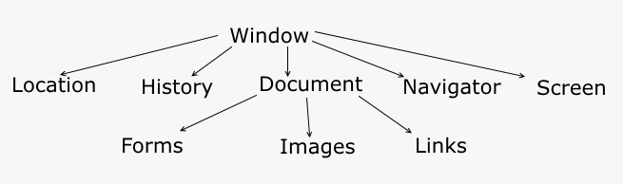
Window object
Even the document object (of the HTML DOM) is a property of the window object:
  window.document.getElementById("header");
is the same as:
  document.getElementById("header");

Slide 5
Window Size
Both properties return the sizes in pixels:
  window.innerHeight - the inner height of the browser window (in pixels)
  window.innerWidth - the inner width of the browser window (in pixels)
var w = window.innerWidth || document.documentElement.clientWidth
|| document.body.clientWidth;
var h = window.innerHeight || document.documentElement.clientHeight
|| document.body.clientHeight;
*For Internet Explorer 8, 7, 6, 5:

Slide 6
Other Window Methods
window.open() - open a new window
  myWindow = window.open('', '', 'width=200, height=100');
  Width, height, left, top, menubar, status, resizable.
  window.open('https://microsoft.com', 'Microsoft', 'width=400, height=400, resizable=yes');
window.close() - close the current window
window.moveTo() - move the current window
  myWindow.moveTo(500, 100);
window.resizeTo() - resize the current window

Slide 7
Window Screen
The window.screen object contains information about the user's screen.
There is no public standard that applies to the screen object, but all major browsers support it.
  screen.width - returns the width of the visitor's screen in pixels
  screen.height - returns the height of the visitor's screen in pixels
  screen.availWidth - the width of the visitor's screen, in pixels, minus interface features like the Windows Taskbar
  screen.availHeight
  screen.colorDepth - returns the number of bits used to display one color

Slide 8
Window location
The location object contains information about the current URL.
  window.location.href - returns the URL of the current page
  window.location.hostname - returns the name of the internet host (of the current page)
  window.location.pathname - returns the pathname of the current page
  window.location.protocol - returns the web protocol of the page
  window.location.assign() - loads a new document.
  location.reload(forceGet) - is used to reload the current document
  replace() - replaces the current document with a new one

Slide 9
Window History
contains the browsers history
  length - returns the number of URLs in the history list of the current browser window
  history.back() - loads the previous URL in the history list
  history.forward() - method loads the next URL in the history list
  history.go() - Loads a specific URL from the history list
    function goBack() {
    window.history.go(-2);
    }

Slide 10
Window Navigator
cookieEnabled - returns true if cookies are enabled
appName property returns the application name of the browser (Netscape)
appCodeName property returns the application code name of the browser (Mozilla)
appVersion property returns version information about the browser
The information from the navigator object can often be misleading, and should not be used to detect browser versions because:
  Different browsers can use the same name
  The navigator data can be changed by the browser owner
  Some browsers misidentify themselves to bypass site tests
  Browsers cannot report new operating systems, released later than the browser

Slide 11
Window Navigator
platform - returns the browser platform (operating system)
language - returns the browser's language
onLine - returns true if the browser is online
geolocation - returns a Geolocation object that can be used to locate the user's position

Slide 12
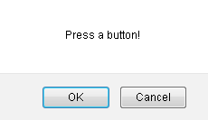
Popup Boxes
window.alert("sometext");
window.confirm("sometext");
  if (confirm("Press a button!") == true)
window.prompt("sometext","defaultText");
  course = prompt("Please enter your course", "BIS");

Slide 13
Timing Events
Timing events – are the intervals between execution of code:
  setTimeout(function, milliseconds) - Executes a function, after waiting a specified number of milliseconds.
  setInterval(function, milliseconds) - repeats the execution of the function continuously
Stop?
  clearTimeout(myVar);
  clearInterval(myVar);
  var myVar = setInterval(myTimer, 1000);
  function myTimer() {
  var d = new Date();
  document.getElementById("demo").innerHTML = d.toLocaleTimeString();
  }

Slide 14
JavaScript Cookies
Cookies are data, stored in small text files, on your computer
Cookies were invented to solve the problem "how to remember information about the user“
Cookies are saved in name-value pairs like:
  username = Shirin Primkulova
  Create, read and delete cookie
  document.cookie = "Shirin Primkulova; expires=Thu, 18 Dec 2013 12:00:00 UTC";
  How to change?
  How to delete?
  expires=Thu, 01 Jan 1970 00:00:00 UTC; path=/;

