Slide 2
Network topologies

Slide 3
Topology
?
Arrangement of elements (nodes)
  Physical
  Logical

Slide 4
Logical
Architecture
  how data flows within a network, regardless of its physical design
  Logical topologies are often closely associated with media access control (MAC) methods and protocols.
  Some networks are able to dynamically change their logical topology through configuration changes to their routers and switches.

Slide 5
Physical
Topology
  the placement of the various components of a network, including device location and cable installation

Slide 6
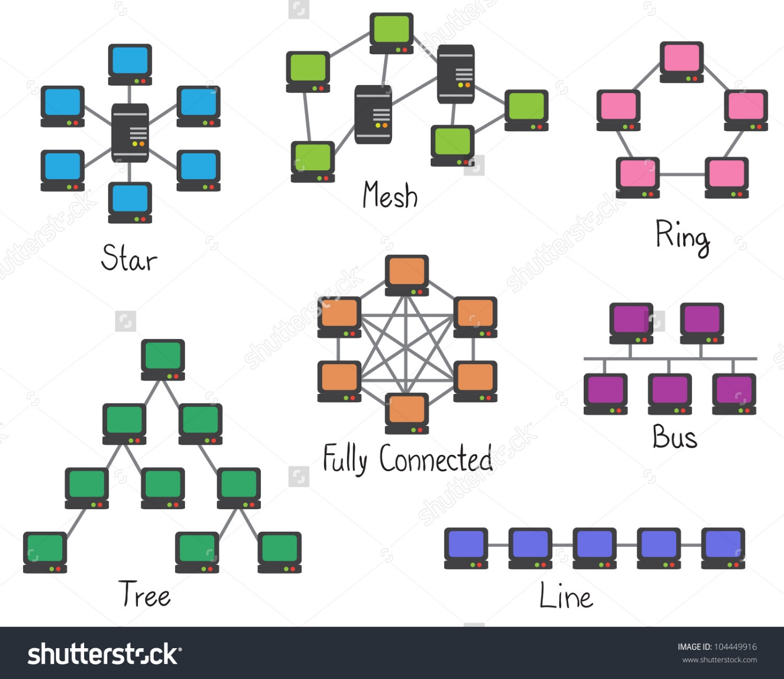
Basic topology
point-to-point,
bus,
star,
ring,
mesh,
tree,
hybrid

Slide 7
Point-to-point
refers to a communications connection between two nodes

Slide 8
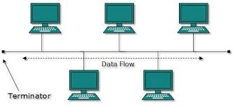
Bus
1) It is easy to set-up and extend bus network.
2) Cable length required for this topology is the least compared to other networks.
3) Bus topology costs very less.
4) Linear Bus network is mostly used in small networks. Good for LAN.

Slide 9
Bus
The cable length is limited. This limits the number of network nodes that can be connected.
This network topology can perform well only for a limited number of nodes. When the number of devices connected to the bus increases, the efficiency decreases.
It is suitable for networks with low traffic. High traffic increases load on the bus, and the network efficiency drops.
It is heavily dependent on the central bus. A fault in the bus leads to network failure.
It is not easy to isolate faults in the network nodes.
Each device on the network "sees" all the data being transmitted, thus posing a security risk.

Slide 10
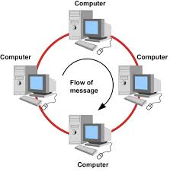
Ring
The data being transmitted between two nodes passes through all the intermediate nodes. A central server is not required for the management of this topology.
The traffic is unidirectional and the data transmission is high-speed.
In comparison to a bus, a ring is better at handling load.
The adding or removing of network nodes is easy, as the process requires changing only two connections.
The configuration makes it easy to identify faults in network nodes.
In this topology, each node has the opportunity to transmit data. Thus, it is a very organized network topology.

Slide 11
Ring
The failure of a single node in the network can cause the entire network to fail.
The movement or changes made to network nodes affect the entire network's performance.
Data sent from one node to another has to pass through all the intermediate nodes. This makes the transmission slower in comparison to that in a star topology. The transmission speed drops with an increase in the number of nodes.
There is heavy dependency on the wire connecting the network nodes in the ring.

Slide 12
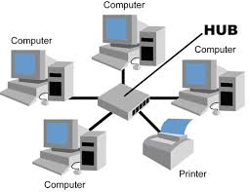
Star
Due to its centralized nature, the topology offers simplicity of operation.
It also achieves isolation of each device in the network.
Adding or removing network nodes is easy, and can be done without affecting the entire network.
Due to the centralized nature, it is easy to detect faults in the network devices.
As the analysis of traffic is easy, the topology poses lesser security risk.
Data packets do not have to pass through many nodes, like in the case of a ring network. Thus, with the use of a high-capacity central hub, traffic load can be handled at fairly decent speeds.

Slide 13
Star
Network operation depends on the functioning of the central hub. Hence, central hub failure leads to failure of the entire network.
Also, the number of nodes that can be added, depends on the capacity of the central hub.
The setup cost is quite high.

Slide 14
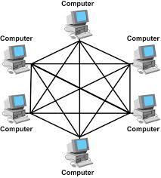
Mesh
The arrangement of the network nodes is such that it is possible to transmit data from one node to many other nodes at the same time.
The failure of a single node does not cause the entire network to fail as there are alternate paths for data transmission.
It can handle heavy traffic, as there are dedicated paths between any two network nodes.
Point-to-point contact between every pair of nodes, makes it easy to identify faults.

Slide 15
Mesh
The arrangement wherein every network node is connected to every other node of the network, many connections serve no major purpose. This leads to redundancy of many network connections.
A lot of cabling is required. Thus, the costs incurred in setup and maintenance are high.
Owing to its complexity, the administration of a mesh network is difficult.

Slide 16
Tree
star-bus network
It is an extension of Star and bus Topologies, so in networks where these topologies can't be implemented individually for reasons related to scalability, tree topology is the best alternative.
Expansion of Network is possible and easy.
Here, we divide the whole network into segments (star networks), which can be easily managed and maintained.
Error detection and correction is easy.
Each segment is provided with dedicated point-to-point wiring to the central hub.
If one segment is damaged, other segments are not affected.

Slide 17
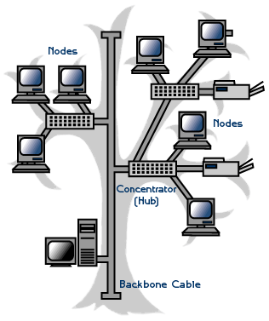
Tree
Because of its basic structure, tree topology, relies heavily on the main bus cable, if it breaks whole network is crippled.
As more and more nodes and segments are added, the maintenance becomes difficult.
Scalability of the network depends on the type of cable used.

Slide 18
Sources
http://www.ianswer4u.com
http://instrumentationtools.com/advantages-and-disadvantages-of-network-topologies/
https://www.tutorialspoint.com/data_communication_computer_network/computer_network_topologies.htm
http://www.techiwarehouse.com/engine/e96bb2f2/Understanding-Ring-Topology
https://whatsincomputer.blogspot.com/2010/08/star-topology.html
http://www.desktopclass.com/computer-it/tree-topology-and-mesh-topology-with-explain-devices.html

